Slide 1

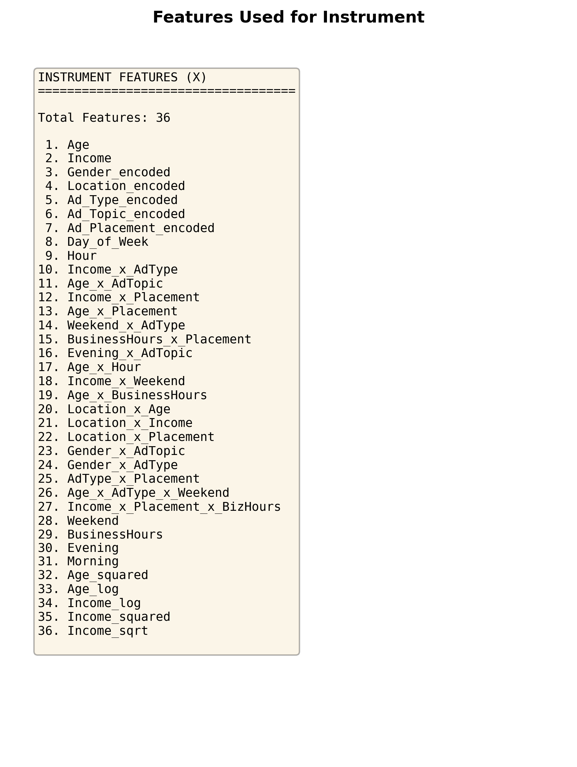
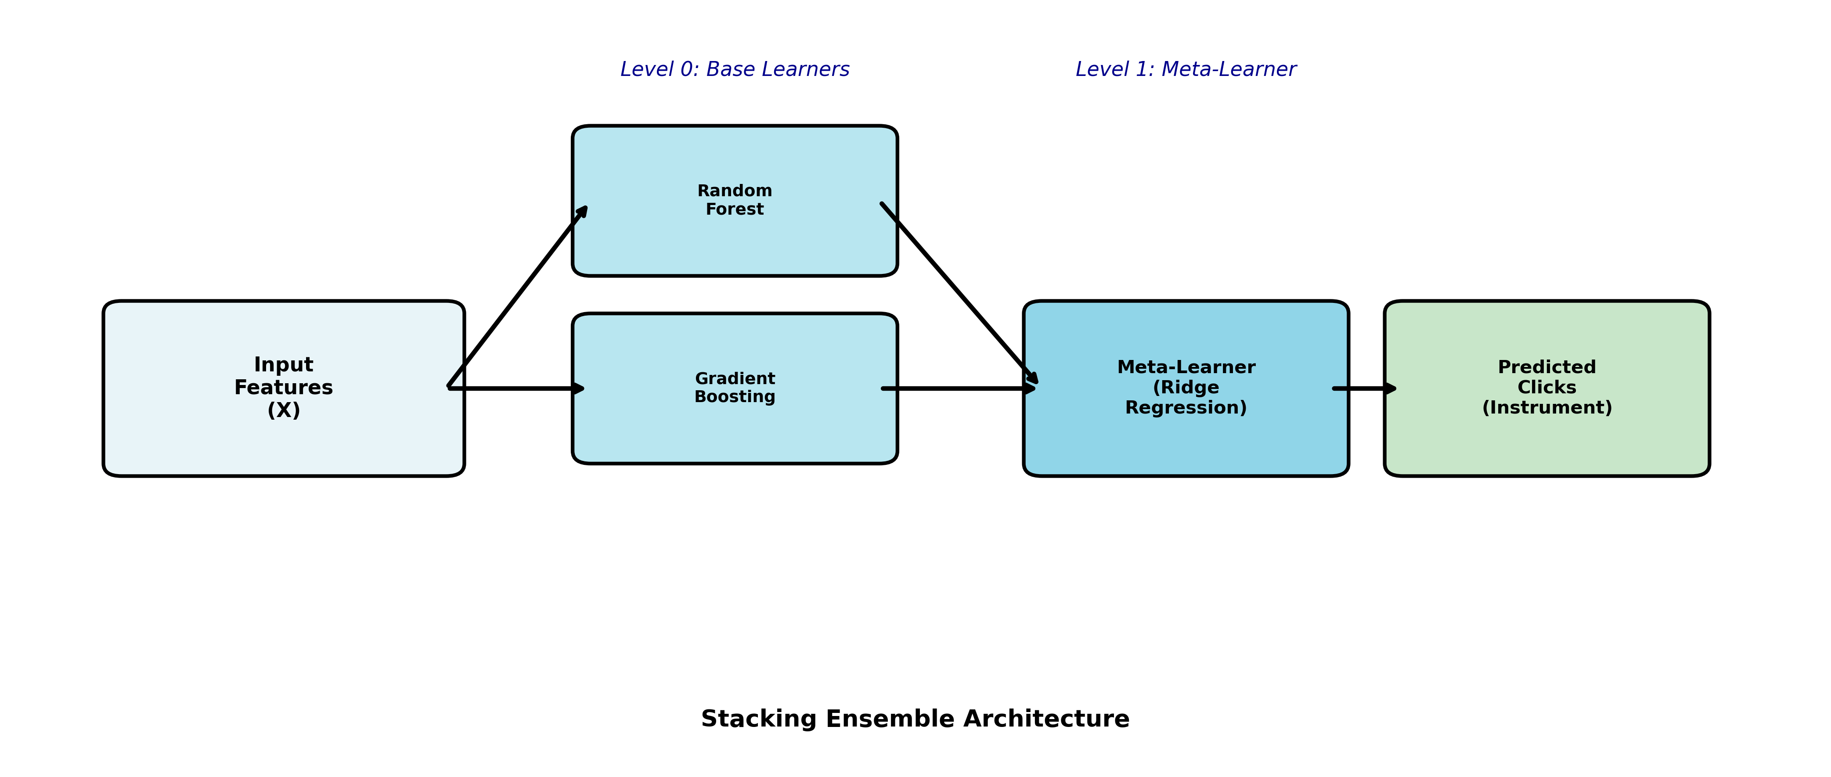
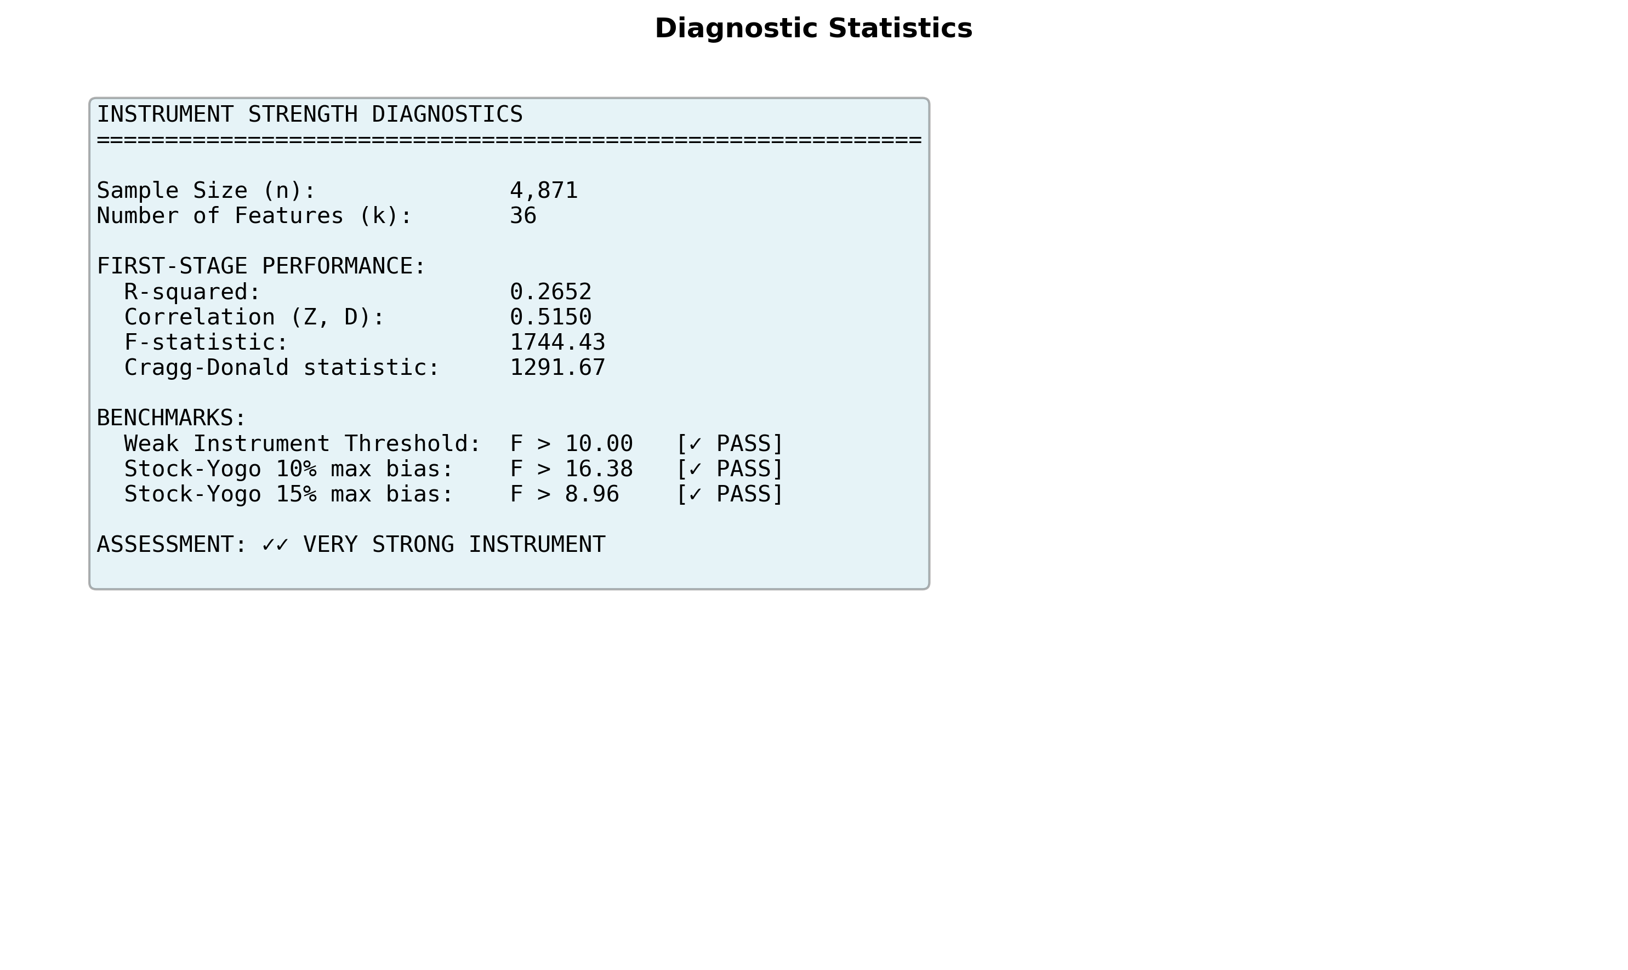
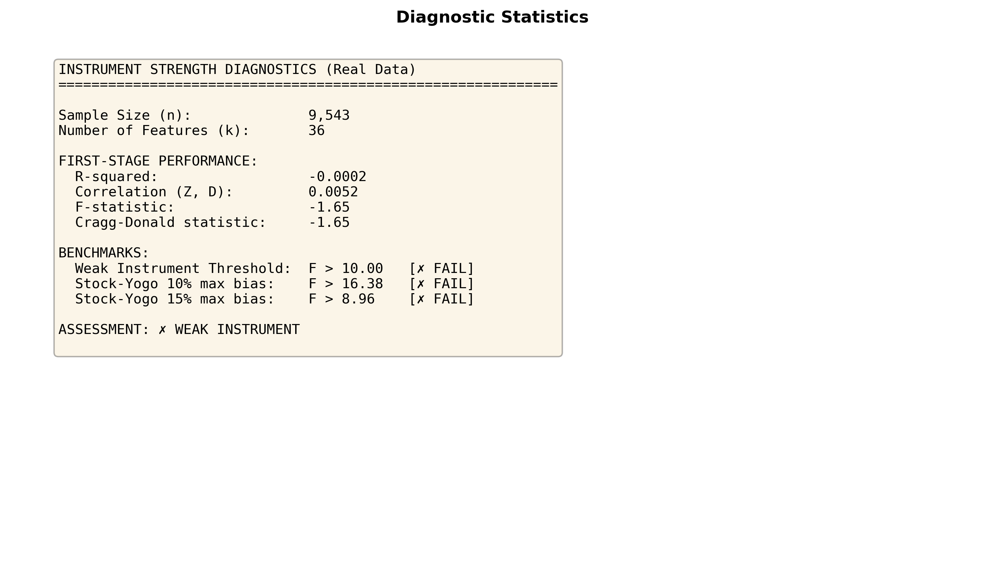
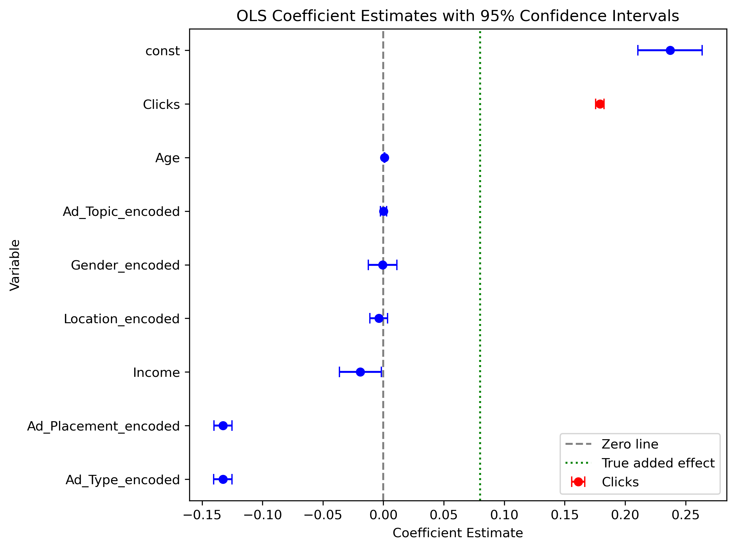
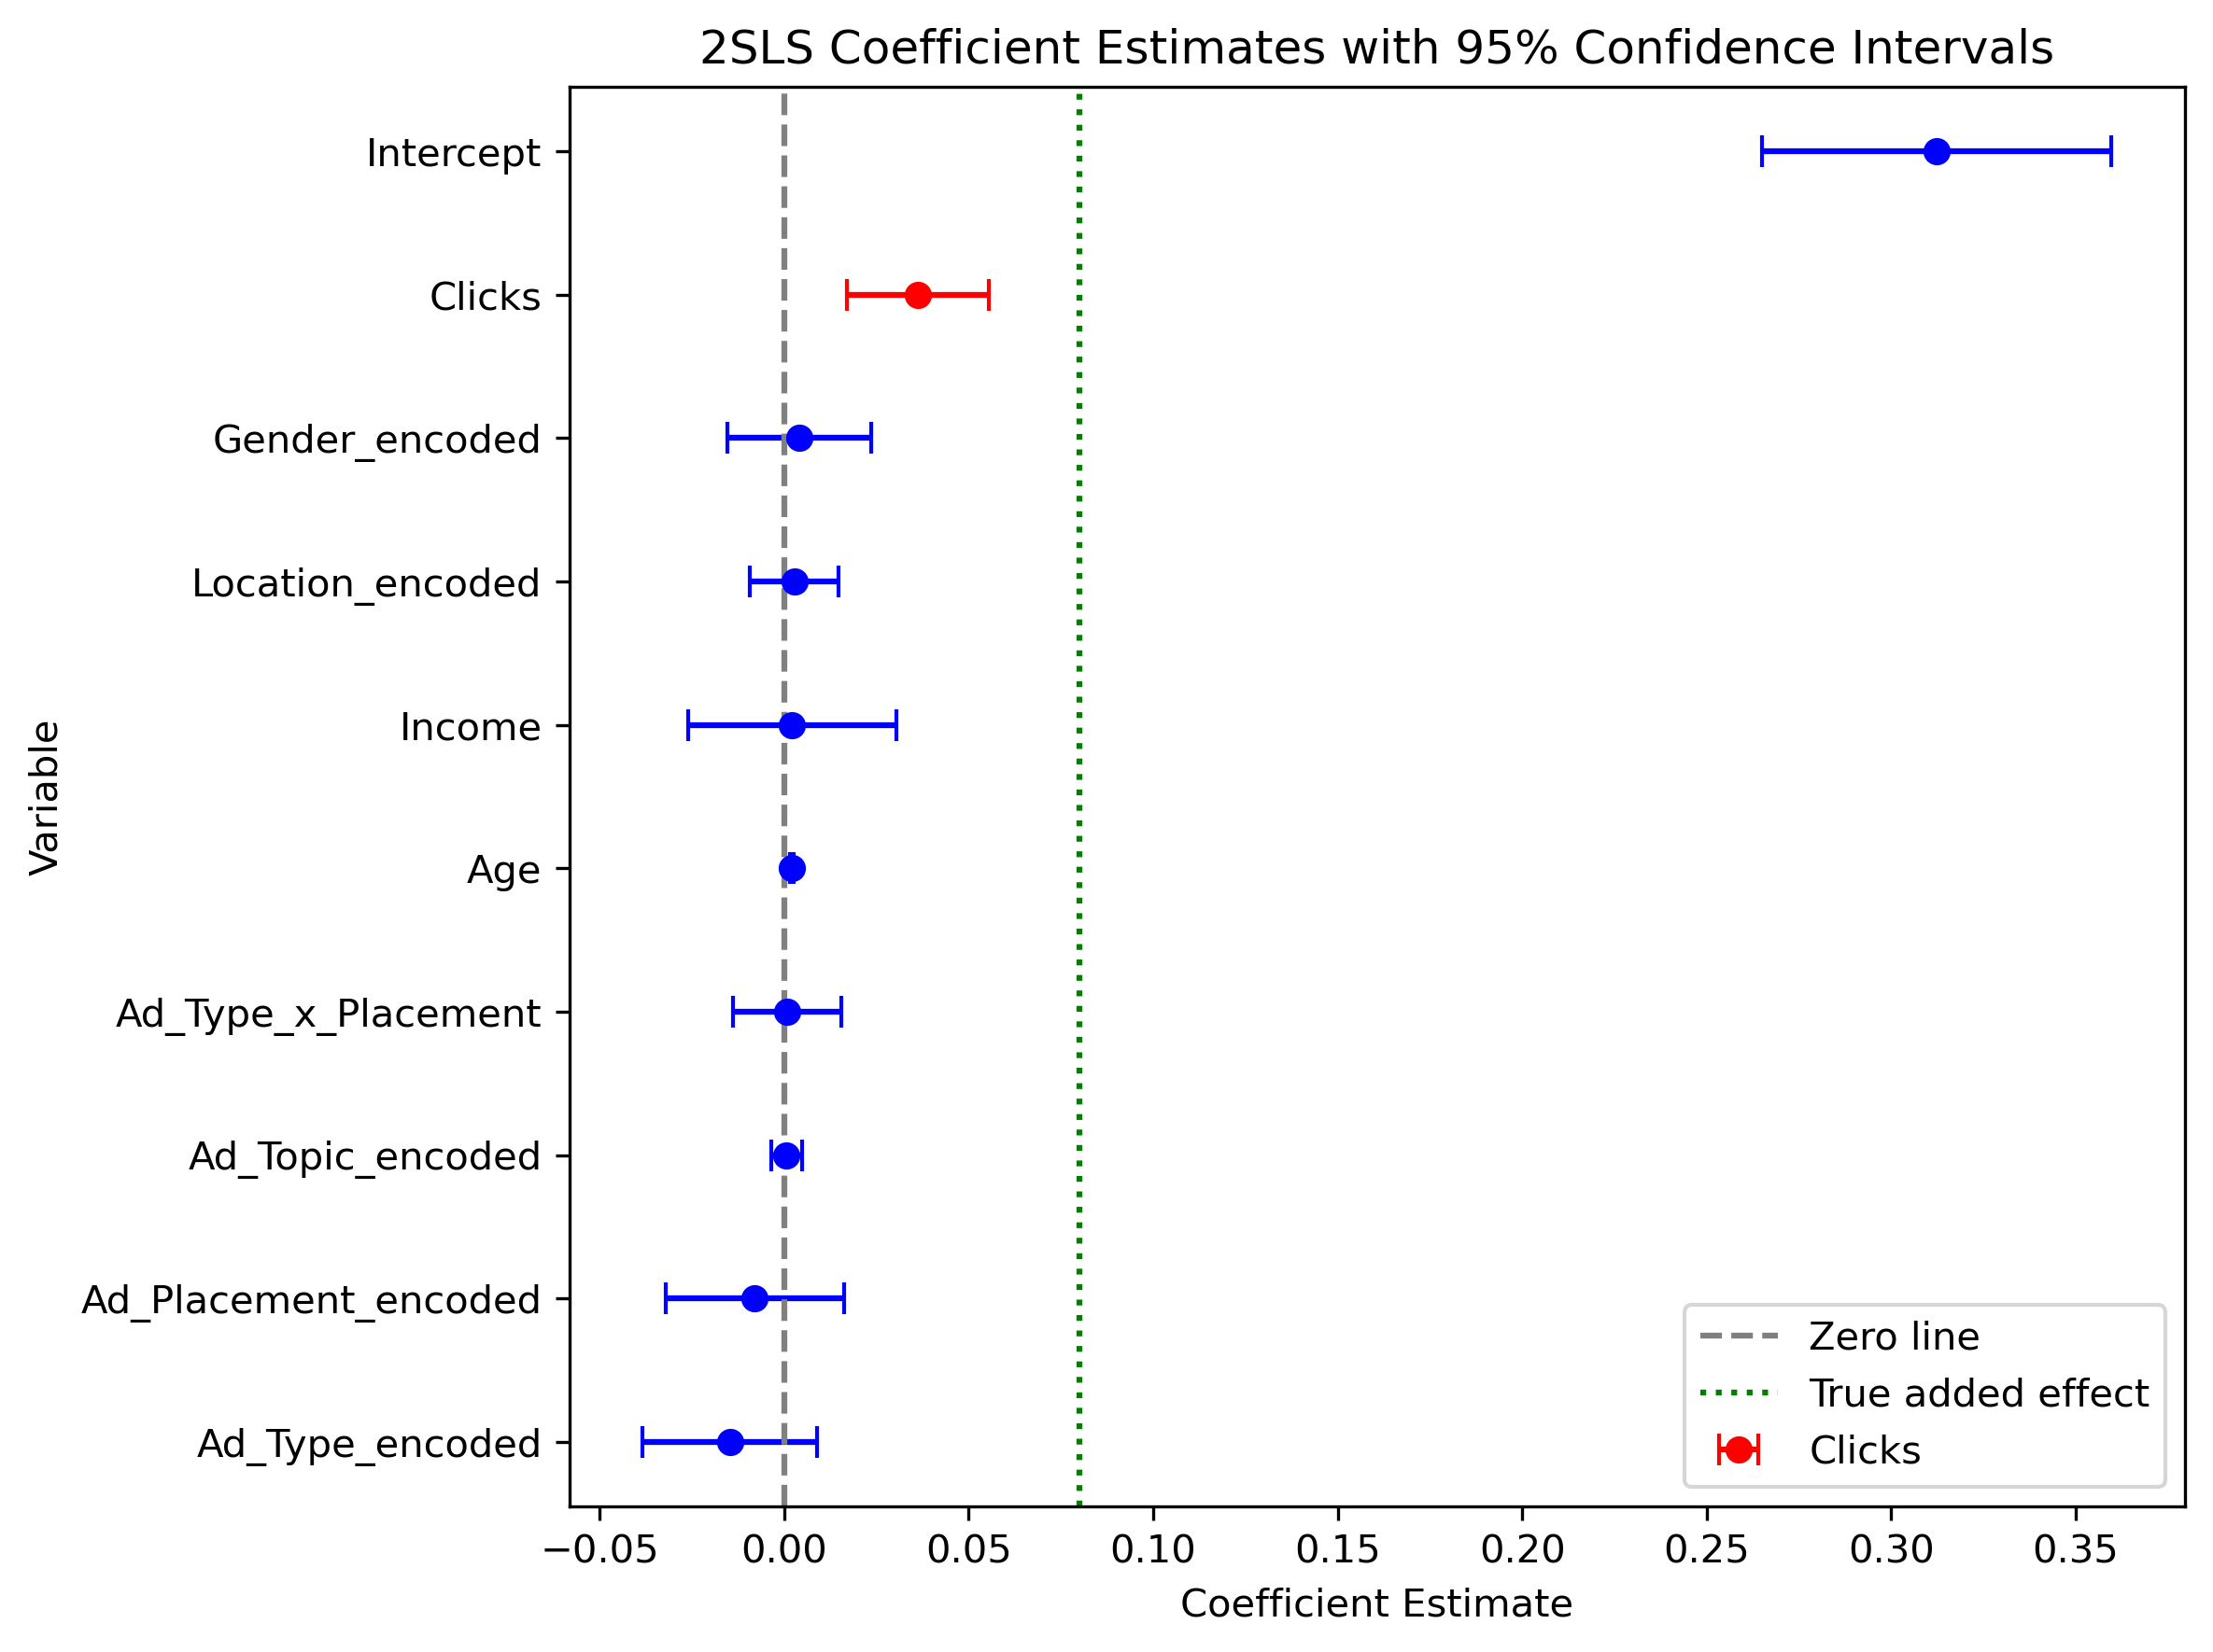
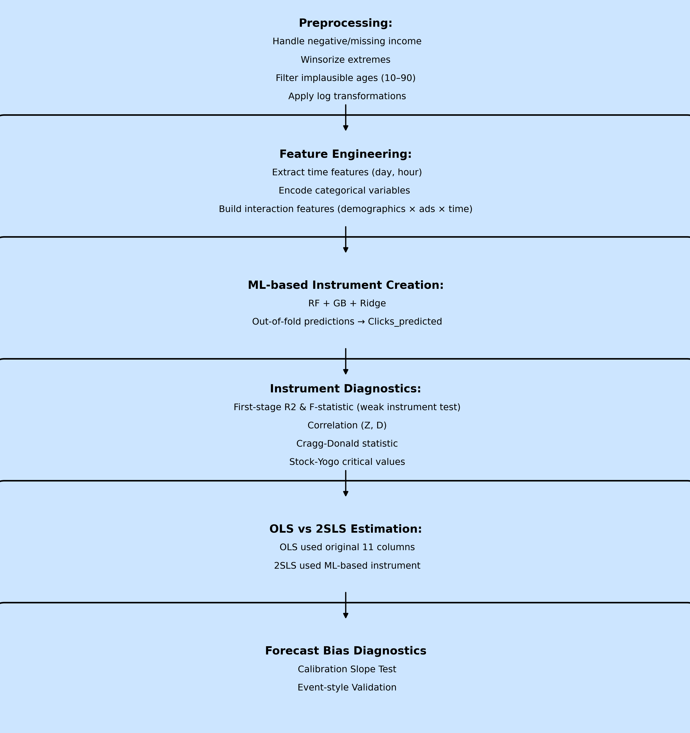
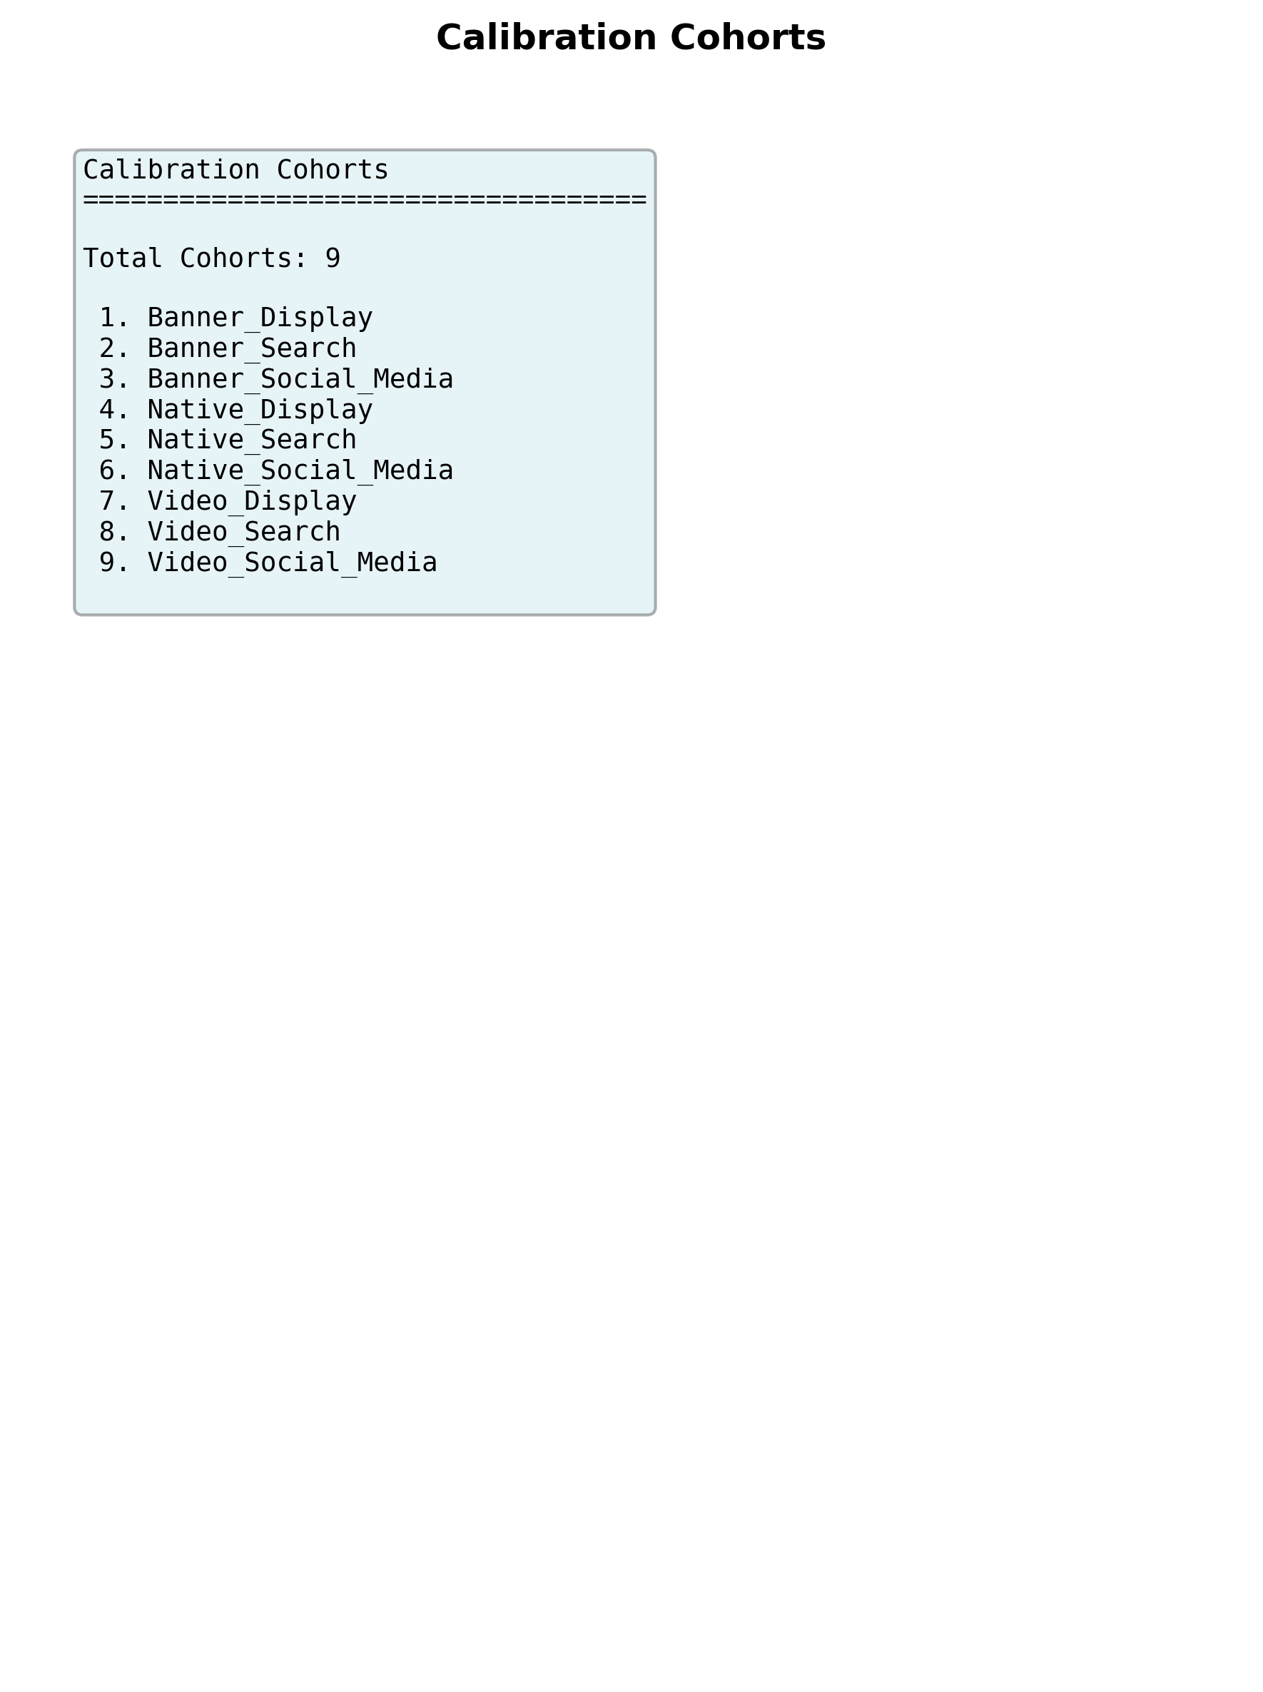
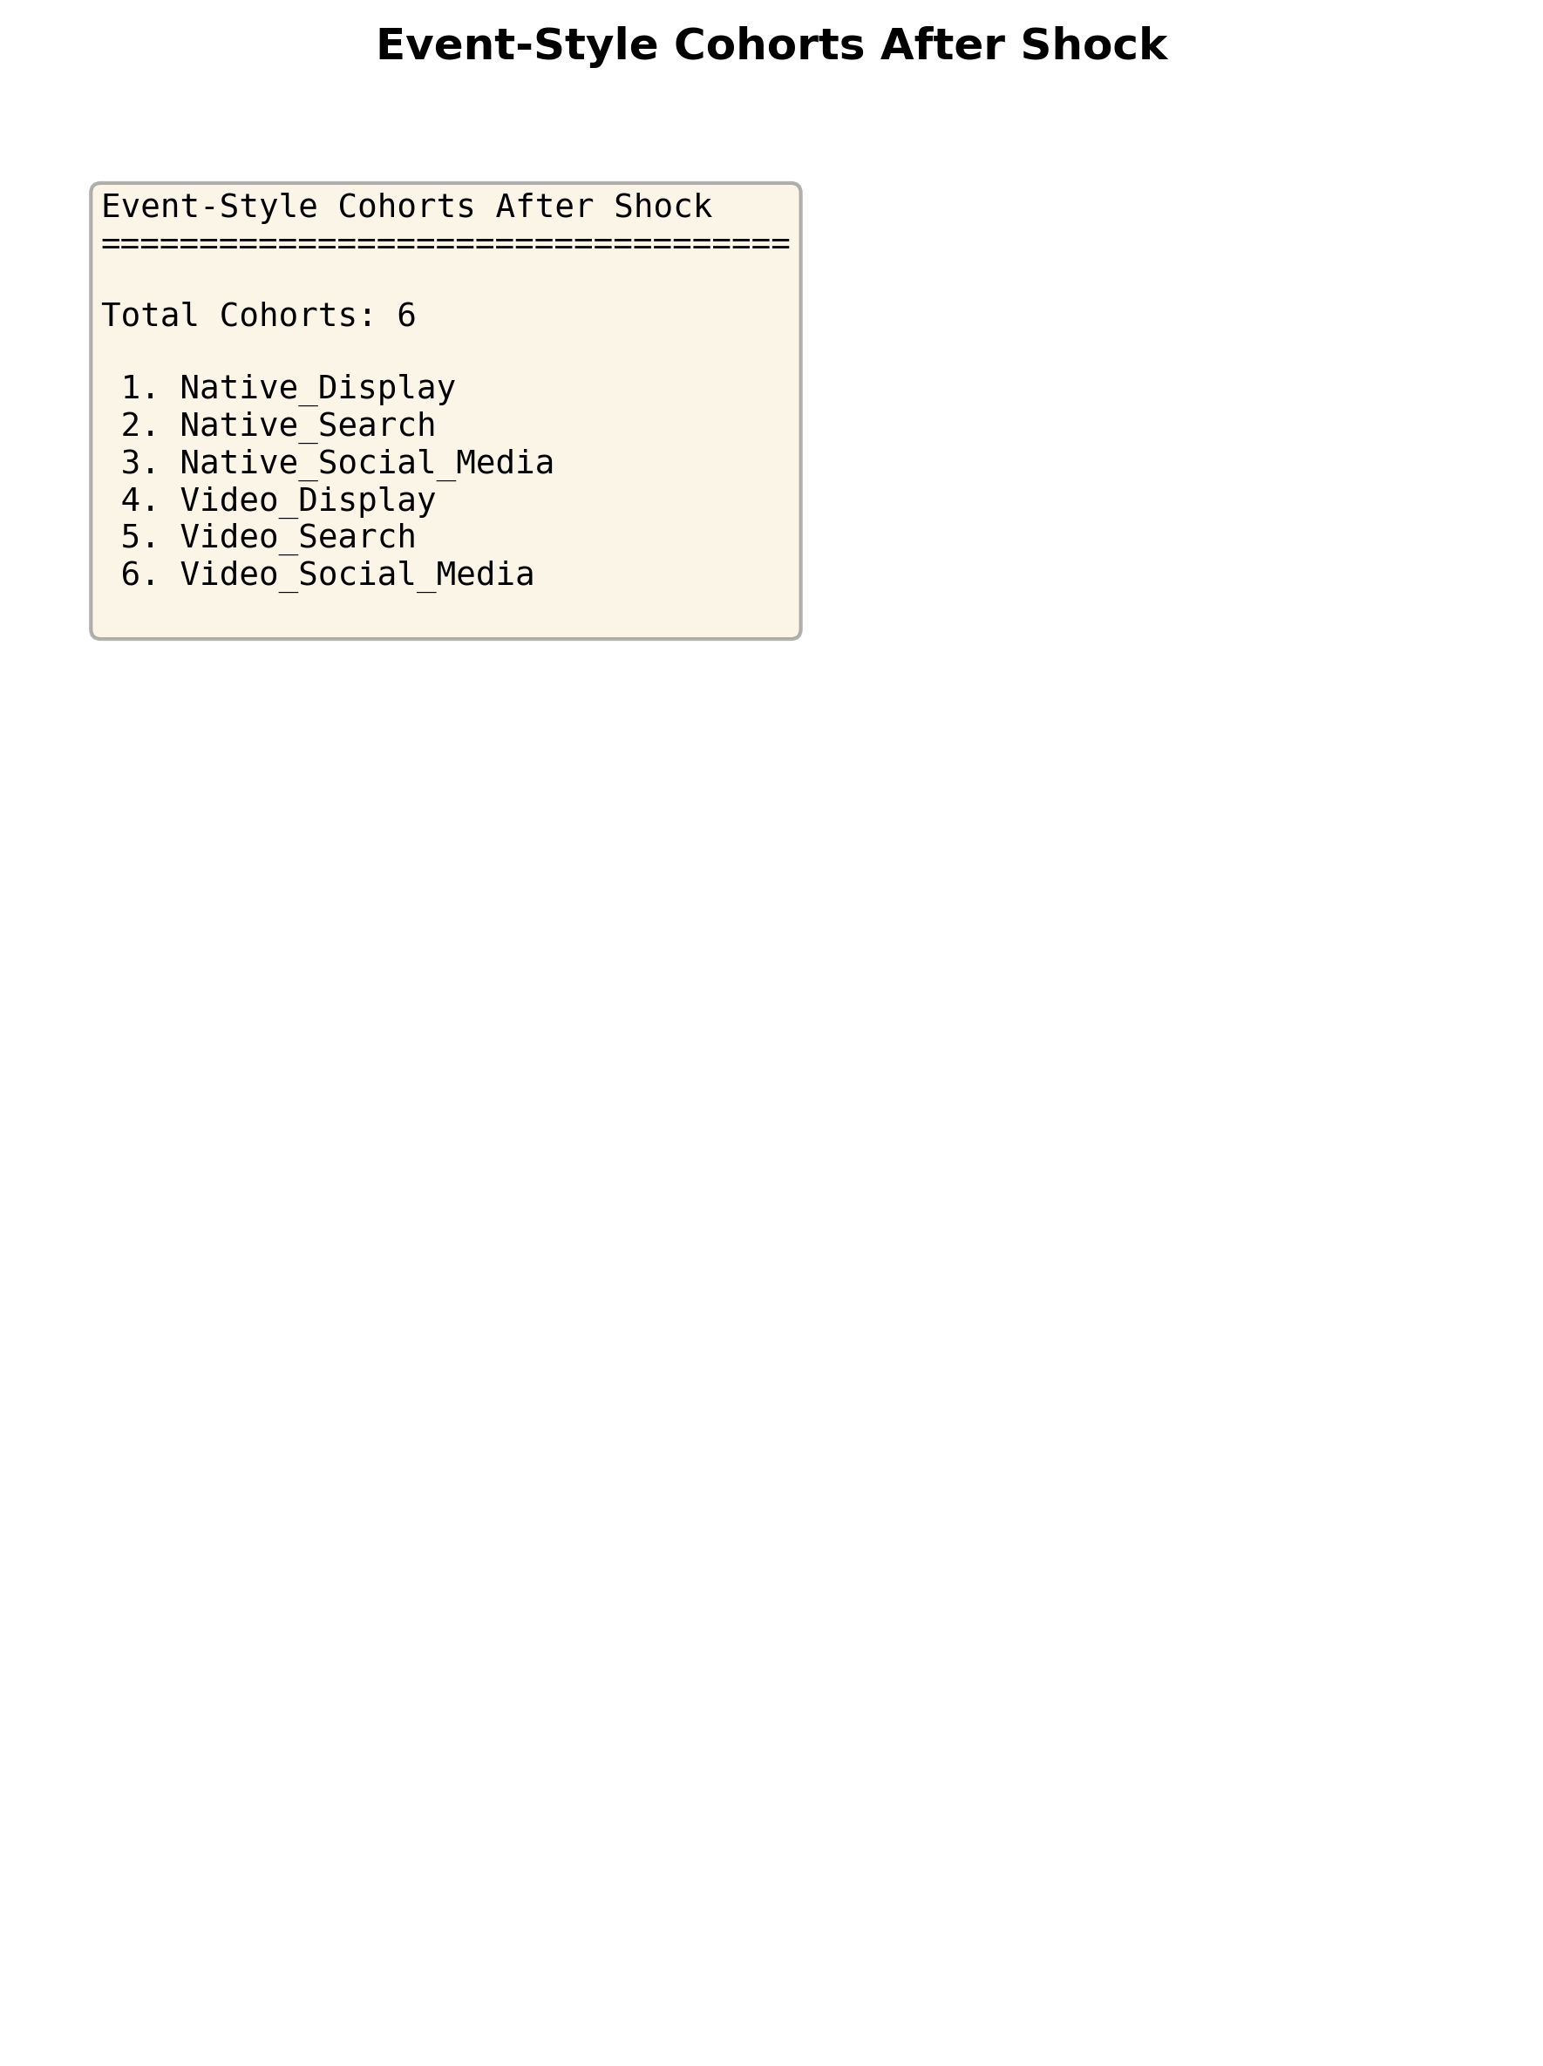
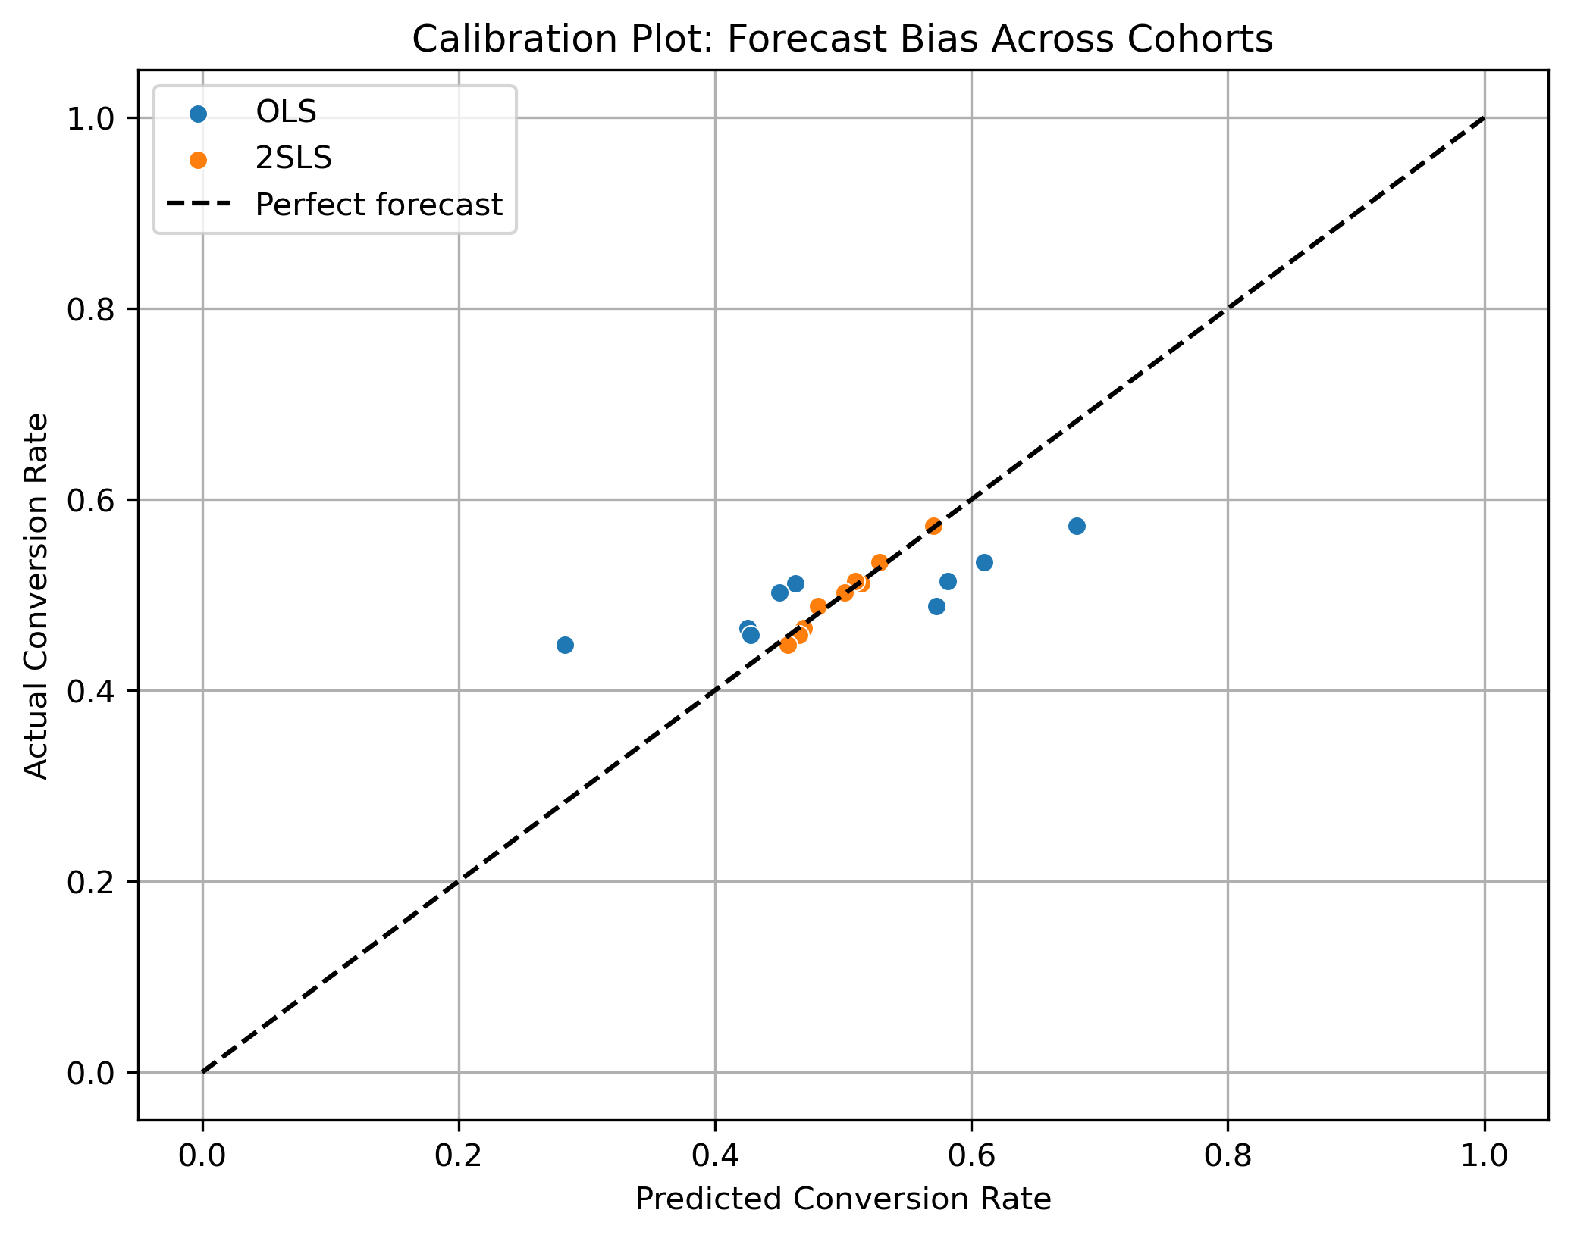
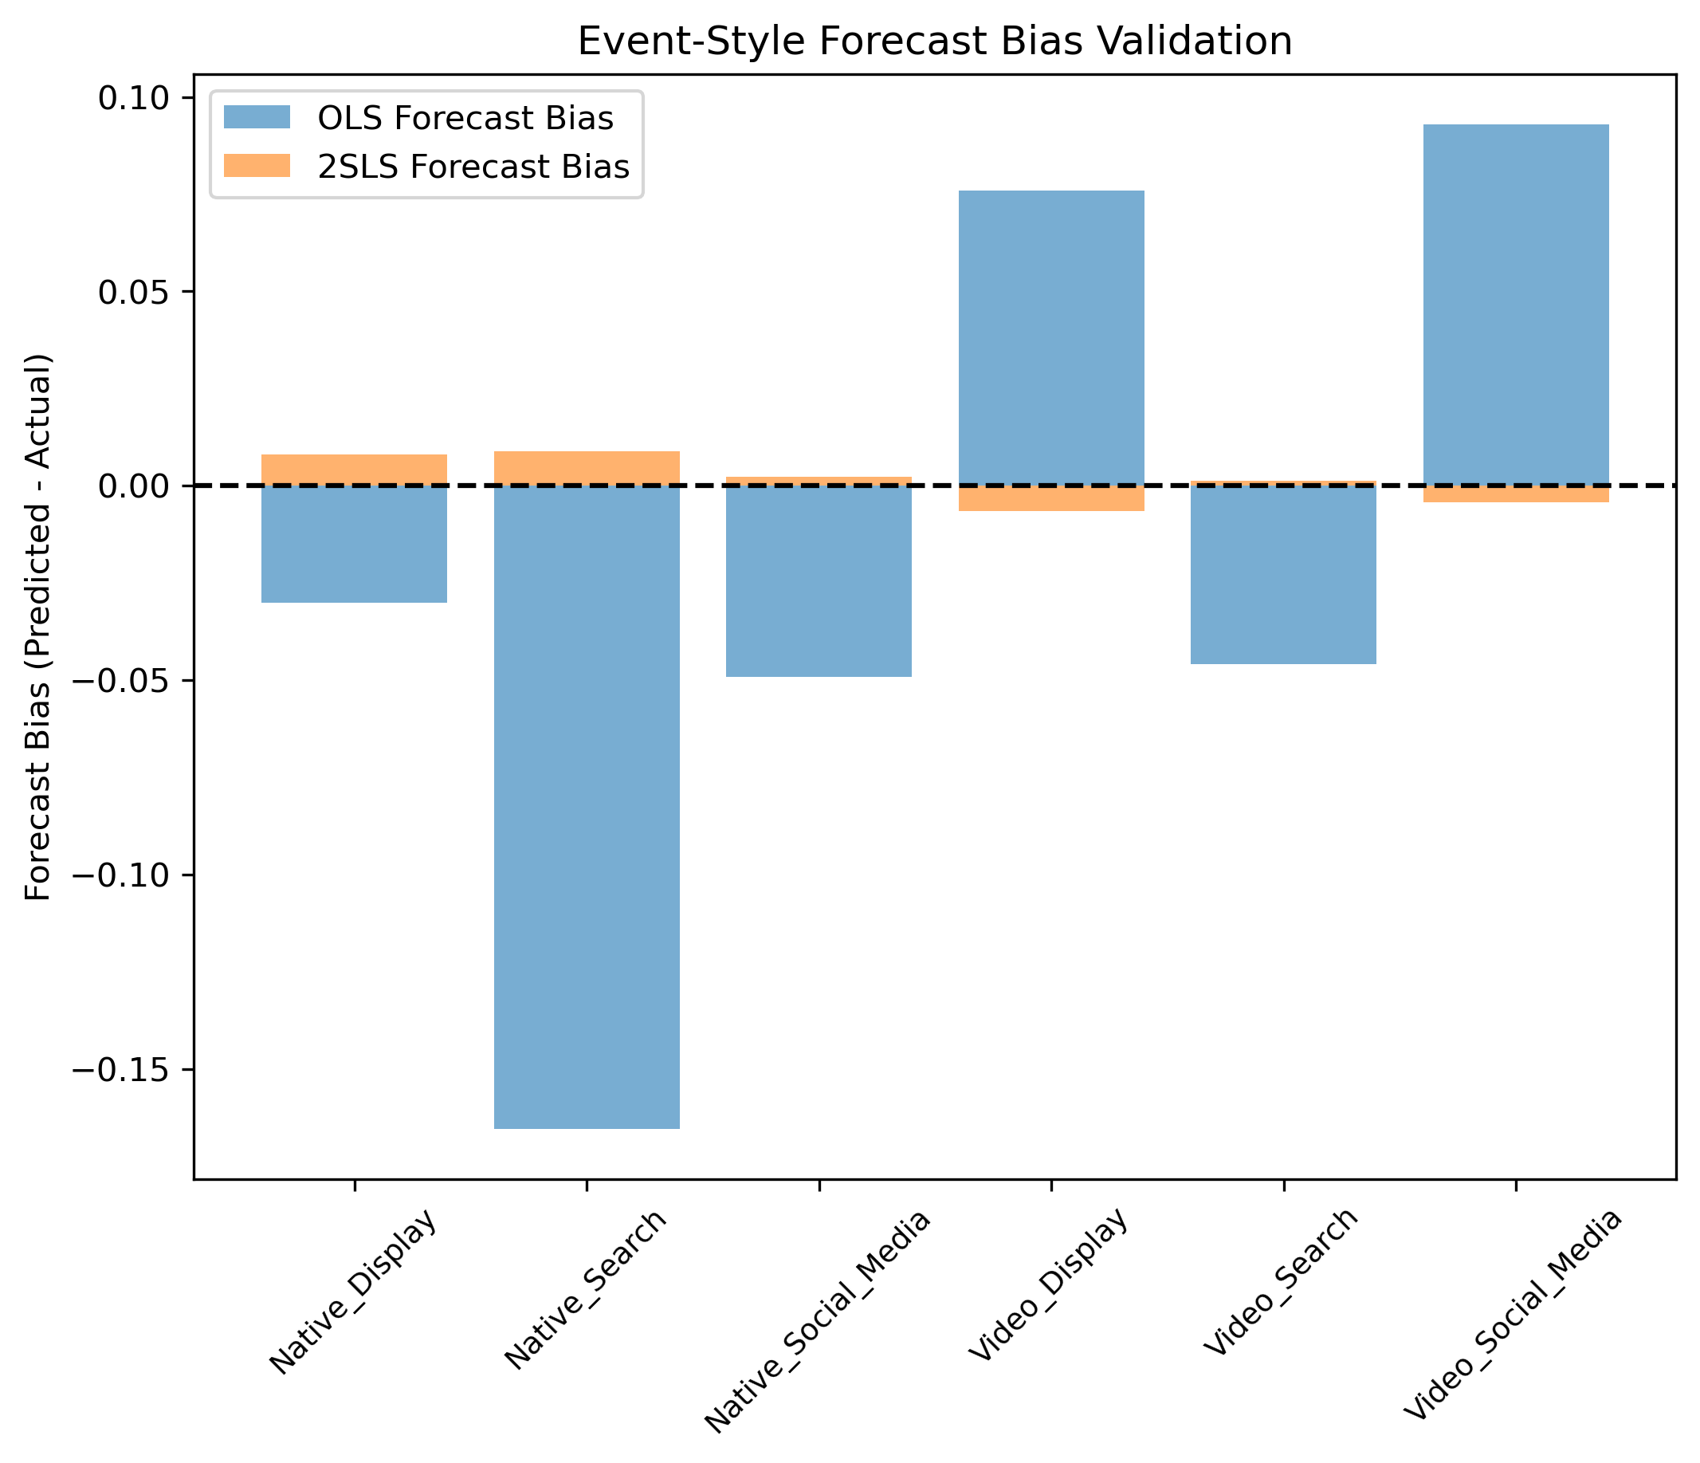
ML IV and Forecast Bias in Digital Ads
Ian Tai Ahn Goddard School of Business & Economics
Weber State University
Introduction
Figures and Results
Conclusion
When an ad is created, the end goal for that ad is to trigger some type of action. That action that is wanted is called a conversion and there are many variables that influence conversions. The dataset in this study contained 11 original columns recording gender, age, income, conversion rate, and other factors. Among these columns there was one named "Clicks". A click may ultimately
drive someone to perform an action which can then be recorded as a conversion.
This means clicks may drive conversions, but it is hard to record latent user
intent and if the click caused the conversion or if they had clicked accidentally. Due to the endogenous nature of clicks, an OLS vs 2SLS study in combination with machine learning techniques to feature engineer a strong viable instrument to remove the endogeneity of clicks was performed.
To further explore how clicks impacted conversion rate a simple calibration slope test, and event-style analysis inspired by Raj Chetty's 2014 value-added forecast-bias works was concatenated onto the first part of this study as a follow-up, or future works section.
The first attempt to implement IV with machine learning techniques failed due to fatal data quality issues in the real-world dataset. The cause was excessive noise and minimal variation in the "Click_time" column, resulting in no meaningful predictors for instrumenting the "Clicks" column. Specifically, the data collection process captured all observations at timestamp 20:45 with only microsecond-level variation. This clear data quality issue rendered the variable unusable as an instrument.
This represents a fundamental flaw in the original data collection design rather than a theoretical limitation. No amount of ML feature engineering could manufacture a valid instrument and so this serves as empirical validation of the 'garbage in, garbage out' principle in causal inference. While this is a valid outcome on its own, there was still curiosity in how data with valid predictors and endogenous variables would take an instrument created from ML techniques. To allow the study to continue synthetic data was generated with endogeneity baked into the "Clicks" predictor and the columns used in the real dataset were used again albeit synthetically created.
Endogeneity was introduced by correlating the error term with 'Clicks' (ρ = 0.08), simulating omitted variable bias to test whether 2SLS could recover unbiased estimates where OLS would fail. A complete ML-based instrumental variable pipeline was successfully implemented on the data, incorporating preprocessing, interaction features, and ensemble modeling. The first-stage F-statistic came out to 1744, which far exceeds the Stock-Yogo critical value of 10 and the Cragg-Donald statistic confirmed instrument strength. While these diagnostics are encouraging, they validate only the synthetic implementation. This ML-instrument demonstrated its utility in an endogeneity study where OLS failed and 2SLS succeeded, establishing a proof-of-concept for the methodological pipeline. This success allowed the study to continue to its other intended research purpose of incorporating Chetty like calibration bias, and event-style shock events. While inspired by his framework the implementation suffered from major issues. The calibration bias estimation lacked the crucial lagged variables, and the event-style shocks were genuine exogenous in Chetty's study unlike the simulated shock artificially induced into the synthetic dataset. The biggest issue was that the data used was synthetic, and in Chetty's study there were millions of rows that were real, based on tax documents, school districts, and such.
Overall, this study yields two key insights. Instruments created by machine learning techniques should be validated and tested on real proven datasets so that ML created IVs may be validated against established IV creation methods.
Chetty's techniques should be implemented with stricter terms to re-create a more accurate exploration of his 2014 study. Despite these limitations, this study demonstrates the technical feasibility of integrating ML feature engineering into the first-stage IV estimation, suggesting a promising avenue for instrument construction when combined with appropriate data quality and validation protocols.
Research Goal
Part I: Estimate the causal effect of clicks on conversions using feature engineered columns and ML techniques to create a strong instrument for 2SLS.
Part II: Diagnose forecast bias in click-based predictions using Chetty-style inspired calibration and event-style validation.
Methods
The figures above outline the first stage of this study. Feature engineering was applied to the original dataset to construct new predictors that would feed into the ensemble model, with the goal of creating a strong instrument for bias correction.
However, the real dataset’s “Clicks” predictor had excessive noise, preventing other variables from explaining its variation. Since Chetty’s forecast bias techniques require a strong instrument, the study would have ended here. To overcome this limitation, synthetic data was generated with endogeneity baked into the “Clicks” variable.
We cleaned ad data (income, age, log transforms), engineered time and categorical features, and built ML‑based instruments for clicks using ensemble models. Instrument strength was validated with first‑stage 𝑅², F‑statistics, Cragg‑Donald, and Stock‑Yogo tests. Finally, we compared OLS vs. 2SLS estimates of clicks on conversion rates and extended with forecast‑bias diagnostics Chetty inspired calibration slope and event‑style validation.
Acknowledgments
I thank the developers of all the Python libraries used. Big thanks to Raj Chetty’s foundational work on forecast bias in education, which inspired this framework. Shoutout to Gavin Roberts who suggested implementing ML instruments with Raj Chetty's techniques. Thank you to the LLMs which allowed the rapid development and validation of ideas and code found in this study.
References
Chetty, R., Friedman, J. N., & Rockoff, J. E. (2014). Measuring the impacts of teachers I: Evaluating bias in teacher value-added estimates. American Economic Review, 104(9), 2593–2632.
Stock, J.H., and Yogo, M. (2005). "Testing for Weak Instruments in Linear IV Regression."
In Identification and Inference for Econometric Models: Essays in Honor of Thomas Rothenberg,
ed. Donald W. K. Andrews and James H. Stock, 80-108. Cambridge University Press.
Cragg, J.G., and Donald, S.G. (1993). "Testing Identifiability and Specification in
Instrumental Variable Models." Econometric Theory, 9(2): 222-240.
The next section draws heavily on Chetty’s 2014 forecast bias framework. Cohort calibration plots and event-style shocks were simulated using two approaches: naïve OLS and an instrument-strengthened 2SLS model. The simulations demonstrate that OLS is biased by endogeneity, whereas 2SLS corrects for it.

Slide 2
Title of Research Project (simple, no jargon)
logo
logo
[AUTHORS LINE] First Name Last Name¹, First Name Last Name², First Name Last Name³ [DEPT./SCHOOL LINE] ¹Department of Integrative Biology, ²Department of Chemistry, College of Natural Sciences, Weber State University
Introduction
Figures and Results
Conclusion
Imintem quas porro debitis itius, nus id quat animus auda platust et imin perovitasped es ipsus mo maios eume di ut a dolupit, sequam, serio bea natis dolupta simperiae nate molorum eati ulparis magnieniam, to intotatur?
Sunto into temperi aturerum et identio nsectatem quo dolorum fuga. Itiatur, quam vendus quodis reria volupienis con posto dolor sam debit experumet odit ut id molorrum que quam fuga. Et volorioraes alit, que plitati onemporro entorio rumendi simenimus mossimus re officit mo officae etur, volorem et optae. Ut ipsam esto temquas dolores sitiandi arum ipicien debisimus doluptatius.
As verepe sectis enda di incto etusda delectet eaque simusda ndanimus, sin cori rem id maximillut hari con ea quiam quam et enduci idunt, corecta alicimp oriaeperum iusaeped unt quis et ut abor ame alis utatur as senet a quibus dolutatur sedit aliam apienda versper feriti delia pa dolo quamus arum es endellu pisquia aditatur audam
figures
figures
Research Goal
figures
figures
Ugiatempore evenis rae doluptatum fugiam earchitiam dit, tempe susdam qui asimin et quissequam la ni ipsunt.
Ditat que voluptat. Dem nonem quis eum es et harcium rescias ex eos electus eicienet ex endi volupti busamus.
Ga. Ro ium versperum re aut omnienderi sinvele stiam, cus eos sime sed que occupta temquia nobisciur? Quis dolenem oluptam ne nonessumqui doluptatem exeribus id eveliquam qui nisqui atet eiciunt. As verepe sectis enda di incto etusda delectet eaque simusda ndanimus, sin cori rem id maximillut hari con ea quiam quam et enduci idunt, corecta alicimp oriaeperum iusaeped unt quis et ut abor ame alis utatur as senet a quibus dolutatur sedit aliam apienda versper feriti delia pa dolo quamus arum es endellu pisquia aditatur audam earupid quo quunt odigniscil earum verios nonsequam duciis et
Methods
As verepe sectis enda di incto etusda delectet eaque simusda ndanimus, sin cori rem id maximillut hari con ea quiam quam et enduci idunt, corecta alicimp oriaeperum iusaeped unt quis et ut abor ame alis utatur as senet a quibus dolutatur sedit aliam apienda versper feriti delia pa dolo quamus arum es endellu pisquia aditatur audam earupid quo quunt odigniscil earum verios nonsequam duciis et
Ga. Oviduntusam exerum fugitat quae el exersperum qui corum sam sitas que officiat am el inust dunt mint ut vel il mintis es vel maxim dolupiet, aut quatur aborem quiae explitatur sum venihit quo con cusda volorum quia qui conessunt vel etur? Quis nullitae porunto mod maiorio ex es dolupis eum
figures
Acknowledgments
figures
Vitam voloria con et, cum laboreium, nam cum, quat paris as core volorest, sust exceatur antio ea voluptas eumquatendit quas doluptatet aut landignam que lantur sania dem escidit min reruptiaero velis maximus aut que pe aliquas sequidisit, omnient hit lam eicias modio con nisin pediam, ent, cust accaborit odio corehen dendae nonet eliquam, aperorepe autatem voles int odic tem nis dolorrum que cores doluptaturi utemolorum imusam, idendaecabo. Nam quo
References
As verepe sectis enda di incto etusda delectet eaque simusda ndanimus, sin cori rem id maximillut hari con ea quiam quam et enduci idunt, corecta alicimp oriaeperum iusaeped unt quis et ut abor ame alis utatur as senet a quibus dolutatur sedit aliam apienda versper feriti delia pa dolo quamus arum es endellu pisquia aditatur audam earupid quo quunt odigniscil earum verios nonsequam duciis et apienda versper feriti delia pa dolo quamus arum es endellu pisquia aditatur audam earupid quo quunt odigniscil earum verios nonsequam
Vitam voloria con et, cum laboreium, nam cum, quat paris as core volorest, sust exceatur antio ea voluptas eumquatendit quas doluptatet aut landignam que lantur sania dem escidit min reruptiaero velis maximus aut que pe aliquas sequidisit, omnient hit lam eicias modio con nisin pediam, ent, cust accaborit odio corehen dendae nonet eliquam, aperorepe autatem voles int odic tem nis dolorrum que cores doluptaturi utemolorum imusam, idendaecabo. Nam quo moluptatur?
eicias modio con nisin pediam, ent, cust accaborit odio corehen dendae nonet eliquam, aperorepe autatem voles int odic tem nis dolorrum que

Slide 3
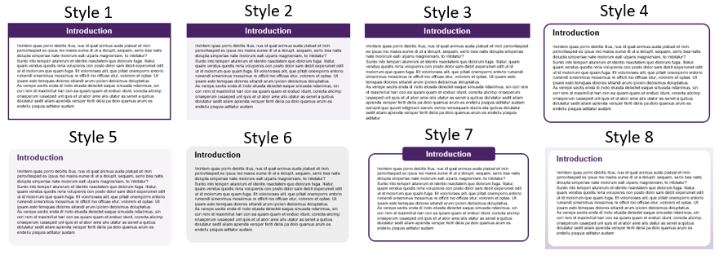
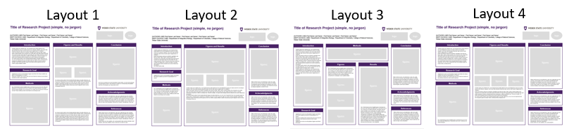
BEFORE YOU START
POSTER SIZE
This template is sized 36 x 42 inches and is the recommended size for conferences. This is the size available for free printing. If you need another size, please consult the template for style ideas.
1. CHOOSE A STYLE
There are 8 different ‘cell’ styles, with various approaches to the headers and border or background. These options are all provided in this template file.
OTHER TEMPLATE FILE
2. CHOOSE A LAYOUT
Different forms/amounts of content might be suited to different column arrangements. These 4 layouts provide a choice of 3-column, 3-column with a wider middle column, a 4-column, and 4-column with the middle columns combined. Think about how your content will be organized and how much space you will need for introductory and concluding information versus data/figures. These options are all provided in this template file.
3. NEXT
Once you’ve chosen the template page that best suits your project, delete other template pages (it might be helpful to keep the following basic tips pages for reference while editing) and save the file under a new name.

Slide 4
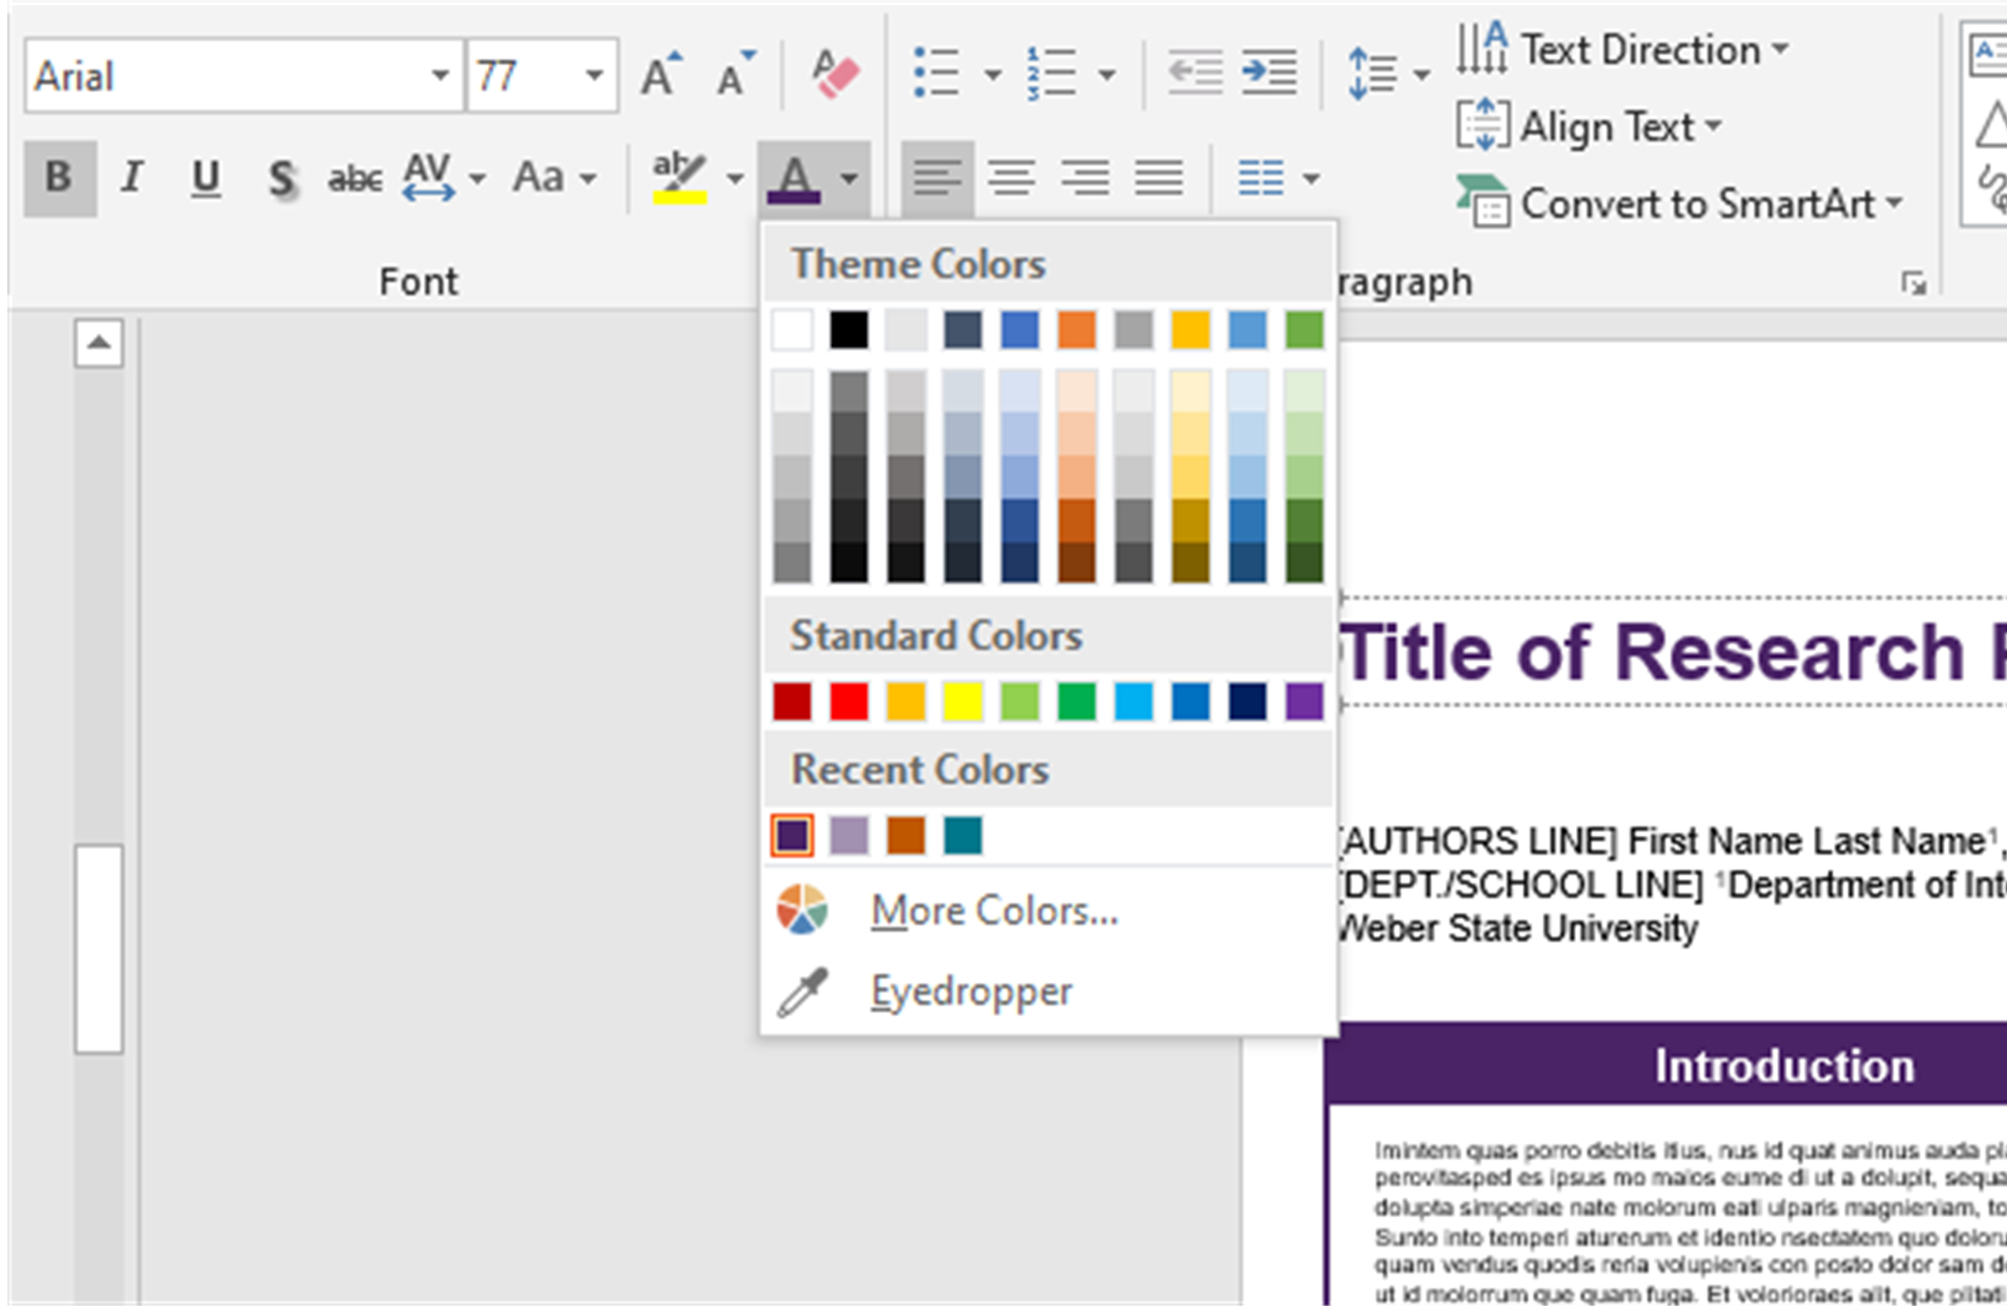
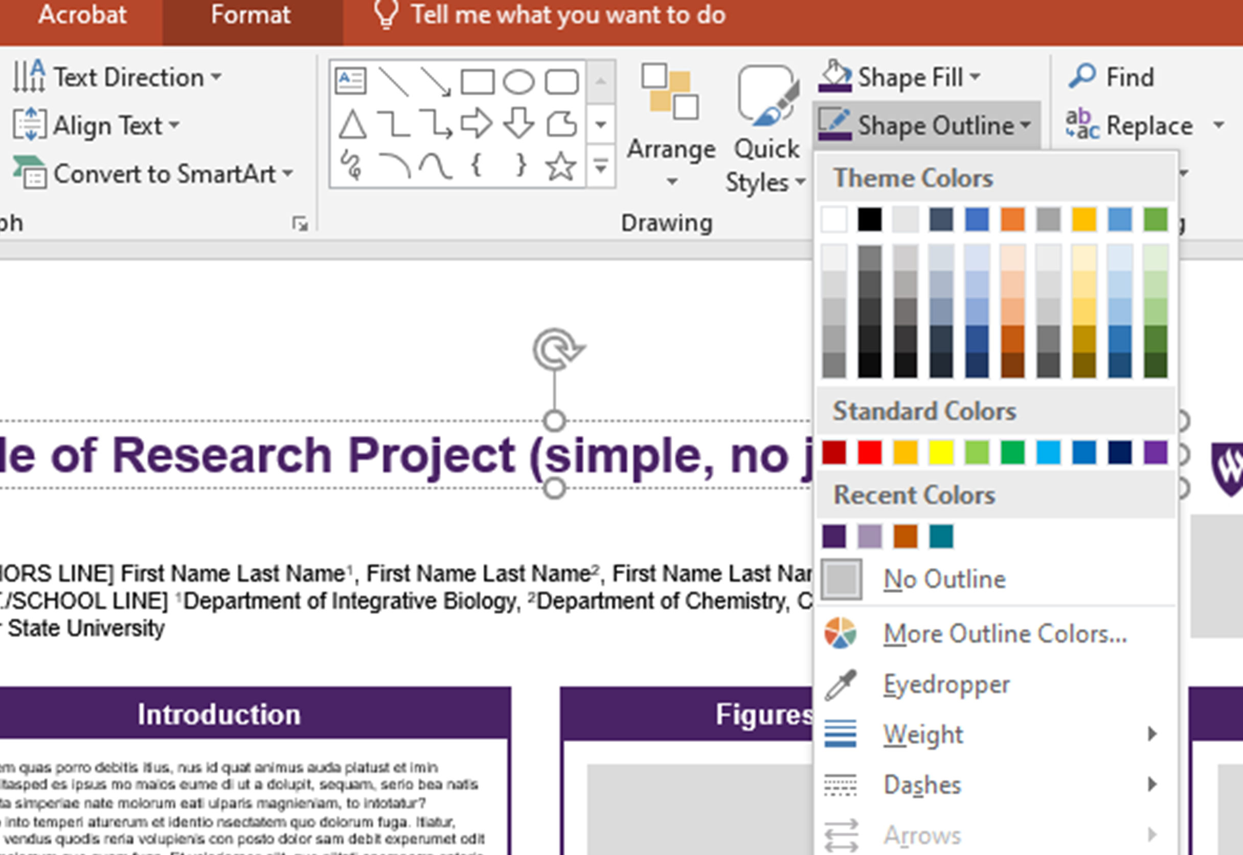
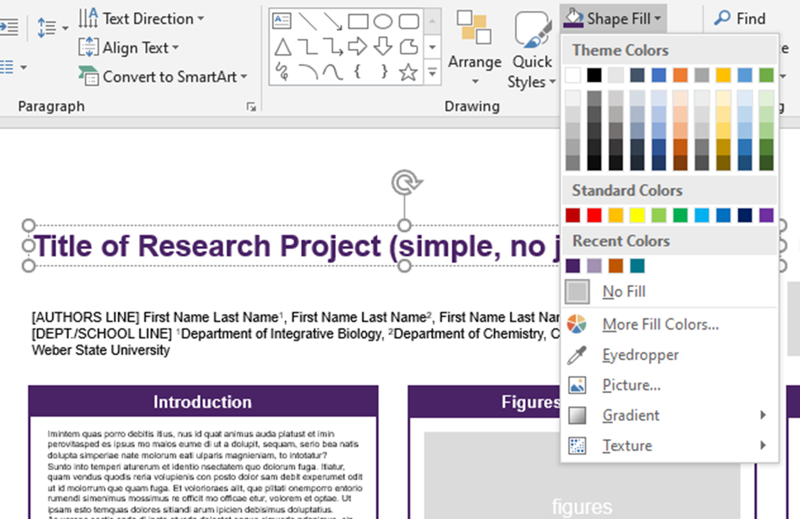
EDITING BASICS
CHANGING COLORS
All templates included here are built with Wildcat Purple as the accent color, but these colors can easily be changed to fit the tone of your content. To do this, you need to know how to change the shape fill, shape outline, and text color.
TEXT COLOR
From either the “home” tab or “shape format” tab, find the ‘A’ with a color block below.
SHAPE FILL COLOR
From the “shape format” tab, find the paint bucket icon with a color block below, and choose from the given swatches or “more fill colors”.
SHAPE OUTLINE COLOR
From the “shape format” tab, find the pencil icon with a color block below, and choose from the given swatches or “more outline colors”.
GRADIENTS: For editing gradients, go to the bottom of the Shape Fill dropdown and choose: Gradient > More Gradients
NOTE: DO NOT ADD A DARK BACKGROUND BEHIND AREAS OF TEXT
White text against a dark background might look acceptable on screen, but can be problematic in printed form. Large areas of dark colors can print differently than expected, and highly saturated ink can bleed into white letters and make the text less legible. White text against a background can be useful for things like bold headers (with larger text), but shouldn’t be used for full paragraphs with small text.

Slide 5
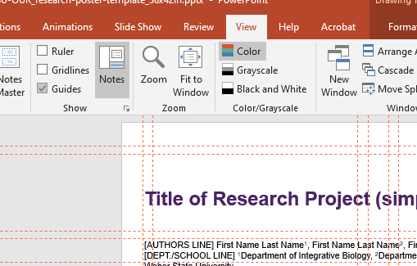

EDITING BASICS
MAKING CHANGES TO CELLS
Most research posters are made up of multiple text boxes with headers, which I’m referring to as ‘cells’. As you add in your own content, the length and number of these cells will probably change. Maintaining the column width as it was designed will preserve the alignment of cells and keep the poster looking polished.
MAKE GUIDES VISIBLE
Guides have been set up in the file to create visible boundaries to align elements as you make changes to the content (these will not show up when printed). If you do not see them upon first opening the file, you can make them visible by going to: View > Guides > Guides
NOTE: These guides might not show up if you are opening this up in an older version of powerpoint, update the software to utilize this feature in the file.
ADJUST CELL TO FIT TEXT LENGTH
With guides visible, copy and paste your own text, and adjust the borders or background shape of the cells to fit the new content.
NOTE: These templates include suggested headers for cells (introduction, research goal, methods, etc), but these are in no way strict guidelines, and can be changed according to what would be appropriate for your content.

Slide 6

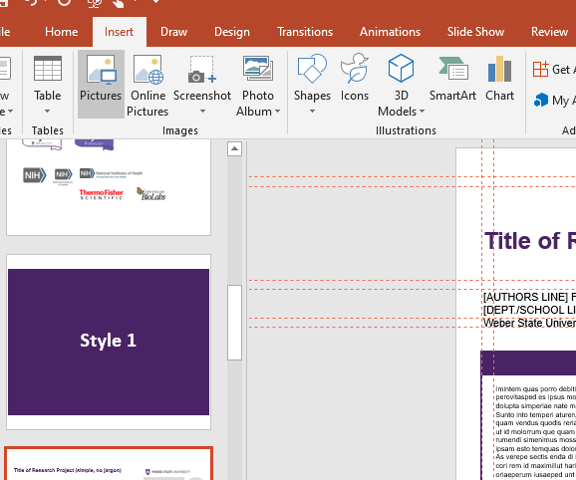


EDITING BASICS
INSERTING AND SCALING IMAGES
INSERTING IMAGES
Insert new images by either dragging them onto the page, or going to the “insert” tab, clicking on the picture icon, and choosing ”picture from file”
SCALE IMAGES PROPORTIONALLY
Make images bigger or smaller by dragging from one of the corner anchor points.
Do NOT scale any images by using anchor points directly horizontal or vertical, which gives the image the appearance of being stretched, as this would result in a significant misrepresentation of a logo or inaccurate depiction of data/charts.

Slide 7

LOGOS
FOR CURRENT LOGO DOWNLOADS
For more information about proper use versus misuse of WSU logos, and to download University-level logos or Colleges/Departments logos, visit:
https://www.weber.edu/brand/logos.html
INCLUDING OTHER LOGOS
If you need to include other logos, acknowledging funding support or partnership with other institutions, there are placeholders for such logos in the top right corner. Delete these gray shapes and position your logo files here.
DO NOT USE OUTDATED LOGOS
Check to make sure you are not using an outdated version of the logo.
DO NOT USE REDUNDANT LOGOS
Consider the number of logos you are using and remove those that are repetitive.

Slide 8








LOGOS
FUNDING LOGOS
Below are some of the logos students commonly use when creating a poster. Some logos have variants and you can choose whichever works better for your poster.

Slide 9






LOGOS
Official University logo. Find out more about using the logo.

Slide 10
Style 1 Box Text

Slide 11
Title of Research Project (simple, no jargon)
logo
logo
[AUTHORS LINE] First Name Last Name¹, First Name Last Name², First Name Last Name³ [DEPT./SCHOOL LINE] ¹Department of Integrative Biology, ²Department of Chemistry, College of Natural Sciences, Weber State University
Introduction
Figures and Results
Conclusion
Imintem quas porro debitis itius, nus id quat animus auda platust et imin perovitasped es ipsus mo maios eume di ut a dolupit, sequam, serio bea natis dolupta simperiae nate molorum eati ulparis magnieniam, to intotatur?
Sunto into temperi aturerum et identio nsectatem quo dolorum fuga. Itiatur, quam vendus quodis reria volupienis con posto dolor sam debit experumet odit ut id molorrum que quam fuga. Et volorioraes alit, que plitati onemporro entorio rumendi simenimus mossimus re officit mo officae etur, volorem et optae. Ut ipsam esto temquas dolores sitiandi arum ipicien debisimus doluptatius.
As verepe sectis enda di incto etusda delectet eaque simusda ndanimus, sin cori rem id maximillut hari con ea quiam quam et enduci idunt, corecta alicimp oriaeperum iusaeped unt quis et ut abor ame alis utatur as senet a quibus dolutatur sedit aliam apienda versper feriti delia pa dolo quamus arum es endellu pisquia aditatur audam
figures
figures
Research Goal
figures
figures
Ugiatempore evenis rae doluptatum fugiam earchitiam dit, tempe susdam qui asimin et quissequam la ni ipsunt.
Ditat que voluptat. Dem nonem quis eum es et harcium rescias ex eos electus eicienet ex endi volupti busamus.
Methods
As verepe sectis enda di incto etusda delectet eaque simusda ndanimus, sin cori rem id maximillut hari con ea quiam quam et enduci idunt, corecta alicimp oriaeperum iusaeped unt quis et ut abor ame alis utatur as senet a quibus dolutatur sedit aliam apienda versper feriti delia pa dolo quamus arum es endellu pisquia aditatur audam earupid quo quunt odigniscil earum verios nonsequam duciis et
Ga. Ro ium versperum re aut omnienderi sinvele stiam, cus eos sime sed que occupta tequila noisier? Quiz dolenem oluptam ne nonessumqui doluptatem exeribus id eveliquam qui nisqui atet eiciunt.
Ga. Oviduntusam exerum fugitat quae el exersperum qui corum sam sitas que officiat am el inust dunt mint ut vel il mintis es vel maxim dolupiet, aut quatur aborem quiae explitatur sum venihit quo con cusda volorum quia qui conessunt vel etur? Quis nullitae porunto mod maiorio ex es dolupis eum
figures
Acknowledgments
figures
Vitam voloria con et, cum laboreium, nam cum, quat paris as core volorest, sust exceatur antio ea voluptas eumquatendit quas doluptatet aut landignam que lantur sania dem escidit min reruptiaero velis maximus aut que pe aliquas sequidisit, omnient hit lam eicias modio con nisin pediam, ent, cust accaborit odio corehen dendae nonet eliquam, aperorepe autatem voles int odic tem nis dolorrum que cores doluptaturi utemolorum imusam, idendaecabo. Nam quo
References
As verepe sectis enda di incto etusda delectet eaque simusda ndanimus, sin cori rem id maximillut hari con ea quiam quam et enduci idunt, corecta alicimp oriaeperum iusaeped unt quis et ut abor ame alis utatur as senet a quibus dolutatur sedit aliam apienda versper feriti delia pa dolo quamus arum es endellu pisquia aditatur audam earupid quo quunt odigniscil earum verios nonsequam duciis et apienda versper feriti delia pa dolo quamus arum es endellu pisquia aditatur audam earupid quo quunt odigniscil earum verios nonsequam
Vitam voloria con et, cum laboreium, nam cum, quat paris as core volorest, sust exceatur antio ea voluptas eumquatendit quas doluptatet aut landignam que lantur sania dem escidit min reruptiaero velis maximus aut que pe aliquas sequidisit, omnient hit lam eicias modio con nisin pediam, ent, cust accaborit odio corehen dendae nonet eliquam, aperorepe autatem voles int odic tem nis dolorrum que cores doluptaturi utemolorum imusam, idendaecabo. Nam quo moluptatur?
eicias modio con nisin pediam, ent, cust accaborit odio corehen dendae nonet eliquam, aperorepe autatem voles int odic tem nis dolorrum que

Slide 12
Title of Research Project (simple, no jargon)
logo
logo
[AUTHORS LINE] First Name Last Name¹, First Name Last Name², First Name Last Name³ [DEPT./SCHOOL LINE] ¹Department of Integrative Biology, ²Department of Chemistry, College of Natural Sciences, Weber State University
Introduction
Figures and Results
Conclusion
Imintem quas porro debitis itius, nus id quat animus auda platust et imin perovitasped es ipsus mo maios eume di ut a dolupit, sequam, serio bea natis dolupta simperiae nate molorum eati ulparis magnieniam, to intotatur?
Sunto into temperi aturerum et identio nsectatem quo dolorum fuga. Itiatur, quam vendus quodis reria volupienis con posto dolor sam debit experumet odit ut id molorrum que quam fuga. Et volorioraes alit, que plitati onemporro entorio rumendi simenimus mossimus re officit mo officae etur, volorem et optae. Ut ipsam esto temquas dolores sitiandi arum ipicien debisimus doluptatius.
As verepe sectis enda
figures
figures
Research Goal
Ugiatempore evenis rae doluptatum fugiam earchitiam dit, tempe susdam qui asimin et quissequam la ni ipsunt.
figures
figures
figures
Methods
Vitam voloria con et, cum laboreium, nam cum, quat paris as core volorest, sust exceatur antio ea voluptas eumquatendit quas doluptatet aut landignam que lantur sania dem escidit min reruptiaero velis maximus aut que pe aliquas sequidisit, omnient hit lam
Ga. Oviduntusam exerum fugitat quae el exersperum qui corum sam sitas que officiat am el inust dunt mint ut vel il mintis es vel maxim dolupiet, aut quatur aborem quiae explitatur sum venihit quo con cusda volorum quia qui conessunt vel etur? Quis nullitae porunto mod maiorio ex es dolupis eum solupta
Imintem quas porro debitis itius, nus id quat animus auda platust et imin perovitasped es ipsus mo maios eume di ut a dolupit, sequam, serio bea natis dolupta simperiae nate molorum eati ulparis magnieniam, to intotatur?
Sunto into temperi aturerum et identio nsectatem quo dolorum fuga. Itiatur, quam vendus quodis reria volupienis con posto dolor sam debit experumet odit ut id molorrum que quam fuga. Et volorioraes alit, que plitati onemporro entorio rumendi simenimus mossimus re officit mo officae etur, volorem et optae. Ut ipsam esto temquas dolores sitiandi arum ipicien debisimus doluptatius.
As verepe sectis enda di incto etusda delectet eaque simusda ndanimus, sin cori rem id maximillut hari con ea quiam quam et enduci idunt, corecta alicimp oriaeperum iusaeped unt quis et ut abor ame alis utatur as senet a quibus dolutatur sedit aliam apienda versper feriti delia pa dolo quamus arum es endellu pisquia aditatur audam earupid quo quunt odigniscil earum verios nonsequam duciis et
Acknowledgments
figures
Vitam voloria con et, cum laboreium, nam cum, quat paris as core volorest, sust exceatur antio ea voluptas eumquatendit quas doluptatet aut landignam que lantur sania dem escidit min reruptiaero velis maximus aut que pe aliquas sequidisit, omnient hit lam eicias modio con nisin pediam, ent, cust accaborit odio corehen dendae nonet
figures
References
Vitam voloria con et, cum laboreium, nam cum, quat paris as core volorest, sust exceatur antio ea voluptas eumquatendit quas doluptatet aut landignam que lantur sania dem escidit min reruptiaero velis maximus aut que pe aliquas sequidisit, omnient hit lam eicias modio con nisin pediam, ent, cust accaborit odio corehen dendae nonet eliquam, aperorepe autatem voles int odic tem nis dolorrum que cores doluptaturi

Slide 13

Title of Research Project (simple, no jargon)
logo
logo
[AUTHORS LINE] First Name Last Name¹, First Name Last Name², First Name Last Name³ [DEPT./SCHOOL LINE] ¹Department of Integrative Biology, ²Department of Chemistry, College of Natural Sciences, Weber State University
Introduction
Methods
Conclusion
Imintem quas porro debitis itius, nus id quat animus auda platust et imin perovitasped es ipsus mo maios eume di ut a dolupit, sequam, serio bea natis dolupta simperiae nate molorum eati ulparis magnieniam, to intotatur?
Sunto into temperi aturerum et identio nsectatem quo dolorum fuga. Itiatur, quam vendus quodis reria volupienis con posto dolor sam debit experumet odit ut id molorrum que quam fuga. Et volorioraes alit, que plitati onemporro entorio rumendi simenimus mossimus re officit mo officae etur, volorem et optae. Ut ipsam esto temquas dolores sitiandi arum ipicien debisimus doluptatius.
As verepe sectis enda di incto etusda delectet eaque simusda ndanimus, sin cori rem id maximillut hari con ea quiam quam et enduci idunt, corecta
Imintem quas porro debitis itius, nus id quat animus auda platust et imin perovitasped es ipsus mo maios eume di ut a dolupit, sequam, serio bea natis dolupta simperiae nate molorum eati ulparis magnieniam, to intotatur?
figures
figures
Figures
Results
Ga. Oviduntusam exerum fugitat quae el exersperum qui corum sam sitas que officiat am el inust dunt mint ut vel il mintis es vel maxim dolupiet, aut quatur aborem quiae explitatur sum venihit quo con cusda volorum quia qui conessunt vel etur? Quis nullitae porunto mod maiorio ex es dolupis eum solupta spellande moluptionem consequae volum audanto tatiae
figures
figures
Vitam voloria con et, cum laboreium, nam cum, quat paris as core volorest, sust exceatur antio ea voluptas eumquatendit quas doluptatet aut landignam que lantur sania dem escidit min reruptiaero velis maximus aut que pe aliquas sequidisit, omnient hit lam eicias modio con nisin pediam, ent, cust accaborit odio corehen dendae nonet eliquam, aperorepe autatem
Acknowledgments
Vitam voloria con et, cum laboreium, nam cum, quat paris as core volorest, sust exceatur antio ea voluptas eumquatendit quas doluptatet aut landignam que lantur sania dem escidit min reruptiaero velis maximus aut que pe aliquas sequidisit, omnient hit lam eicias modio con nisin pediam, ent, cust accaborit odio corehen dendae nonet
Research Goal
Ga. Oviduntusam exerum fugitat quae el exersperum qui corum sam sitas que officiat am el inust dunt mint ut vel il mintis es vel maxim dolupiet, aut quatur aborem quiae explitatur sum venihit quo con cusda volorum quia qui conessunt vel etur? Quis nullitae porunto mod maiorio ex es dolupis eum solupta spellande moluptionem consequae volum audanto tatiae sam quodit quaerumquiam ex eatquid eliqui dolupta tiatiumet et voluptae sequi consent, occusa inciend itatqui tem quis idest iligenti dolesti nvenda que comnient que nessi sandianis con et adi sit, occum fugiaestibea doloris ut quaspic tem licidita voluptatus ent eos res dolorescimus doloreptur, erem dignatist,
References
figures
Vitam voloria con et, cum laboreium, nam cum, quat paris as core volorest, sust exceatur antio ea voluptas eumquatendit quas doluptatet aut landignam que lantur sania dem escidit min reruptiaero velis maximus aut que pe aliquas sequidisit, omnient hit lam eicias modio con nisin pediam, ent, cust accaborit odio corehen dendae nonet eliquam, aperorepe autatem voles int odic tem nis dolorrum que cores doluptaturi
Ugiatempore evenis rae doluptatum fugiam earchitiam dit, tempe susdam qui asimin et quissequam la ni ipsunt.
Ditat que voluptat. Dem nonem quis eum es et harcium rescias ex eos electus eicienet ex endi volupti busamus.
Ugiatempore evenis rae doluptatum fugiam earchitiam dit, tempe

Slide 14
Title of Research Project (simple, no jargon)
logo
logo
[AUTHORS LINE] First Name Last Name¹, First Name Last Name², First Name Last Name³ [DEPT./SCHOOL LINE] ¹Department of Integrative Biology, ²Department of Chemistry, College of Natural Sciences, Weber State University
Introduction
Figures and Results
Conclusion
Imintem quas porro debitis itius, nus id quat animus auda platust et imin perovitasped es ipsus mo maios eume di ut a dolupit, sequam, serio bea natis dolupta simperiae nate molorum eati ulparis magnieniam, to intotatur?
Sunto into temperi aturerum et identio nsectatem quo dolorum fuga. Itiatur, quam vendus quodis reria volupienis con posto dolor sam debit experumet odit ut id molorrum que quam fuga. Et volorioraes alit, que plitati onemporro entorio rumendi simenimus mossimus re officit mo officae etur, volorem et optae. Ut ipsam esto temquas dolores sitiandi arum ipicien debisimus doluptatius.
As verepe sectis enda di incto etusda delectet eaque simusda ndanimus, sin cori rem id maximillut hari con ea quiam quam et enduci idunt, corecta alicimp
figures
figures
Research Goal
Ugiatempore evenis rae doluptatum fugiam earchitiam dit, tempe susdam qui asimin et quissequam la ni ipsunt.
Ditat que voluptat. Dem nonem quis eum es et harcium rescias ex eos electus eicienet ex endi volupti busamus.
figures
figures
figures
Vitam voloria con et, cum laboreium, nam cum, quat paris as core volorest, sust exceatur antio ea voluptas eumquatendit quas doluptatet aut landignam que lantur sania dem escidit min reruptiaero velis maximus aut que pe aliquas sequidisit, omnient hit lam eicias modio con nisin pediam, ent, cust accaborit odio corehen dendae nonet eliquam, aperorepe autatem
Methods
figures
Imintem quas porro debitis itius, nus id quat animus auda platust et imin perovitasped es ipsus mo maios eume di ut a dolupit, sequam, serio bea natis dolupta simperiae nate molorum eati ulparis magnieniam, to intotatur?
Sunto into temperi aturerum et identio nsectatem quo dolorum fuga. Itiatur, quam vendus quodis reria volupienis con posto dolor sam debit experumet odit ut id molorrum que quam fuga. Et volorioraes alit, que plitati onemporro entorio rumendi simenimus mossimus re officit mo officae etur, volorem et optae. Ut ipsam esto temquas dolores sitiandi arum ipicien debisimus doluptatius.
As verepe sectis enda di incto etusda delectet eaque simusda ndanimus, sin cori rem id maximillut hari con ea quiam quam et enduci idunt, corecta alicimp oriaeperum et
Acknowledgments
Vitam voloria con et, cum laboreium, nam cum, quat paris as core volorest, sust exceatur antio ea voluptas eumquatendit quas doluptatet aut landignam que lantur sania dem escidit min reruptiaero velis maximus aut que pe aliquas sequidisit, omnient hit lam eicias modio con nisin pediam, ent, cust accaborit odio corehen dendae nonet eliquam, aperorepe autatem voles int odic tem nis dolorrum
figures
References
Vitam voloria con et, cum laboreium, nam cum, quat paris as core volorest, sust exceatur antio ea voluptas eumquatendit quas doluptatet aut landignam que lantur sania dem escidit min reruptiaero velis maximus aut que pe aliquas sequidisit, omnient hit lam eicias modio con nisin pediam, ent, cust accaborit odio corehen dendae nonet eliquam, aperorepe autatem voles int odic tem nis dolorrum que cores doluptaturi utemolorum imusam, idendaecabo. Nam quo moluptatur?
eicias modio con nisin pediam, ent, cust accaborit
Ga. Oviduntusam exerum fugitat quae el exersperum qui corum sam sitas que officiat am el inust dunt mint ut vel il mintis es vel maxim dolupiet

Slide 15
Style 2 Shadow Box Text

Slide 16
Title of Research Project (simple, no jargon)
logo
logo
[AUTHORS LINE] First Name Last Name¹, First Name Last Name², First Name Last Name³ [DEPT./SCHOOL LINE] ¹Department of Integrative Biology, ²Department of Chemistry, College of Natural Sciences, Weber State University
Introduction
Figures and Results
Conclusion
Imintem quas porro debitis itius, nus id quat animus auda platust et imin perovitasped es ipsus mo maios eume di ut a dolupit, sequam, serio bea natis dolupta simperiae nate molorum eati ulparis magnieniam, to intotatur?
Sunto into temperi aturerum et identio nsectatem quo dolorum fuga. Itiatur, quam vendus quodis reria volupienis con posto dolor sam debit experumet odit ut id molorrum que quam fuga. Et volorioraes alit, que plitati onemporro entorio rumendi simenimus mossimus re officit mo officae etur, volorem et optae. Ut ipsam esto temquas dolores sitiandi arum ipicien debisimus doluptatius.
As verepe sectis enda di incto etusda delectet eaque simusda ndanimus, sin cori rem id maximillut hari con ea quiam quam et enduci idunt, corecta alicimp oriaeperum iusaeped unt quis et ut abor ame alis utatur as senet a quibus dolutatur sedit aliam apienda versper feriti delia pa dolo quamus arum es endellu pisquia aditatur audam
figures
figures
Research Goal
figures
figures
Ugiatempore evenis rae doluptatum fugiam earchitiam dit, tempe susdam qui asimin et quissequam la ni ipsunt.
Ditat que voluptat. Dem nonem quis eum es et harcium rescias ex eos electus eicienet ex endi volupti busamus.
Ga. Ro ium versperum re aut omnienderi sinvele stiam, cus eos sime sed que occupta temquia nobisciur? Quis dolenem oluptam ne nonessumqui doluptatem exeribus id eveliquam qui nisqui atet eiciunt. As verepe sectis enda di incto etusda delectet eaque simusda ndanimus, sin cori rem id maximillut hari con ea quiam quam et enduci idunt, corecta alicimp oriaeperum iusaeped unt quis et ut abor ame alis utatur as senet a quibus dolutatur sedit aliam apienda versper feriti delia pa dolo quamus arum es endellu pisquia aditatur audam earupid quo quunt odigniscil earum verios nonsequam duciis et
Methods
As verepe sectis enda di incto etusda delectet eaque simusda ndanimus, sin cori rem id maximillut hari con ea quiam quam et enduci idunt, corecta alicimp oriaeperum iusaeped unt quis et ut abor ame alis utatur as senet a quibus dolutatur sedit aliam apienda versper feriti delia pa dolo quamus arum es endellu pisquia aditatur audam earupid quo quunt odigniscil earum verios nonsequam duciis et
Ga. Oviduntusam exerum fugitat quae el exersperum qui corum sam sitas que officiat am el inust dunt mint ut vel il mintis es vel maxim dolupiet, aut quatur aborem quiae explitatur sum venihit quo con cusda volorum quia qui conessunt vel etur? Quis nullitae porunto mod maiorio ex es dolupis eum
figures
Acknowledgments
figures
Vitam voloria con et, cum laboreium, nam cum, quat paris as core volorest, sust exceatur antio ea voluptas eumquatendit quas doluptatet aut landignam que lantur sania dem escidit min reruptiaero velis maximus aut que pe aliquas sequidisit, omnient hit lam eicias modio con nisin pediam, ent, cust accaborit odio corehen dendae nonet eliquam, aperorepe autatem voles int odic tem nis dolorrum que cores doluptaturi utemolorum imusam, idendaecabo. Nam quo
References
As verepe sectis enda di incto etusda delectet eaque simusda ndanimus, sin cori rem id maximillut hari con ea quiam quam et enduci idunt, corecta alicimp oriaeperum iusaeped unt quis et ut abor ame alis utatur as senet a quibus dolutatur sedit aliam apienda versper feriti delia pa dolo quamus arum es endellu pisquia aditatur audam earupid quo quunt odigniscil earum verios nonsequam duciis et apienda versper feriti delia pa dolo quamus arum es endellu pisquia aditatur audam earupid quo quunt odigniscil earum verios nonsequam
Vitam voloria con et, cum laboreium, nam cum, quat paris as core volorest, sust exceatur antio ea voluptas eumquatendit quas doluptatet aut landignam que lantur sania dem escidit min reruptiaero velis maximus aut que pe aliquas sequidisit, omnient hit lam eicias modio con nisin pediam, ent, cust accaborit odio corehen dendae nonet eliquam, aperorepe autatem voles int odic tem nis dolorrum que cores doluptaturi utemolorum imusam, idendaecabo. Nam quo moluptatur?
eicias modio con nisin pediam, ent, cust accaborit odio corehen dendae nonet eliquam, aperorepe autatem voles int odic tem nis dolorrum que

Slide 17
Title of Research Project (simple, no jargon)
logo
logo
[AUTHORS LINE] First Name Last Name¹, First Name Last Name², First Name Last Name³ [DEPT./SCHOOL LINE] ¹Department of Integrative Biology, ²Department of Chemistry, College of Natural Sciences, Weber State University
Introduction
Figures and Results
Conclusion
Imintem quas porro debitis itius, nus id quat animus auda platust et imin perovitasped es ipsus mo maios eume di ut a dolupit, sequam, serio bea natis dolupta simperiae nate molorum eati ulparis magnieniam, to intotatur?
Sunto into temperi aturerum et identio nsectatem quo dolorum fuga. Itiatur, quam vendus quodis reria volupienis con posto dolor sam debit experumet odit ut id molorrum que quam fuga. Et volorioraes alit, que plitati onemporro entorio rumendi simenimus mossimus re officit mo officae etur, volorem et optae. Ut ipsam esto temquas dolores sitiandi arum ipicien debisimus doluptatius.
As verepe sectis enda
figures
figures
Research Goal
Ugiatempore evenis rae doluptatum fugiam earchitiam dit, tempe susdam qui asimin et quissequam la ni ipsunt.
figures
figures
figures
Methods
Vitam voloria con et, cum laboreium, nam cum, quat paris as core volorest, sust exceatur antio ea voluptas eumquatendit quas doluptatet aut landignam que lantur sania dem escidit min reruptiaero velis maximus aut que pe aliquas sequidisit, omnient hit lam
Ga. Oviduntusam exerum fugitat quae el exersperum qui corum sam sitas que officiat am el inust dunt mint ut vel il mintis es vel maxim dolupiet, aut quatur aborem quiae explitatur sum venihit quo con cusda volorum quia qui conessunt vel etur? Quis nullitae porunto mod maiorio ex es dolupis eum solupta
Imintem quas porro debitis itius, nus id quat animus auda platust et imin perovitasped es ipsus mo maios eume di ut a dolupit, sequam, serio bea natis dolupta simperiae nate molorum eati ulparis magnieniam, to intotatur?
Sunto into temperi aturerum et identio nsectatem quo dolorum fuga. Itiatur, quam vendus quodis reria volupienis con posto dolor sam debit experumet odit ut id molorrum que quam fuga. Et volorioraes alit, que plitati onemporro entorio rumendi simenimus mossimus re officit mo officae etur, volorem et optae. Ut ipsam esto temquas dolores sitiandi arum ipicien debisimus doluptatius.
As verepe sectis enda di incto etusda delectet eaque simusda ndanimus, sin cori rem id maximillut hari con ea quiam quam et enduci idunt, corecta alicimp oriaeperum iusaeped unt quis et ut abor ame alis utatur as senet a quibus dolutatur sedit aliam apienda versper feriti delia pa dolo quamus arum es endellu pisquia aditatur audam earupid quo quunt odigniscil earum verios nonsequam duciis et
Acknowledgments
figures
Vitam voloria con et, cum laboreium, nam cum, quat paris as core volorest, sust exceatur antio ea voluptas eumquatendit quas doluptatet aut landignam que lantur sania dem escidit min reruptiaero velis maximus aut que pe aliquas sequidisit, omnient hit lam eicias modio con nisin pediam, ent, cust accaborit odio corehen dendae
figures
References
Vitam voloria con et, cum laboreium, nam cum, quat paris as core volorest, sust exceatur antio ea voluptas eumquatendit quas doluptatet aut landignam que lantur sania dem escidit min reruptiaero velis maximus aut que pe aliquas sequidisit, omnient hit lam eicias modio con nisin pediam, ent, cust accaborit odio corehen dendae nonet eliquam, aperorepe autatem voles int odic tem nis dolorrum que cores doluptaturi

Slide 18
Title of Research Project (simple, no jargon)
logo
logo
[AUTHORS LINE] First Name Last Name¹, First Name Last Name², First Name Last Name³ [DEPT./SCHOOL LINE] ¹Department of Integrative Biology, ²Department of Chemistry, College of Natural Sciences, Weber State University
Introduction
Methods
Conclusion
Imintem quas porro debitis itius, nus id quat animus auda platust et imin perovitasped es ipsus mo maios eume di ut a dolupit, sequam, serio bea natis dolupta simperiae nate molorum eati ulparis magnieniam, to intotatur?
Sunto into temperi aturerum et identio nsectatem quo dolorum fuga. Itiatur, quam vendus quodis reria volupienis con posto dolor sam debit experumet odit ut id molorrum que quam fuga. Et volorioraes alit, que plitati onemporro entorio rumendi simenimus mossimus re officit mo officae etur, volorem et optae. Ut ipsam esto temquas dolores sitiandi arum ipicien debisimus doluptatius.
As verepe sectis enda di incto etusda delectet eaque simusda ndanimus, sin cori rem id maximillut hari con ea quiam quam et enduci idunt, corecta
Imintem quas porro debitis itius, nus id quat animus auda platust et imin perovitasped es ipsus mo maios eume di ut a dolupit, sequam, serio bea natis dolupta simperiae nate molorum eati ulparis magnieniam, to intotatur?
figures
figures
Figures
Results
Vitam voloria con et, cum laboreium, nam cum, quat paris as core volorest, sust exceatur antio ea voluptas eumquatendit quas doluptatet aut landignam que lantur sania dem escidit min reruptiaero velis maximus aut que pe aliquas sequidisit, omnient hit lam eicias modio con nisin pediam, ent, cust accaborit odio corehen dendae nonet eliquam, aperorepe autatem Ga. Oviduntusam exerum fugitat quae el exersperum qui corum sam sitas que officiat am el inust dunt mint ut vel il mintis es vel maxim dolupiet, aut quatur aborem quiae explitatur sum venihit quo con cusda volorum quia qui conessunt vel etur?
figures
Ga. Oviduntusam exerum fugitat quae el exersperum qui corum sam sitas que officiat am el inust dunt mint ut vel il mintis es vel maxim dolupiet, aut quatur aborem quiae explitatur sum venihit quo con cusda volorum quia qui conessunt vel etur? Quis nullitae porunto mod maiorio ex es dolupis eum solupta spellande moluptionem consequae volum audanto tatiae
figures
figures
Acknowledgments
Vitam voloria con et, cum laboreium, nam cum, quat paris as core volorest, sust exceatur antio ea voluptas eumquatendit quas doluptatet aut landignam que lantur sania dem escidit min reruptiaero velis maximus aut que pe aliquas sequidisit, omnient hit lam eicias modio con nisin pediam, ent, cust accaborit odio corehen dendae nonet eliquam,
figures
Ga. Oviduntusam exerum fugitat quae el exersperum qui corum sam sitas que officiat am el inust dunt mint ut vel il mintis es vel maxim dolupiet, aut quatur aborem quiae explitatur sum venihit quo con cusda volorum quia qui conessunt vel etur? Quis nullitae porunto mod maiorio ex es dolupis eum solupta spellande moluptionem consequae volum audanto tatiae sam quodit quaerumquiam ex eatquid eliqui dolupta tiatiumet et voluptae sequi consent, occusa inciend itatqui tem quis idest iligenti dolesti nvenda que comnient que nessi sandianis con et adi sit, occum fugiaestibea doloris ut quaspic tem licidita voluptatus ent eos res dolorescimus doloreptur, erem dignatist,
References
Research Goal
Ugiatempore evenis rae doluptatum fugiam earchitiam dit, tempe susdam qui asimin et quissequam la ni ipsunt.
Ditat que voluptat. Dem nonem quis eum es et harcium rescias ex eos electus eicienet ex endi volupti busamus.
Ugiatempore evenis rae doluptatum fugiam earchitiam dit, tempe
figures
Vitam voloria con et, cum laboreium, nam cum, quat paris as core volorest, sust exceatur antio ea voluptas eumquatendit quas doluptatet aut landignam que lantur sania dem escidit min reruptiaero velis maximus aut que pe aliquas sequidisit, omnient hit lam eicias modio con nisin pediam, ent, cust accaborit odio corehen dendae nonet eliquam, aperorepe autatem voles int odic tem nis dolorrum que cores doluptaturi

Slide 19
Title of Research Project (simple, no jargon)
logo
logo
[AUTHORS LINE] First Name Last Name¹, First Name Last Name², First Name Last Name³ [DEPT./SCHOOL LINE] ¹Department of Integrative Biology, ²Department of Chemistry, College of Natural Sciences, Weber State University
Introduction
Figures and Results
Conclusion
Imintem quas porro debitis itius, nus id quat animus auda platust et imin perovitasped es ipsus mo maios eume di ut a dolupit, sequam, serio bea natis dolupta simperiae nate molorum eati ulparis magnieniam, to intotatur?
Sunto into temperi aturerum et identio nsectatem quo dolorum fuga. Itiatur, quam vendus quodis reria volupienis con posto dolor sam debit experumet odit ut id molorrum que quam fuga. Et volorioraes alit, que plitati onemporro entorio rumendi simenimus mossimus re officit mo officae etur, volorem et optae. Ut ipsam esto temquas dolores sitiandi arum ipicien debisimus doluptatius.
As verepe sectis enda di incto etusda delectet eaque simusda ndanimus, sin cori rem id maximillut hari con ea quiam quam et enduci idunt, corecta alicimp Ugiatempore evenis rae doluptatum fugiam earchitiam dit, tempe susdam qui asimin et quissequam la ni ipsunt.
Ditat que voluptat. Dem nonem quis eum es et harcium rescias ex eos electus eicienet ex endi volupti busamus
figures
figures
Research Goal
figures
figures
figures
Vitam voloria con et, cum laboreium, nam cum, quat paris as core volorest, sust exceatur antio ea voluptas eumquatendit quas doluptatet aut landignam que lantur sania dem escidit min reruptiaero velis maximus aut que pe aliquas sequidisit, omnient hit lam eicias modio con nisin pediam, ent, cust accaborit odio corehen dendae nonet eliquam, aperorepe autatem
Ugiatempore evenis rae doluptatum fugiam earchitiam dit, tempe susdam qui asimin et quissequam la ni ipsunt.
Ditat que voluptat. Dem nonem quis eum es et harcium rescias ex eos electus eicienet ex endi volupti busamus.
Methods
Imintem quas porro debitis itius, nus id quat animus auda platust et imin perovitasped es ipsus mo maios eume di ut a dolupit, sequam, serio bea natis dolupta simperiae nate molorum eati ulparis magnieniam, to intotatur?
Sunto into temperi aturerum et identio nsectatem quo dolorum fuga. Itiatur, quam vendus quodis reria volupienis con posto dolor sam debit experumet odit ut id molorrum que quam fuga. Et volorioraes alit, que plitati onemporro entorio rumendi simenimus mossimus re officit mo officae etur, volorem et optae. Ut ipsam esto temquas dolores sitiandi arum ipicien debisimus doluptatius.
As verepe sectis enda di incto etusda delectet eaque simusda ndanimus, sin cori rem id maximillut hari con ea quiam quam et enduci idunt, corecta alicimp oriaeperum et
Acknowledgments
figures
Vitam voloria con et, cum laboreium, nam cum, quat paris as core volorest, sust exceatur antio ea voluptas eumquatendit quas doluptatet aut landignam que lantur sania dem escidit min reruptiaero velis maximus aut que pe aliquas sequidisit, omnient hit lam eicias modio con nisin pediam, ent, cust accaborit odio corehen dendae nonet eliquam, aperorepe autatem voles int odic tem nis dolorrum que cores doluptaturi utemolorum imusam,
figures
References
Vitam voloria con et, cum laboreium, nam cum, quat paris as core volorest, sust exceatur antio ea voluptas eumquatendit quas doluptatet aut landignam que lantur sania dem escidit min reruptiaero velis maximus aut que pe aliquas sequidisit, omnient hit lam eicias modio con nisin pediam, ent, cust accaborit odio corehen dendae nonet eliquam, aperorepe autatem voles int odic tem nis dolorrum que cores doluptaturi utemolorum imusam, idendaecabo. Nam quo moluptatur?
eicias modio con nisin pediam, ent, cust accaborit
Ga. Oviduntusam exerum fugitat quae el exersperum qui corum sam sitas que officiat am el inust dunt mint ut vel il mintis es vel maxim dolupiet

Slide 20
Style 3 No Boxes Text

Slide 21
Title of Research Project (simple, no jargon)
logo
logo
[AUTHORS LINE] First Name Last Name¹, First Name Last Name², First Name Last Name³ [DEPT./SCHOOL LINE] ¹Department of Integrative Biology, ²Department of Chemistry, College of Natural Sciences, Weber State University
Introduction
Figures and Results
Conclusion
Imintem quas porro debitis itius, nus id quat animus auda platust et imin perovitasped es ipsus mo maios eume di ut a dolupit, sequam, serio bea natis dolupta simperiae nate molorum eati ulparis magnieniam, to intotatur?
Sunto into temperi aturerum et identio nsectatem quo dolorum fuga. Itiatur, quam vendus quodis reria volupienis con posto dolor sam debit experumet odit ut id molorrum que quam fuga. Et volorioraes alit, que plitati onemporro entorio rumendi simenimus mossimus re officit mo officae etur, volorem et optae. Ut ipsam esto temquas dolores sitiandi arum ipicien debisimus doluptatius.
As verepe sectis enda di incto etusda delectet eaque simusda ndanimus, sin cori rem id maximillut hari con ea quiam quam et enduci idunt, corecta alicimp oriaeperum iusaeped unt quis et ut abor ame alis utatur as senet a quibus dolutatur sedit aliam apienda versper feriti delia pa dolo quamus arum es endellu pisquia aditatur audam earupid quo quunt odigniscil earum verios nonsequam duciis eta quibus dolutatur sedit aliam apienda versper feriti delia pa dolo quamus arum es endellu pisquia aditatur
figures
figures
Research Goal
figures
figures
Ugiatempore evenis rae doluptatum fugiam earchitiam dit, tempe susdam qui asimin et quissequam la ni ipsunt.
Ditat que a quibus dolutatur sedit aliam apienda versper feriti delia pa dolo quamus arum es endellu pisquia aditatur audam earupid quo quunt odigniscil earum verios nonsequam duciis et
Vitam voloria con et, cum laboreium, nam cum, quat paris as core volorest, sust exceatur antio ea voluptas eumquatendit quas doluptatet aut landignam que lantur sania dem escidit min reruptiaero velis maximus aut que pe aliquas sequidisit, omnient hit lam Vitam voloria con et, cum laboreium, nam cum, quat paris as core volorest, sust exceatur antio ea voluptas eumquatendit quas doluptatet aut landignam que lantur sania dem escidit min reruptiaero velis maximus aut que pe aliquas sequidisit, omnient hit lam eicias modio con nisin pediam, ent, cust accaborit odio corehen dendae nonet eliquam, aperorepe autatem voles int odic tem nis dolorrum que cores doluptaturi utemolorum imusam, idendaecabo. Nam quo moluptatur? aut omnienderi sinvele stiam, cus eos sime sed que occupta temquia nobisciur? Quis dolenem oluptam ne nonessumqui
Methods
As verepe sectis enda di incto etusda delectet eaque simusda ndanimus, sin cori rem id maximillut hari con ea quiam quam et enduci idunt, corecta alicimp oriaeperum iusaeped unt quis et ut abor ame alis utatur as senet a quibus dolutatur sedit aliam apienda versper feriti delia pa dolo quamus arum es endellu pisquia aditatur audam earupid quo quunt odigniscil earum verios nonsequam duciis et
Ga. Oviduntusam exerum fugitat quae el exersperum qui corum sam sitas que officiat am el inust dunt mint ut vel il mintis es vel maxim dolupiet, aut quatur aborem quiae explitatur sum venihit quo con cusda volorum quia qui conessunt vel etur? Quis nullitae porunto mod maiorio ex es dolupis eum
figures
figures
Acknowledgments
Vitam voloria con et, cum laboreium, nam cum, quat paris as core volorest, sust exceatur antio ea voluptas eumquatendit quas doluptatet aut landignam que lantur sania dem escidit min reruptiaero velis maximus aut que pe aliquas sequidisit, omnient hit lam eicias modio con nisin pediam, ent, cust accaborit odio corehen dendae nonet eliquam, aperorepe autatem voles int odic tem nis dolorrum que cores doluptaturi utemolorum imusam, idendaecabo. Nam quo moluptatur? aut omnienderi sinvele stiam, cus eos sime sed que occupta temquia nobisciur? Quis dolenem oluptam ne nonessumqui
References
As verepe sectis enda di incto etusda delectet eaque simusda ndanimus, sin cori rem id maximillut hari con ea quiam quam et enduci idunt, corecta alicimp oriaeperum iusaeped unt quis et ut abor ame alis utatur as senet a quibus dolutatur sedit aliam apienda versper feriti delia pa dolo quamus arum es endellu pisquia aditatur audam earupid quo quunt odigniscil earum verios nonsequam duciis et apienda versper feriti delia pa dolo quamus arum es endellu pisquia aditatur audam earupid quo quunt odigniscil earum verios nonsequam
Vitam voloria con et, cum laboreium, nam cum, quat paris as core volorest, sust exceatur antio ea voluptas eumquatendit quas doluptatet aut landignam que lantur sania dem escidit min reruptiaero velis maximus aut que pe aliquas sequidisit, omnient hit lam eicias modio con nisin pediam, ent, cust accaborit odio corehen dendae nonet eliquam, aperorepe autatem voles int odic tem nis dolorrum que cores doluptaturi utemolorum imusam, idendaecabo. Nam quo moluptatur?
eicias modio con nisin pediam, ent, cust accaborit odio corehen dendae nonet eliquam, aperorepe autatem voles int odic tem nis dolorrum que

Slide 22
Title of Research Project (simple, no jargon)
logo
logo
[AUTHORS LINE] First Name Last Name¹, First Name Last Name², First Name Last Name³ [DEPT./SCHOOL LINE] ¹Department of Integrative Biology, ²Department of Chemistry, College of Natural Sciences, Weber State University
Introduction
Figures and Results
Conclusion
Imintem quas porro debitis itius, nus id quat animus auda platust et imin perovitasped es ipsus mo maios eume di ut a dolupit, sequam, serio bea natis dolupta simperiae nate molorum eati ulparis magnieniam, to intotatur?
Sunto into temperi aturerum et identio nsectatem quo dolorum fuga. Itiatur, quam vendus quodis reria volupienis con posto dolor sam debit experumet odit ut id molorrum que quam fuga. Et volorioraes alit, que plitati onemporro entorio rumendi simenimus mossimus re officit mo officae etur, volorem et optae. Ut ipsam esto temquas dolores sitiandi arum ipicien debisimus doluptatius.
As verepe sectis enda di incto etusda delectet eaque simusda ndanimus, sin cori rem id maximillut hari con ea quiam quam et enduci idunt, corecta
figures
figures
Research Goal
Ugiatempore evenis rae doluptatum fugiam earchitiam dit, tempe susdam qui asimin et quissequam la ni ipsunt.
Ditat que a quibus dolutatur sedit aliam apienda versper feriti delia pa dolo quamus arum es endellu pisquia aditatur audam earupid quo
figures
figures
figures
Imintem quas porro debitis itius, nus id quat animus auda platust et imin perovitasped es ipsus mo maios eume di ut a dolupit, sequam, serio bea natis dolupta simperiae nate molorum eati ulparis magnieniam, to intotatur?
Sunto into temperi aturerum et identio nsectatem quo dolorum fuga. Itiatur, quam vendus quodis reria volupienis Sunto into temperi aturerum et identio nsectatem quo dolorum fuga. Itiatur, quam vendus quodis reria volupienis con posto dolor As verepe sectis enda di incto etusda delectet eaque simusda ndanimus, sin cori rem id maximillut hari con ea quiam quam et enduci idunt, corecta alicimp oriaeperum iusaeped unt quis et ut abor ame alis utatur as senet a quibus dolutatur sedit aliam apienda versper feriti delia pa dolo quamus arum es endellu pisquia aditatur audam earupid quo quunt odigniscil earum verios nonsequam duciis et
Methods
Ga. Oviduntusam exerum fugitat quae el exersperum qui corum sam sitas que officiat am el inust dunt mint ut vel il mintis es vel maxim dolupiet, aut quatur aborem quiae explitatur sum venihit quo con cusda volorum quia qui conessunt vel etur? Quis nullitae porunto mod maiorio ex es dolupis eum solupta
Imintem quas porro debitis itius, nus id quat animus auda platust et imin perovitasped es ipsus mo maios eume di ut a dolupit, sequam, serio bea natis dolupta simperiae nate molorum eati ulparis magnieniam, to intotatur?
Sunto into temperi aturerum et identio nsectatem quo dolorum fuga. Itiatur, quam vendus quodis reria volupienis con posto dolor sam debit experumet odit ut id molorrum que quam fuga. Et volorioraes alit, que plitati onemporro entorio rumendi simenimus mossimus re officit mo officae etur, volorem et optae. Ut ipsam esto temquas dolores sitiandi arum ipicien debisimus doluptatius.
As verepe sectis enda di incto etusda delectet eaque simusda ndanimus, sin cori rem id maximillut hari con ea quiam quam et enduci idunt, corecta alicimp oriaeperum iusaeped unt quis et ut abor ame alis utatur as senet a quibus dolutatur sedit aliam apienda versper feriti delia pa dolo quamus arum es endellu pisquia aditatur audam earupid quo quunt odigniscil earum verios nonsequam duciis et
figures
Acknowledgments
figures
Vitam voloria con et, cum laboreium, nam cum, quat paris as core volorest, sust exceatur antio ea voluptas eumquatendit quas doluptatet aut landignam que lantur sania dem escidit min reruptiaero velis maximus aut que pe aliquas sequidisit, omnient hit lam eicias modio con nisin pediam, ent, cust accaborit odio corehen dendae nonet eliquam, aperorepe autatem odio corehen dendae nonet eliquam, aperorepe autatem
References
Vitam voloria con et, cum laboreium, nam cum, quat paris as core volorest, sust exceatur antio ea voluptas eumquatendit quas doluptatet aut landignam que lantur sania dem escidit min reruptiaero velis maximus aut que pe aliquas sequidisit, omnient hit lam eicias modio con nisin pediam, ent, cust accaborit odio corehen dendae nonet eliquam, aperorepe autatem voles int odic tem nis dolorrum que cores doluptaturi

Slide 23
Title of Research Project (simple, no jargon)
logo
logo
[AUTHORS LINE] First Name Last Name¹, First Name Last Name², First Name Last Name³ [DEPT./SCHOOL LINE] ¹Department of Integrative Biology, ²Department of Chemistry, College of Natural Sciences, Weber State University
Introduction
Methods
Conclusion
Imintem quas porro debitis itius, nus id quat animus auda platust et imin perovitasped es ipsus mo maios eume di ut a dolupit, sequam, serio bea natis dolupta simperiae nate molorum eati ulparis magnieniam, to intotatur?
Sunto into temperi aturerum et identio nsectatem quo dolorum fuga. Itiatur, quam vendus quodis reria volupienis con posto dolor sam debit experumet odit ut id molorrum que quam fuga. Et volorioraes alit, que plitati onemporro entorio rumendi simenimus mossimus re officit mo officae etur, volorem et optae. Ut ipsam esto temquas dolores sitiandi arum ipicien debisimus doluptatius.
As verepe sectis enda di incto etusda delectet eaque simusda ndanimus, sin cori rem id maximillut hari con ea quiam quam et enduci idunt, corecta
Ga. Oviduntusam exerum fugitat quae el exersperum qui corum sam sitas que officiat am el inust dunt mint ut vel il mintis es vel maxim dolupiet, aut quatur aborem quiae explitatur sum venihit quo con cusda volorum quia qui conessunt vel etur? Quis nullitae porunto mod maiorio ex es dolupis eum solupta spellande moluptionem consequae volum audanto tatiae
figures
figures
Figures
Results
Ga. Oviduntusam exerum fugitat quae el exersperum qui corum sam sitas que officiat am el inust dunt mint ut vel il mintis es vel maxim dolupiet, aut quatur aborem quiae explitatur sum venihit quo con cusda volorum quia qui conessunt vel etur? Quis nullitae porunto mod maiorio ex es dolupis eum solupta spellande moluptionem consequae volum audanto tatiae
Ga. Oviduntusam exerum fugitat quae el exersperum qui corum sam sitas que officiat am el inust dunt mint ut vel il mintis es vel maxim dolupiet, aut quatur aborem quiae explitatur sum venihit quo con cusda volorum quia qui conessunt vel etur? Quis nullitae porunto mod maiorio ex es dolupis eum solupta spellande moluptionem consequae volum audanto tatiae
figures
Vitam voloria con et, cum laboreium, nam cum, quat paris as core volorest, sust exceatur antio ea voluptas eumquatendit quas doluptatet aut landignam que lantur sania dem escidit min reruptiaero velis maximus aut que pe aliquas sequidisit, omnient hit lam eicias modio con nisin pediam, ent, cust accaborit odio corehen dendae nonet eliquam, aperorepe autatem fuga. Itiatur, quam vendus quodis reria volupienis con posto dolor sam debit experumet odit ut id molorrum que quam fuga. Et volorioraes alit, que plitati onemporro entorio rumendi simenimus mossimus re officit mo officae etur, volorem et optae. Ut ipsam esto temquas dolores sitiandi arum ipicien debisimus doluptatius.
figures
figures
Acknowledgments
figures
Vitam voloria con et, cum laboreium, nam cum, quat paris as core volorest, sust exceatur antio ea voluptas eumquatendit quas doluptatet aut landignam que lantur sania dem escidit min reruptiaero velis maximus aut que pe aliquas sequidisit, omnient hit lam eicias modio con nisin pediam, ent, cust accaborit odio corehen dendae nonet eliquam, aperorepe autatem
Research Goal
Ugiatempore evenis rae doluptatum fugiam earchitiam dit, tempe susdam qui asimin et quissequam la ni ipsunt.
Ditat que voluptat. Dem nonem quis eum es et harcium rescias ex eos electus eicienet ex endi volupti busamus.
Ugiatempore evenis rae doluptatum fugiam earchitiam dit, tempe
Ga. Oviduntusam exerum fugitat quae el exersperum qui corum sam sitas que officiat am el inust dunt mint ut vel il mintis es vel maxim dolupiet, aut quatur aborem quiae explitatur sum venihit quo con cusda volorum quia qui conessunt vel etur? Quis nullitae porunto mod maiorio ex es dolupis eum solupta spellande moluptionem consequae volum audanto tatiae
Ga. Oviduntusam exerum fugitat quae el exersperum qui corum sam sitas que officiat am el inust dunt mint ut vel il mintis es vel maxim dolupiet, aut quatur aborem quiae explitatur sum venihit quo con cusda volorum quia qui conessunt vel etur? Quis nullitae porunto mod maiorio ex es dolupis eum solupta spellande moluptionem consequae volum audanto tatiae sam quodit quaerumquiam ex eatquid eliqui dolupta tiatiumet et voluptae sequi consent, occusa inciend itatqui tem quis idest iligenti dolesti nvenda que comnient que nessi sandianis con et adi sit, occum fugiaestibea doloris ut quaspic tem licidita voluptatus ent eos res dolorescimus doloreptur, erem dignatist,
References
figures
Vitam voloria con et, cum laboreium, nam cum, quat paris as core volorest, sust exceatur antio ea voluptas eumquatendit quas doluptatet aut landignam que lantur sania dem escidit min reruptiaero velis maximus aut que pe aliquas sequidisit, omnient hit lam eicias modio con nisin pediam, ent, cust accaborit odio corehen dendae nonet eliquam, aperorepe autatem voles int odic tem nis dolorrum que cores doluptaturi

Slide 24
Title of Research Project (simple, no jargon)
logo
logo
[AUTHORS LINE] First Name Last Name¹, First Name Last Name², First Name Last Name³ [DEPT./SCHOOL LINE] ¹Department of Integrative Biology, ²Department of Chemistry, College of Natural Sciences, Weber State University
Introduction
Figures and Results
Conclusion
Imintem quas porro debitis itius, nus id quat animus auda platust et imin perovitasped es ipsus mo maios eume di ut a dolupit, sequam, serio bea natis dolupta simperiae nate molorum eati ulparis magnieniam, to intotatur?
Sunto into temperi aturerum et identio nsectatem quo dolorum fuga. Itiatur, quam vendus quodis reria volupienis con posto dolor sam debit experumet odit ut id molorrum que quam fuga. Et volorioraes alit, que plitati onemporro entorio rumendi simenimus mossimus re officit mo officae etur, volorem et optae. Ut ipsam esto temquas dolores sitiandi arum ipicien debisimus doluptatius.
As verepe sectis enda di incto etusda delectet eaque simusda ndanimus, sin cori rem id maximillut hari con ea quiam quam et enduci idunt, corecta alicimp oriaeperum iusaeped unt quis et ut abor ame alis utatur as senet a quibus dolutatur sedit
figures
figures
Research Goal
ipsam esto temquas dolores sitiandi arum ipicien debisimus doluptatius.
As verepe sectis enda di incto etusda delectet eaque simusda ndanimus, sin cori rem id maximillut hari con ea quiam quam et enduci idunt, corecta alicimp oriaeperum iusaeped unt quis et ut abor ame alis utatur as senet a quibus dolutatur sedit
figures
figures
figures
Methods
Vitam voloria con et, cum laboreium, nam cum, quat paris as core volorest, sust exceatur antio ea voluptas eumquatendit quas doluptatet aut landignam que lantur sania dem escidit min reruptiaero velis maximus aut que pe aliquas sequidisit, omnient hit lam eicias modio con nisin pediam, ent, cust accaborit odio corehen dendae nonet eliquam, aperorepe autatem
figures
Imintem quas porro debitis itius, nus id quat animus auda platust et imin perovitasped es ipsus mo maios eume di ut a dolupit, sequam, serio bea natis dolupta simperiae nate molorum eati ulparis magnieniam, to intotatur?
Sunto into temperi aturerum et identio nsectatem quo dolorum fuga. Itiatur, quam vendus quodis reria volupienis con posto dolor sam debit experumet odit ut id molorrum que quam fuga. Et volorioraes alit, que plitati onemporro entorio rumendi simenimus mossimus re officit mo officae etur, volorem et optae. Ut ipsam esto temquas dolores sitiandi arum ipicien debisimus doluptatius.
As verepe sectis enda di incto etusda delectet eaque simusda ndanimus, sin cori rem id maximillut hari con ea quiam quam et enduci idunt, corecta alicimp oriaeperum et
Acknowledgments
figures
Vitam voloria con et, cum laboreium, nam cum, quat paris as core volorest, sust exceatur antio ea voluptas eumquatendit quas doluptatet aut landignam que lantur sania dem escidit min reruptiaero velis maximus aut que pe aliquas sequidisit, omnient hit lam eicias modio con nisin pediam, ent, cust accaborit odio corehen dendae nonet eliquam, aperorepe autatem voles int odic tem nis dolorrum que cores doluptaturi utemolorum imusam,
References
Vitam voloria con et, cum laboreium, nam cum, quat paris as core volorest, sust exceatur antio ea voluptas eumquatendit quas doluptatet aut landignam que lantur sania dem escidit min reruptiaero velis maximus aut que pe aliquas sequidisit, omnient hit lam eicias modio con nisin pediam, ent, cust accaborit odio corehen dendae nonet eliquam, aperorepe autatem voles int odic tem nis dolorrum que cores doluptaturi utemolorum imusam, idendaecabo. Nam quo moluptatur?
eicias modio con nisin pediam, ent, cust accaborit
Ga. Oviduntusam exerum fugitat quae el exersperum qui corum sam sitas que officiat am el inust dunt mint ut vel il mintis es vel maxim dolupiet

Slide 25
Style 4 Rounded Box Text

Slide 26
Title of Research Project (simple, no jargon)
logo
logo
[AUTHORS LINE] First Name Last Name¹, First Name Last Name², First Name Last Name³ [DEPT./SCHOOL LINE] ¹Department of Integrative Biology, ²Department of Chemistry, College of Natural Sciences, Weber State University
Introduction
Figures and Results
Conclusion
Imintem quas porro debitis itius, nus id quat animus auda platust et imin perovitasped es ipsus mo maios eume di ut a dolupit, sequam, serio bea natis dolupta simperiae nate molorum eati ulparis magnieniam, to intotatur?
Sunto into temperi aturerum et identio nsectatem quo dolorum fuga. Itiatur, quam vendus quodis reria volupienis con posto dolor sam debit experumet odit ut id molorrum que quam fuga. Et volorioraes alit, que plitati onemporro entorio rumendi simenimus mossimus re officit mo officae etur, volorem et optae. Ut ipsam esto temquas dolores sitiandi arum ipicien debisimus doluptatius.
As verepe sectis enda di incto etusda delectet eaque simusda ndanimus, sin cori rem id maximillut hari con ea quiam quam et enduci idunt, corecta alicimp oriaeperum iusaeped unt quis et ut abor ame alis utatur as senet a quibus dolutatur sedit aliam apienda versper feriti delia pa dolo quamus arum es endellu pisquia aditatur audam
figures
figures
Research Goal
figures
figures
Ugiatempore evenis rae doluptatum fugiam earchitiam dit, tempe susdam qui asimin et quissequam la ni ipsunt.
Ditat que voluptat. Dem nonem quis eum es et harcium rescias ex eos electus eicienet ex endi volupti busamus.
Ga. Ro ium versperum re aut omnienderi sinvele stiam, cus eos sime sed que occupta temquia nobisciur? Quis dolenem oluptam ne nonessumqui doluptatem exeribus id eveliquam qui nisqui atet eiciunt.
As verepe sectis enda di incto etusda delectet eaque simusda ndanimus, sin cori rem id maximillut hari con ea quiam quam et enduci idunt, corecta alicimp oriaeperum iusaeped unt quis et ut abor ame alis utatur as senet a quibus dolutatur sedit aliam apienda versper feriti delia pa dolo quamus arum es endellu pisquia aditatur audam earupid quo quunt odigniscil earum verios nonsequam duciis et
As verepe sectis enda di incto etusda delectet eaque simusda ndanimus, sin cori rem id maximillut hari con ea quiam quam et enduci idunt, corecta alicimp oriaeperum iusaeped unt quis et ut abor ame alis utatur as senet a quibus dolutatur sedit aliam apienda versper feriti delia pa dolo quamus arum es endellu pisquia aditatur audam earupid quo quunt odigniscil earum verios nonsequam duciis et
Methods
Ga. Oviduntusam exerum fugitat quae el exersperum qui corum sam sitas que officiat am el inust dunt mint ut vel il mintis es vel maxim dolupiet, aut quatur aborem quiae explitatur sum venihit quo con cusda volorum quia qui conessunt vel etur? Quis nullitae porunto mod maiorio ex es dolupis eum
figures
Acknowledgments
figures
Vitam voloria con et, cum laboreium, nam cum, quat paris as core volorest, sust exceatur antio ea voluptas eumquatendit quas doluptatet aut landignam que lantur sania dem escidit min reruptiaero velis maximus aut que pe aliquas sequidisit, omnient hit lam eicias modio con nisin pediam, ent, cust accaborit odio corehen dendae nonet eliquam, aperorepe autatem voles int odic tem nis dolorrum que cores doluptaturi utemolorum imusam,
As verepe sectis enda di incto etusda delectet eaque simusda ndanimus, sin cori rem id maximillut hari con ea quiam quam et enduci idunt, corecta alicimp oriaeperum iusaeped unt quis et ut abor ame alis utatur as senet a quibus dolutatur sedit aliam apienda versper feriti delia pa dolo quamus arum es endellu pisquia aditatur audam earupid quo quunt odigniscil earum verios nonsequam duciis et apienda versper feriti delia pa dolo quamus arum es endellu pisquia aditatur audam earupid quo quunt odigniscil earum verios nonsequam
As verepe sectis enda di incto etusda delectet eaque simusda ndanimus, sin cori rem id maximillut hari con ea quiam quam et enduci idunt, corecta alicimp oriaeperum iusaeped unt quis et ut abor ame alis utatur as senet a quibus dolutatur sedit aliam apienda versper feriti delia pa dolo quamus arum es endellu pisquia aditatur audam earupid quo quunt odigniscil earum verios nonsequam duciis et
References
Vitam voloria con et, cum laboreium, nam cum, quat paris as core volorest, sust exceatur antio ea voluptas eumquatendit quas doluptatet aut landignam que lantur sania dem escidit min reruptiaero velis maximus aut que pe aliquas sequidisit, omnient hit lam eicias modio con nisin pediam, ent, cust accaborit odio corehen dendae nonet eliquam, aperorepe autatem voles int odic tem nis dolorrum que cores doluptaturi utemolorum imusam, idendaecabo. Nam quo moluptatur?
eicias modio con nisin pediam, ent, cust accaborit odio corehen dendae nonet eliquam, aperorepe autatem voles int odic tem nis dolorrum que

Slide 27
Title of Research Project (simple, no jargon)
logo
logo
[AUTHORS LINE] First Name Last Name¹, First Name Last Name², First Name Last Name³ [DEPT./SCHOOL LINE] ¹Department of Integrative Biology, ²Department of Chemistry, College of Natural Sciences, Weber State University
Introduction
Figures and Results
Conclusion
Imintem quas porro debitis itius, nus id quat animus auda platust et imin perovitasped es ipsus mo maios eume di ut a dolupit, sequam, serio bea natis dolupta simperiae nate molorum eati ulparis magnieniam, to intotatur?
Sunto into temperi aturerum et identio nsectatem quo dolorum fuga. Itiatur, quam vendus quodis reria volupienis con posto dolor sam debit experumet odit ut id molorrum que quam fuga. Et volorioraes alit, que plitati onemporro entorio rumendi simenimus mossimus re officit mo officae etur, volorem et optae. Ut ipsam esto temquas dolores sitiandi arum ipicien debisimus doluptatius.
As verepe sectis enda
figures
figures
Research Goal
Ugiatempore evenis rae doluptatum fugiam earchitiam dit, tempe susdam qui asimin et quissequam la ni ipsunt.
figures
figures
figures
Vitam voloria con et, cum laboreium, nam cum, quat paris as core volorest, sust exceatur antio ea voluptas eumquatendit quas doluptatet aut landignam que lantur sania dem escidit min reruptiaero velis maximus aut que pe aliquas sequidisit, omnient hit lam
As verepe sectis enda di incto etusda delectet eaque simusda ndanimus, sin cori rem id maximillut hari con ea utatur as senet a quibus dolutatur sedit aliam apienda versper feriti delia pa dolo quamus arum es endellu pisquia aditatur audam earupid quo quunt odigniscil earum verios nonsequam duciis et
Methods
Ga. Oviduntusam exerum fugitat quae el exersperum qui cusda volorum quia qui conessunt vel etur? Quis nullitae porunto mod maiorio ex es dolupis eum solupta
As verepe sectis enda di incto etusda delectet eaque simusda ndanimus, sin cori rem id maximillut hari con ea quiam quam et enduci idunt, corecta alicimp oriaeperum iusaeped unt quis et ut abor ame alis utatur as senet a quibus dolutatur sedit aliam apienda versper feriti delia pa dolo quamus arum es endellu pisquia aditatur audam earupid quo quunt odigniscil earum verios nonsequam duciis et
Imintem quas porro debitis itius, nus id quat animus auda platust et imin perovitasped es ipsus mo maios eume di ut a dolupit, sequam, serio bea natis dolupta simperiae nate molorum eati ulparis magnieniam, to intotatur?
Sunto into temperi aturerum et identio nsectatem quo dolorum fuga. Itiatur, quam vendus quodis reria volupienis con posto dolor sam debit experumet odit ut id molorrum que quam fuga. Et volorioraes alit, que plitati onemporro entorio rumendi simenimus mossimus re officit mo officae etur, volorem et optae. Ut ipsam esto temquas dolores sitiandi arum ipicien debisimus doluptatius.
As verepe sectis enda di incto etusda delectet eaque simusda ndanimus, sin cori rem id maximillut hari con ea quiam quam et enduci idunt, corecta alicimp oriaeperum iusaeped unt quis et ut abor ame alis utatur as senet a quibus dolutatur sedit aliam apienda versper feriti delia pa dolo quamus arum es endellu pisquia aditatur audam earupid quo quunt odigniscil earum verios nonsequam duciis et
Acknowledgments
Vitam voloria con et, cum laboreium, nam cum, quat paris as core volorest, sust exceatur antio ea voluptas eumquatendit quas doluptatet aut landignam que lantur sania dem escidit min reruptiaero velis maximus aut que pe aliquas sequidisit, omnient hit lam eicias modio con nisin pediam, ent, cust accaborit odio
figures
figures
References
Vitam voloria con et, cum laboreium, nam cum, quat paris as core volorest, sust exceatur antio ea voluptas eumquatendit quas doluptatet aut landignam que lantur sania dem escidit min reruptiaero velis maximus aut que pe aliquas sequidisit, omnient hit lam eicias modio con nisin pediam, ent, cust accaborit odio corehen dendae nonet eliquam, aperorepe autatem voles int odic tem nis dolorrum que cores doluptaturi

Slide 28
Title of Research Project (simple, no jargon)
logo
logo
[AUTHORS LINE] First Name Last Name¹, First Name Last Name², First Name Last Name³ [DEPT./SCHOOL LINE] ¹Department of Integrative Biology, ²Department of Chemistry, College of Natural Sciences, Weber State University
Introduction
Methods
Conclusion
Imintem quas porro debitis itius, nus id quat animus auda platust et imin perovitasped es ipsus mo maios eume di ut a dolupit, sequam, serio bea natis dolupta simperiae nate molorum eati ulparis magnieniam, to intotatur?
Sunto into temperi aturerum et identio nsectatem quo dolorum fuga. Itiatur, quam vendus quodis reria volupienis con posto dolor sam debit experumet odit ut id molorrum que quam fuga. Et volorioraes alit, que plitati onemporro entorio rumendi simenimus mossimus re officit mo officae etur, volorem et optae. Ut ipsam esto temquas dolores sitiandi arum ipicien debisimus doluptatius.
As verepe sectis enda di incto etusda delectet eaque simusda ndanimus, sin cori rem id maximillut hari con ea quiam quam et enduci idunt, corecta
Imintem quas porro debitis itius, nus id quat animus auda platust et imin perovitasped es ipsus mo maios eume di ut a dolupit, sequam, serio bea natis dolupta simperiae nate molorum eati ulparis magnieniam, to intotatur?
figures
figures
Figures
Results
Vitam voloria con et, cum laboreium, nam cum, quat paris as core volorest, sust exceatur antio ea voluptas eumquatendit quas doluptatet aut landignam que lantur sania dem escidit min reruptiaero velis maximus aut que pe aliquas sequidisit, omnient hit lam eicias modio con nisin pediam, ent, cust accaborit odio corehen dendae nonet eliquam, aperorepe autatem
figures
Ga. Oviduntusam exerum fugitat quae el exersperum qui corum sam sitas que officiat am el inust dunt mint ut vel il mintis es vel maxim dolupiet, aut quatur aborem quiae explitatur sum venihit quo con cusda volorum quia qui conessunt vel etur? Quis nullitae porunto mod maiorio ex es dolupis eum solupta spellande moluptionem consequae volum audanto tatiae
figures
figures
Acknowledgments
Vitam voloria con et, cum laboreium, nam cum, quat paris as core volorest, sust exceatur antio ea voluptas eumquatendit quas doluptatet aut landignam que lantur sania dem escidit min reruptiaero velis maximus aut que pe aliquas sequidisit, omnient hit lam eicias modio con nisin
figures
Ga. Oviduntusam exerum fugitat quae el exersperum qui corum sam sitas que officiat am el inust dunt mint ut vel il mintis es vel maxim dolupiet, aut quatur aborem quiae explitatur sum venihit quo con cusda volorum quia qui conessunt vel etur? Quis nullitae porunto mod maiorio ex es dolupis eum solupta spellande moluptionem consequae volum audanto tatiae sam quodit quaerumquiam ex eatquid eliqui dolupta tiatiumet et voluptae sequi consent, occusa inciend itatqui tem quis idest iligenti dolesti nvenda que comnient que nessi sandianis con et adi sit, occum fugiaestibea doloris ut quaspic tem licidita voluptatus ent eos res dolorescimus doloreptur, erem dignatist,
References
Research Goal
Ugiatempore evenis rae doluptatum fugiam earchitiam dit, tempe susdam qui asimin et quissequam la ni ipsunt.
Ditat que voluptat. Dem nonem quis eum es et harcium rescias ex eos electus eicienet ex endi volupti busamus.
Ugiatempore evenis rae doluptatum fugiam earchitiam dit, tempe
figures
Vitam voloria con et, cum laboreium, nam cum, quat paris as core volorest, sust exceatur antio ea voluptas eumquatendit quas doluptatet aut landignam que lantur sania dem escidit min reruptiaero velis maximus aut que pe aliquas sequidisit, omnient hit lam eicias modio con nisin pediam, ent, cust accaborit odio corehen dendae nonet eliquam, aperorepe autatem voles int odic tem nis dolorrum que cores doluptaturi

Slide 29
Title of Research Project (simple, no jargon)
logo
logo
[AUTHORS LINE] First Name Last Name¹, First Name Last Name², First Name Last Name³ [DEPT./SCHOOL LINE] ¹Department of Integrative Biology, ²Department of Chemistry, College of Natural Sciences, Weber State University
Introduction
Figures and Results
Conclusion
Imintem quas porro debitis itius, nus id quat animus auda platust et imin perovitasped es ipsus mo maios eume di ut a dolupit, sequam, serio bea natis dolupta simperiae nate molorum eati ulparis magnieniam, to intotatur?
Sunto into temperi aturerum et identio nsectatem quo dolorum fuga. Itiatur, quam vendus quodis reria volupienis con posto dolor sam debit experumet odit ut id molorrum que quam fuga. Et volorioraes alit, que plitati onemporro entorio rumendi simenimus mossimus re officit mo officae etur, volorem et optae. Ut ipsam esto temquas dolores sitiandi arum ipicien debisimus doluptatius.
As verepe sectis enda di incto etusda delectet eaque simusda ndanimus, sin cori rem id maximillut hari con ea quiam quam et enduci idunt, corecta alicimp
As verepe sectis enda di incto etusda delectet eaque simusda ndanimus, sin cori rem id maximillut hari con ea quiam quam et enduci idunt, corecta alicimp oriaeperum iusaeped unt quis et ut abor ame alis utatur as senet a quibus dolutatur sedit aliam apienda versper feriti delia pa dolo quamus arum es endellu pisquia aditatur audam earupid quo quunt odigniscil earum verios nonsequam duciis et
figures
figures
Vitam voloria con et, cum laboreium, nam cum, quat paris as core volorest, sust exceatur antio ea voluptas eumquatendit quas doluptatet aut landignam que lantur sania dem escidit min reruptiaero velis maximus aut que pe aliquas sequidisit, omnient hit lam eicias modio con nisin pediam, ent, cust accaborit odio corehen dendae nonet eliquam, aperorepe autatem
As verepe sectis enda di incto etusda delectet eaque simusda ndanimus, sin cori rem id maximillut hari con ea quiam quam tur as senet a quibus dolutatur sedit aliam apienda versper feriti delia pa dolo quamus arum es endellu pisquia aditatur audam earupid quo quunt odigniscil earum verios nonsequam duciis et
Research Goal
figures
figures
figures
Ugiatempore evenis rae doluptatum fugiam earchitiam dit, tempe susdam qui asimin et quissequam la ni ipsunt.
Ditat que voluptat. Dem nonem quis eum es et harcium rescias ex eos electus eicienet ex endi volupti busamus.
Imintem quas porro debitis itius, nus id quat animus auda platust et imin perovitasped es ipsus mo maios eume di ut a dolupit, sequam, serio bea natis dolupta simperiae nate molorum eati ulparis magnieniam, to intotatur?
Sunto into temperi aturerum et identio nsectatem quo dolorum fuga. Itiatur, quam vendus quodis reria volupienis con posto dolor sam debit experumet odit ut id molorrum que quam fuga. Et volorioraes alit, que plitati onemporro entorio rumendi simenimus mossimus re officit mo officae etur, volorem et optae. Ut ipsam esto temquas dolores sitiandi arum ipicien debisimus doluptatius.
As verepe sectis enda di incto etusda delectet eaque simusda ndanimus, sin cori rem id maximillut hari con ea quiam quam et enduci idunt, corecta alicimp oriaeperum et
As verepe sectis enda di incto etusda delectet eaque simusda ndanimus, sin cori rem id maximillut hari con ea quiam quam et enduci idunt, corecta alicimp oriaeperum iusaeped unt quis et ut abor ame alis utatur as senet a quibus dolutatur sedit aliam apienda versper feriti delia pa dolo quamus arum es endellu pisquia aditatur audam earupid quo quunt odigniscil earum verios nonsequam duciis et
Methods
Acknowledgments
figures
Vitam voloria con et, cum laboreium, nam cum, quat paris as core volorest, sust exceatur antio ea voluptas eumquatendit quas doluptatet aut landignam que lantur sania dem escidit min reruptiaero velis maximus aut que pe aliquas sequidisit, omnient hit lam eicias modio con nisin pediam, ent, cust accaborit odio corehen dendae nonet eliquam, aperorepe autatem voles int odic tem nis dolorrum que cores doluptaturi utemolorum imusam,
figures
References
Vitam voloria con et, cum laboreium, nam cum, quat paris as core volorest, sust exceatur antio ea voluptas eumquatendit quas doluptatet aut landignam que lantur sania dem escidit min reruptiaero velis maximus aut que pe aliquas sequidisit, omnient hit lam eicias modio con nisin pediam, ent, cust accaborit odio corehen dendae nonet eliquam, aperorepe autatem voles int odic tem nis dolorrum que cores doluptaturi utemolorum imusam, idendaecabo. Nam quo moluptatur?
eicias modio con nisin pediam, ent, cust accaborit
Ga. Oviduntusam exerum fugitat quae el exersperum qui corum sam sitas que officiat am el inust dunt mint ut vel il mintis es vel maxim dolupiet

Slide 30
Style 5 Rounded Shadow Box Text

Slide 31
Title of Research Project (simple, no jargon)
logo
logo
[AUTHORS LINE] First Name Last Name¹, First Name Last Name², First Name Last Name³ [DEPT./SCHOOL LINE] ¹Department of Integrative Biology, ²Department of Chemistry, College of Natural Sciences, Weber State University
Introduction
Figures and Results
Conclusion
Imintem quas porro debitis itius, nus id quat animus auda platust et imin perovitasped es ipsus mo maios eume di ut a dolupit, sequam, serio bea natis dolupta simperiae nate molorum eati ulparis magnieniam, to intotatur?
Sunto into temperi aturerum et identio nsectatem quo dolorum fuga. Itiatur, quam vendus quodis reria volupienis con posto dolor sam debit experumet odit ut id molorrum que quam fuga. Et volorioraes alit, que plitati onemporro entorio rumendi simenimus mossimus re officit mo officae etur, volorem et optae. Ut ipsam esto temquas dolores sitiandi arum ipicien debisimus doluptatius.
As verepe sectis enda di incto etusda delectet eaque simusda ndanimus, sin cori rem id maximillut hari con ea quiam quam et enduci idunt, corecta alicimp oriaeperum iusaeped unt quis et ut abor ame alis utatur as senet a quibus dolutatur sedit aliam apienda versper feriti delia pa dolo quamus arum es endellu pisquia aditatur audam
figures
figures
Research Goal
figures
figures
Ugiatempore evenis rae doluptatum fugiam earchitiam dit, tempe susdam qui asimin et quissequam la ni ipsunt.
Ditat que voluptat. Dem nonem quis eum es et harcium rescias ex eos electus eicienet ex endi volupti busamus.
As verepe sectis enda di incto etusda delectet eaque simusda ndanimus, sin cori rem id maximillut hari con ea quiam quam et enduci idunt, corecta alicimp oriaeperum iusaeped unt quis et ut abor ame alis utatur as senet a quibus dolutatur sedit aliam apienda versper feriti delia pa dolo quamus arum es endellu pisquia aditatur audam earupid quo quunt odigniscil earum verios nonsequam duciis et
Methods
Ga. Ro ium versperum re aut omnienderi sinvele stiam, cus eos sime sed que occupta temquia nobisciur? Quis dolenem oluptam ne nonessumqui doluptatem exeribus id eveliquam qui nisqui atet eiciunt.
Ga. Oviduntusam exerum fugitat quae el exersperum qui corum sam sitas que officiat am el inust dunt mint ut vel il mintis es vel maxim dolupiet, aut quatur aborem quiae explitatur sum venihit quo con cusda volorum quia qui conessunt vel etur? Quis nullitae porunto mod maiorio ex es dolupis eum
figures
Acknowledgments
figures
Vitam voloria con et, cum laboreium, nam cum, quat paris as core volorest, sust exceatur antio ea voluptas eumquatendit quas doluptatet aut landignam que lantur sania dem escidit min reruptiaero velis maximus aut que pe aliquas sequidisit, omnient hit lam eicias modio con nisin pediam, ent, cust accaborit odio corehen dendae nonet eliquam, aperorepe autatem voles int odic tem nis dolorrum que cores doluptaturi utemolorum imusam,
References
As verepe sectis enda di incto etusda delectet eaque simusda ndanimus, sin cori rem id maximillut hari con ea quiam quam et enduci idunt, corecta alicimp oriaeperum iusaeped unt quis et ut abor ame alis utatur as senet a quibus dolutatur sedit aliam apienda versper feriti delia pa dolo quamus arum es endellu pisquia aditatur audam earupid quo quunt odigniscil earum verios nonsequam duciis et apienda versper feriti delia pa dolo quamus arum es endellu pisquia aditatur audam earupid quo quunt odigniscil earum verios nonsequam
Vitam voloria con et, cum laboreium, nam cum, quat paris as core volorest, sust exceatur antio ea voluptas eumquatendit quas doluptatet aut landignam que lantur sania dem escidit min reruptiaero velis maximus aut que pe aliquas sequidisit, omnient hit lam eicias modio con nisin pediam, ent, cust accaborit odio corehen dendae nonet eliquam, aperorepe autatem voles int odic tem nis dolorrum que cores doluptaturi utemolorum imusam, idendaecabo. Nam quo moluptatur?
eicias modio con nisin pediam, ent, cust accaborit odio corehen dendae nonet eliquam, aperorepe autatem voles int odic tem nis dolorrum que

Slide 32
Title of Research Project (simple, no jargon)
logo
logo
[AUTHORS LINE] First Name Last Name¹, First Name Last Name², First Name Last Name³ [DEPT./SCHOOL LINE] ¹Department of Integrative Biology, ²Department of Chemistry, College of Natural Sciences, Weber State University
Introduction
Figures and Results
Conclusion
Imintem quas porro debitis itius, nus id quat animus auda platust et imin perovitasped es ipsus mo maios eume di ut a dolupit, sequam, serio bea natis dolupta simperiae nate molorum eati ulparis magnieniam, to intotatur?
Sunto into temperi aturerum et identio nsectatem quo dolorum fuga. Itiatur, quam vendus quodis reria volupienis con posto dolor sam debit experumet odit ut id molorrum que quam fuga. Et volorioraes alit, que plitati onemporro entorio rumendi simenimus mossimus re officit mo officae etur, volorem et optae. Ut ipsam esto temquas dolores sitiandi arum ipicien debisimus doluptatius.
As verepe sectis enda
figures
figures
Research Goal
Ugiatempore evenis rae doluptatum fugiam earchitiam dit, tempe susdam qui asimin et quissequam la ni ipsunt.
figures
figures
figures
Vitam voloria con et, cum laboreium, nam cum, quat paris as core volorest, sust exceatur antio ea voluptas eumquatendit quas doluptatet aut landignam que lantur sania dem escidit min reruptiaero velis maximus aut que pe aliquas sequidisit, omnient hit lam
Methods
Ga. Oviduntusam exerum fugitat quae el exersperum qui corum sam sitas que officiat am el inust dunt mint ut vel il mintis es vel maxim dolupiet, aut quatur aborem quiae explitatur sum venihit quo con cusda volorum quia qui conessunt vel etur? Quis nullitae porunto mod maiorio ex es dolupis eum solupta
Imintem quas porro debitis itius, nus id quat animus auda platust et imin perovitasped es ipsus mo maios eume di ut a dolupit, sequam, serio bea natis dolupta simperiae nate molorum eati ulparis magnieniam, to intotatur?
Sunto into temperi aturerum et identio nsectatem quo dolorum fuga. Itiatur, quam vendus quodis reria volupienis con posto dolor sam debit experumet odit ut id molorrum que quam fuga. Et volorioraes alit, que plitati onemporro entorio rumendi simenimus mossimus re officit mo officae etur, volorem et optae. Ut ipsam esto temquas dolores sitiandi arum ipicien debisimus doluptatius.
As verepe sectis enda di incto etusda delectet eaque simusda ndanimus, sin cori rem id maximillut hari con ea quiam quam et enduci idunt, corecta alicimp oriaeperum iusaeped unt quis et ut abor ame alis utatur as senet a quibus dolutatur sedit aliam apienda versper feriti delia pa dolo quamus arum es endellu pisquia aditatur audam earupid quo quunt odigniscil earum verios nonsequam duciis et
Acknowledgments
figures
Vitam voloria con et, cum laboreium, nam cum, quat paris as core volorest, sust exceatur antio ea voluptas eumquatendit quas doluptatet aut landignam que lantur sania dem escidit min reruptiaero velis maximus aut que pe aliquas sequidisit, omnient hit lam eicias modio con nisin pediam, ent, cust accaborit odio corehen dendae nonet eliquam, aperorepe autatem
figures
References
Vitam voloria con et, cum laboreium, nam cum, quat paris as core volorest, sust exceatur antio ea voluptas eumquatendit quas doluptatet aut landignam que lantur sania dem escidit min reruptiaero velis maximus aut que pe aliquas sequidisit, omnient hit lam eicias modio con nisin pediam, ent, cust accaborit odio corehen dendae nonet eliquam, aperorepe autatem voles int odic tem nis dolorrum que cores doluptaturi

Slide 33
Title of Research Project (simple, no jargon)
logo
logo
[AUTHORS LINE] First Name Last Name¹, First Name Last Name², First Name Last Name³ [DEPT./SCHOOL LINE] ¹Department of Integrative Biology, ²Department of Chemistry, College of Natural Sciences, Weber State University
Introduction
Methods
Conclusion
Imintem quas porro debitis itius, nus id quat animus auda platust et imin perovitasped es ipsus mo maios eume di ut a dolupit, sequam, serio bea natis dolupta simperiae nate molorum eati ulparis magnieniam, to intotatur?
Sunto into temperi aturerum et identio nsectatem quo dolorum fuga. Itiatur, quam vendus quodis reria volupienis con posto dolor sam debit experumet odit ut id molorrum que quam fuga. Et volorioraes alit, que plitati onemporro entorio rumendi simenimus mossimus re officit mo officae etur, volorem et optae. Ut ipsam esto temquas dolores sitiandi arum ipicien debisimus doluptatius.
As verepe sectis enda di incto etusda delectet eaque simusda ndanimus, sin cori rem id maximillut hari con ea quiam quam et enduci idunt, corecta
Imintem quas porro debitis itius, nus id quat animus auda platust et imin perovitasped es ipsus mo maios eume di ut a dolupit, sequam, serio bea natis dolupta simperiae nate molorum eati ulparis magnieniam, to intotatur?
figures
figures
Figures
Results
figures
Ga. Oviduntusam exerum fugitat quae el exersperum qui corum sam sitas que officiat am el inust dunt mint ut vel il mintis es vel maxim dolupiet, aut quatur aborem quiae explitatur sum venihit quo con cusda volorum quia qui conessunt vel etur? Quis nullitae porunto mod maiorio ex es dolupis eum solupta spellande moluptionem consequae volum audanto tatiae
figures
Vitam voloria con et, cum laboreium, nam cum, quat paris as core volorest, sust exceatur antio ea voluptas eumquatendit quas doluptatet aut landignam que lantur sania dem escidit min reruptiaero velis maximus aut que pe aliquas sequidisit, omnient hit lam eicias modio con nisin pediam, ent, cust accaborit odio corehen dendae nonet eliquam, aperorepe autatem
figures
Acknowledgments
Vitam voloria con et, cum laboreium, nam cum, quat paris as core volorest, sust exceatur antio ea voluptas eumquatendit quas doluptatet aut landignam que lantur sania dem escidit min reruptiaero velis maximus aut que pe aliquas sequidisit, omnient hit lam eicias modio con nisin pediam, ent,
figures
Ga. Oviduntusam exerum fugitat quae el exersperum qui corum sam sitas que officiat am el inust dunt mint ut vel il mintis es vel maxim dolupiet, aut quatur aborem quiae explitatur sum venihit quo con cusda volorum quia qui conessunt vel etur? Quis nullitae porunto mod maiorio ex es dolupis eum solupta spellande moluptionem consequae volum audanto tatiae sam quodit quaerumquiam ex eatquid eliqui dolupta tiatiumet et voluptae sequi consent, occusa inciend itatqui tem quis idest iligenti dolesti nvenda que comnient que nessi sandianis con et adi sit, occum fugiaestibea doloris ut quaspic tem licidita voluptatus ent eos res dolorescimus doloreptur, erem dignatist,
References
Research Goal
Ugiatempore evenis rae doluptatum fugiam earchitiam dit, tempe susdam qui asimin et quissequam la ni ipsunt.
Ditat que voluptat. Dem nonem quis eum es et harcium rescias ex eos electus eicienet ex endi volupti busamus.
Ugiatempore evenis rae doluptatum fugiam earchitiam dit, tempe
figures
Vitam voloria con et, cum laboreium, nam cum, quat paris as core volorest, sust exceatur antio ea voluptas eumquatendit quas doluptatet aut landignam que lantur sania dem escidit min reruptiaero velis maximus aut que pe aliquas sequidisit, omnient hit lam eicias modio con nisin pediam, ent, cust accaborit odio corehen dendae nonet eliquam, aperorepe autatem voles int odic tem nis dolorrum que cores doluptaturi

Slide 34
Title of Research Project (simple, no jargon)
logo
logo
[AUTHORS LINE] First Name Last Name¹, First Name Last Name², First Name Last Name³ [DEPT./SCHOOL LINE] ¹Department of Integrative Biology, ²Department of Chemistry, College of Natural Sciences, Weber State University
Introduction
Figures and Results
Conclusion
Imintem quas porro debitis itius, nus id quat animus auda platust et imin perovitasped es ipsus mo maios eume di ut a dolupit, sequam, serio bea natis dolupta simperiae nate molorum eati ulparis magnieniam, to intotatur?
Sunto into temperi aturerum et identio nsectatem quo dolorum fuga. Itiatur, quam vendus quodis reria volupienis con posto dolor sam debit experumet odit ut id molorrum que quam fuga. Et volorioraes alit, que plitati onemporro entorio rumendi simenimus mossimus re officit mo officae etur, volorem et optae. Ut ipsam esto temquas dolores sitiandi arum ipicien debisimus doluptatius.
As verepe sectis enda di incto etusda delectet eaque simusda ndanimus, sin cori rem id maximillut hari con ea quiam quam et enduci idunt, corecta alicimp
figures
figures
Research Goal
Ugiatempore evenis rae doluptatum fugiam earchitiam dit, tempe susdam qui asimin et quissequam la ni ipsunt.
Ditat que voluptat. Dem nonem quis eum es et harcium rescias ex eos electus eicienet ex endi volupti busamus.
figures
figures
figures
Vitam voloria con et, cum laboreium, nam cum, quat paris as core volorest, sust exceatur antio ea voluptas eumquatendit quas doluptatet aut landignam que lantur sania dem escidit min reruptiaero velis maximus aut que pe aliquas sequidisit, omnient hit lam eicias modio con nisin pediam, ent, cust accaborit odio corehen dendae nonet eliquam, aperorepe autatem
Methods
figures
Imintem quas porro debitis itius, nus id quat animus auda platust et imin perovitasped es ipsus mo maios eume di ut a dolupit, sequam, serio bea natis dolupta simperiae nate molorum eati ulparis magnieniam, to intotatur?
Sunto into temperi aturerum et identio nsectatem quo dolorum fuga. Itiatur, quam vendus quodis reria volupienis con posto dolor sam debit experumet odit ut id molorrum que quam fuga. Et volorioraes alit, que plitati onemporro entorio rumendi simenimus mossimus re officit mo officae etur, volorem et optae. Ut ipsam esto temquas dolores sitiandi arum ipicien debisimus doluptatius.
As verepe sectis enda di incto etusda delectet eaque simusda ndanimus, sin cori rem id maximillut hari con ea quiam quam et enduci idunt, corecta alicimp oriaeperum et
Acknowledgments
Vitam voloria con et, cum laboreium, nam cum, quat paris as core volorest, sust exceatur antio ea voluptas eumquatendit quas doluptatet aut landignam que lantur sania dem escidit min reruptiaero velis maximus aut que pe aliquas sequidisit, omnient hit lam eicias modio con nisin pediam, ent, cust accaborit odio corehen dendae nonet eliquam, aperorepe autatem voles int odic tem nis dolorrum que cores doluptaturi utemolorum imusam,
figures
References
Vitam voloria con et, cum laboreium, nam cum, quat paris as core volorest, sust exceatur antio ea voluptas eumquatendit quas doluptatet aut landignam que lantur sania dem escidit min reruptiaero velis maximus aut que pe aliquas sequidisit, omnient hit lam eicias modio con nisin pediam, ent, cust accaborit odio corehen dendae nonet eliquam, aperorepe autatem voles int odic tem nis dolorrum que cores doluptaturi utemolorum imusam, idendaecabo. Nam quo moluptatur?
eicias modio con nisin pediam, ent, cust accaborit
Ga. Oviduntusam exerum fugitat quae el exersperum qui corum sam sitas que officiat am el inust dunt mint ut vel il mintis es vel maxim dolupiet

Slide 35
Style 6 Rounded Box Title

Slide 36
Title of Research Project (simple, no jargon)
[AUTHORS LINE] First Name Last Name¹, First Name Last Name², First Name Last Name³ [DEPT./SCHOOL LINE] ¹Department of Integrative Biology, ²Department of Chemistry, College of Natural Sciences, Weber State University
logo
logo
Introduction
Figures and Results
Conclusion
Imintem quas porro debitis itius, nus id quat animus auda platust et imin perovitasped es ipsus mo maios eume di ut a dolupit, sequam, serio bea natis dolupta simperiae nate molorum eati ulparis magnieniam, to intotatur?
Sunto into temperi aturerum et identio nsectatem quo dolorum fuga. Itiatur, quam vendus quodis reria volupienis con posto dolor sam debit experumet odit ut id molorrum que quam fuga. Et volorioraes alit, que plitati onemporro entorio rumendi simenimus mossimus re officit mo officae etur, volorem et optae. Ut ipsam esto temquas dolores sitiandi arum ipicien debisimus doluptatius.
As verepe sectis enda di incto etusda delectet eaque simusda ndanimus, sin cori rem id maximillut hari con ea quiam quam et enduci idunt, corecta alicimp oriaeperum iusaeped unt quis et ut abor ame alis utatur as senet a quibus dolutatur sedit aliam apienda versper feriti delia pa dolo quamus arum es endellu pisquia aditatur audam
figures
figures
Research Goal
figures
figures
Ugiatempore evenis rae doluptatum fugiam earchitiam dit, tempe susdam qui asimin et quissequam la ni ipsunt.
Ditat que voluptat. Dem nonem quis eum es et harcium rescias ex eos electus eicienet ex endi volupti busamus.
As verepe sectis enda di incto etusda delectet eaque simusda ndanimus, sin cori rem id maximillut hari con ea quiam quam et enduci idunt, corecta alicimp oriaeperum iusaeped unt quis et ut abor ame alis utatur as senet a quibus dolutatur sedit aliam apienda versper feriti delia pa dolo quamus arum es endellu pisquia aditatur audam earupid quo quunt odigniscil earum verios nonsequam duciis et
Methods
Ga. Ro ium versperum re aut omnienderi sinvele stiam, cus eos sime sed que occupta temquia nobisciur? Quis dolenem oluptam ne nonessumqui doluptatem exeribus id eveliquam qui nisqui atet eiciunt.
Ga. Oviduntusam exerum fugitat quae el exersperum qui corum sam sitas que officiat am el inust dunt mint ut vel il mintis es vel maxim dolupiet, aut quatur aborem quiae explitatur sum venihit quo con cusda volorum quia qui conessunt vel etur? Quis nullitae porunto mod maiorio ex es dolupis eum
figures
Acknowledgments
figures
Vitam voloria con et, cum laboreium, nam cum, quat paris as core volorest, sust exceatur antio ea voluptas eumquatendit quas doluptatet aut landignam que lantur sania dem escidit min reruptiaero velis maximus aut que pe aliquas sequidisit, omnient hit lam eicias modio con nisin pediam, ent, cust accaborit odio corehen dendae nonet eliquam, aperorepe autatem voles int odic tem nis dolorrum que cores doluptaturi utemolo
As verepe sectis enda di incto etusda delectet eaque simusda ndanimus, sin cori rem id maximillut hari con ea quiam quam et enduci idunt, corecta alicimp oriaeperum iusaeped unt quis et ut abor ame alis utatur as senet a quibus dolutatur sedit aliam apienda versper feriti delia pa dolo quamus arum es endellu pisquia aditatur audam earupid quo quunt odigniscil earum verios nonsequam duciis et apienda versper feriti delia pa dolo quamus arum es endellu pisquia aditatur audam earupid quo quunt odigniscil earum verios nonsequam
As verepe sectis enda di incto etusda delectet eaque simusda ndanimus, sin cori rem id maximillut hari con ea quiam quam et enduci idunt, corecta alicimp oriaeperum iusaeped unt quis et ut abor ame alis utatur as senet a quibus dolutatur sedit aliam apienda versper feriti delia pa dolo quamus arum es endellu pisquia aditatur audam earupid quo quunt odigniscil earum verios nonsequam duciis et
References
Vitam voloria con et, cum laboreium, nam cum, quat paris as core volorest, sust exceatur antio ea voluptas eumquatendit quas doluptatet aut landignam que lantur sania dem escidit min reruptiaero velis maximus aut que pe aliquas sequidisit, omnient hit lam eicias modio con nisin pediam, ent, cust accaborit odio corehen dendae nonet eliquam, aperorepe autatem voles int odic tem nis dolorrum que cores doluptaturi utemolorum imusam, idendaecabo. Nam quo moluptatur?
eicias modio con nisin pediam, ent, cust accaborit odio corehen dendae nonet

Slide 37
Title of Research Project (simple, no jargon)
[AUTHORS LINE] First Name Last Name¹, First Name Last Name², First Name Last Name³ [DEPT./SCHOOL LINE] ¹Department of Integrative Biology, ²Department of Chemistry, College of Natural Sciences, Weber State University
logo
logo
Introduction
Figures and Results
Conclusion
Imintem quas porro debitis itius, nus id quat animus auda platust et imin perovitasped es ipsus mo maios eume di ut a dolupit, sequam, serio bea natis dolupta simperiae nate molorum eati ulparis magnieniam, to intotatur?
Sunto into temperi aturerum et identio nsectatem quo dolorum fuga. Itiatur, quam vendus quodis reria volupienis con posto dolor sam debit experumet odit ut id molorrum que quam fuga. Et volorioraes alit, que plitati onemporro entorio rumendi simenimus mossimus re officit mo officae etur, volorem et optae. Ut ipsam esto temquas dolores sitiandi arum ipicien debisimus doluptatius.
As verepe sectis enda
figures
figures
Research Goal
Ugiatempore evenis rae doluptatum fugiam earchitiam dit, tempe susdam qui asimin et quissequam la ni ipsunt.
figures
figures
figures
Vitam voloria con et, cum laboreium, nam cum, quat paris as core volorest, sust exceatur antio ea voluptas eumquatendit quas doluptatet aut landignam que lantur sania dem escidit min reruptiaero velis maximus aut que pe aliquas sequidisit, omnient hit lam
As verepe sectis enda di incto etusda delectet eaque simusda ndanimus, sin cori rem id maximillut hari con ea quiam quam et enduci idunt, corecta alicimp oriaeperum iusaeped unt quis et ut abor ame alis utatur as senet a quibus dolutatur sedit aliam apienda versper feriti delia pa dolo quamus arum es endellu pisquia aditatur audam earupid quo quunt odigniscil earum verios nonsequam duciis et
Methods
Ga. Oviduntusam exerum fugitat quae el exersperum qui corum sam sitas que officiat am el inust dunt mint ut vel il mintis es vel maxim dolupiet, aut quatur aborem quiae explitatur sum venihit quo con cusda volorum quia qui conessunt vel etur? Quis nullitae porunto mod maiorio ex es dolupis eum solupta
Imintem quas porro debitis itius, nus id quat animus auda platust et imin perovitasped es ipsus mo maios eume di ut a dolupit, sequam, serio bea natis dolupta simperiae nate molorum eati ulparis magnieniam, to intotatur?
Sunto into temperi aturerum et identio nsectatem quo dolorum fuga. Itiatur, quam vendus quodis reria volupienis con posto dolor sam debit experumet odit ut id molorrum que quam fuga. Et volorioraes alit, que plitati onemporro entorio rumendi simenimus mossimus re officit mo officae etur, volorem et optae. Ut ipsam esto temquas dolores sitiandi arum ipicien debisimus doluptatius.
As verepe sectis enda di incto etusda delectet eaque simusda ndanimus, sin cori rem id maximillut hari con ea quiam quam et enduci idunt, corecta alicimp oriaeperum iusaeped unt quis et ut abor ame alis utatur as senet a quibus dolutatur sedit aliam apienda versper feriti delia pa dolo quamus arum es endellu pisquia aditatur audam earupid quo quunt odigniscil earum verios nonsequam duciis et
Acknowledgments
figures
Vitam voloria con et, cum laboreium, nam cum, quat paris as core volorest, sust exceatur antio ea voluptas eumquatendit quas doluptatet aut landignam que lantur sania dem escidit min reruptiaero velis maximus aut que pe aliquas sequidisit, omnient hit lam eicias modio con nisin pediam, ent, cust accaborit odio corehen dendae nonet eliquam, aperorepe autatem
figures
References
Vitam voloria con et, cum laboreium, nam cum, quat paris as core volorest, sust exceatur antio ea voluptas eumquatendit quas doluptatet aut landignam que lantur sania dem escidit min reruptiaero velis maximus aut que pe aliquas sequidisit, omnient hit lam eicias modio con nisin pediam, ent, cust accaborit odio corehen dendae nonet eliquam, aperorepe autatem voles int odic tem nis dolorrum que cores doluptaturi

Slide 38
Title of Research Project (simple, no jargon)
[AUTHORS LINE] First Name Last Name¹, First Name Last Name², First Name Last Name³ [DEPT./SCHOOL LINE] ¹Department of Integrative Biology, ²Department of Chemistry, College of Natural Sciences, Weber State University
logo
logo
Introduction
Methods
Conclusion
Imintem quas porro debitis itius, nus id quat animus auda platust et imin perovitasped es ipsus mo maios eume di ut a dolupit, sequam, serio bea natis dolupta simperiae nate molorum eati ulparis magnieniam, to intotatur?
Sunto into temperi aturerum et identio nsectatem quo dolorum fuga. Itiatur, quam vendus quodis reria volupienis con posto dolor sam debit experumet odit ut id molorrum que quam fuga. Et volorioraes alit, que plitati onemporro entorio rumendi simenimus mossimus re officit mo officae etur, volorem et optae. Ut ipsam esto temquas dolores sitiandi arum ipicien debisimus doluptatius.
As verepe sectis enda di incto etusda delectet eaque simusda ndanimus, sin cori rem id maximillut hari con ea quiam quam et enduci idunt, corecta
Imintem quas porro debitis itius, nus id quat animus auda platust et imin perovitasped es ipsus mo maios eume di ut a dolupit, sequam, serio bea natis dolupta simperiae nate molorum eati ulparis magnieniam, to intotatur?
figures
figures
Figures
Results
figures
Ga. Oviduntusam exerum fugitat quae el exersperum qui corum sam sitas que officiat am el inust dunt mint ut vel il mintis es vel maxim dolupiet, aut quatur aborem quiae explitatur sum venihit quo con cusda volorum quia qui conessunt vel etur? Quis nullitae porunto mod maiorio ex es dolupis eum solupta spellande moluptionem consequae volum audanto tatiae
figures
Vitam voloria con et, cum laboreium, nam cum, quat paris as core volorest, sust exceatur antio ea voluptas eumquatendit quas doluptatet aut landignam que lantur sania dem escidit min reruptiaero velis maximus aut que pe aliquas sequidisit, omnient hit lam eicias modio con nisin pediam, ent, cust accaborit odio corehen dendae nonet eliquam, aperorepe autatem
figures
Acknowledgments
Vitam voloria con et, cum laboreium, nam cum, quat paris as core volorest, sust exceatur antio ea voluptas eumquatendit quas doluptatet aut landignam que lantur sania dem escidit min reruptiaero velis maximus aut que pe aliquas sequidisit, omnient hit lam eicias modio con nisin pediam, ent, cust accaborit odio corehen dendae nonet eliquam,
figures
Ga. Oviduntusam exerum fugitat quae el exersperum qui corum sam sitas que officiat am el inust dunt mint ut vel il mintis es vel maxim dolupiet, aut quatur aborem quiae explitatur sum venihit quo con cusda volorum quia qui conessunt vel etur? Quis nullitae porunto mod maiorio ex es dolupis eum solupta spellande moluptionem consequae volum audanto tatiae sam quodit quaerumquiam ex eatquid eliqui dolupta tiatiumet et voluptae sequi consent, occusa inciend itatqui tem quis idest iligenti dolesti nvenda que comnient que nessi sandianis con et adi sit, occum fugiaestibea doloris ut quaspic tem licidita voluptatus ent eos res dolorescimus doloreptur, erem dignatist,
References
Research Goal
Ugiatempore evenis rae doluptatum fugiam earchitiam dit, tempe susdam qui asimin et quissequam la ni ipsunt.
Ditat que voluptat. Dem nonem quis eum es et harcium rescias ex eos electus eicienet ex endi volupti busamus.
Ugiatempore evenis rae doluptatum fugiam earchitiam dit, tempe
figures
Vitam voloria con et, cum laboreium, nam cum, quat paris as core volorest, sust exceatur antio ea voluptas eumquatendit quas doluptatet aut landignam que lantur sania dem escidit min reruptiaero velis maximus aut que pe aliquas sequidisit, omnient hit lam eicias modio con nisin pediam, ent, cust accaborit odio corehen dendae nonet eliquam, aperorepe autatem voles int odic tem nis dolorrum

Slide 39
Title of Research Project (simple, no jargon)
[AUTHORS LINE] First Name Last Name¹, First Name Last Name², First Name Last Name³ [DEPT./SCHOOL LINE] ¹Department of Integrative Biology, ²Department of Chemistry, College of Natural Sciences, Weber State University
logo
logo
Introduction
Figures and Results
Conclusion
Imintem quas porro debitis itius, nus id quat animus auda platust et imin perovitasped es ipsus mo maios eume di ut a dolupit, sequam, serio bea natis dolupta simperiae nate molorum eati ulparis magnieniam, to intotatur?
Sunto into temperi aturerum et identio nsectatem quo dolorum fuga. Itiatur, quam vendus quodis reria volupienis con posto dolor sam debit experumet odit ut id molorrum que quam fuga. Et volorioraes alit, que plitati onemporro entorio rumendi simenimus mossimus re officit mo officae etur, volorem et optae. Ut ipsam esto temquas dolores sitiandi arum ipicien debisimus doluptatius.
As verepe sectis enda di incto etusda delectet eaque simusda ndanimus, sin cori rem id maximillut hari con ea quiam quam et enduci idunt, corecta alicimp
figures
figures
Research Goal
Vitam voloria con et, cum laboreium, nam cum, quat paris as core volorest, sust exceatur antio ea voluptas eumquatendit quas doluptatet aut landignam que lantur sania dem escidit min reruptiaero velis maximus aut que pe aliquas sequidisit, omnient hit lam eicias modio con nisin pediam, ent, cust accaborit odio corehen dendae nonet eliquam, aperorepe autatem
As verepe sectis enda di incto etusda delectet eaque simusda ndanimus, sin cori rem id maximillut hari con ea quiam quam et enduci idunt, corecta alicimp oriaeperum iusaeped unt quis et ut abor ame alis utatur as senet a quibus dolutatur sedit aliam quo quunt odigniscil earum verios nonsequam duciis et
Ugiatempore evenis rae doluptatum fugiam earchitiam dit, tempe susdam qui asimin et quissequam la ni ipsunt.
Ditat que voluptat. Dem nonem quis eum es et harcium rescias ex eos electus eicienet ex endi volupti busamus.
figures
figures
figures
Methods
figures
Imintem quas porro debitis itius, nus id quat animus auda platust et imin perovitasped es ipsus mo maios eume di ut a dolupit, sequam, serio bea natis dolupta simperiae nate molorum eati ulparis magnieniam, to intotatur?
Sunto into temperi aturerum et identio nsectatem quo dolorum fuga. Itiatur, quam vendus quodis reria volupienis con posto dolor sam debit experumet odit ut id molorrum que quam fuga. Et volorioraes alit, que plitati onemporro entorio rumendi simenimus mossimus re officit mo officae etur, volorem et optae. Ut ipsam esto temquas dolores sitiandi arum ipicien debisimus doluptatius.
As verepe sectis enda di incto etusda delectet eaque simusda ndanimus, sin cori rem id maximillut hari con ea quiam quam et enduci idunt, corecta alicimp oriaeperum et
Acknowledgments
Vitam voloria con et, cum laboreium, nam cum, quat paris as core volorest, sust exceatur antio ea voluptas eumquatendit quas doluptatet aut landignam que lantur sania dem escidit min reruptiaero velis maximus aut que pe aliquas sequidisit, omnient hit lam eicias modio con nisin pediam, ent, cust accaborit odio corehen dendae nonet eliquam, aperorepe autatem
figures
References
Ga. Oviduntusam exerum fugitat quae el exersperum qui corum sam sitas que officiat am el inust dunt mint ut vel il mintis es vel maxim dolupiet
As verepe sectis enda di incto etusda delectet eaque simusda ndanimus, sin cori rem id maximillut hari con ea quiam quam et enduci idunt, corecta alicimp oriaeperum iusaeped unt quis et ut abor ame alis utatur as senet a quibus dolutatur sedit aliam apienda versper feriti delia pa dolo quamus arum es endellu pisquia aditatur audam earupid quo quunt odigniscil earum verios nonsequam duciis et
Vitam voloria con et, cum laboreium, nam cum, quat paris as core volorest, sust exceatur antio ea voluptas eumquatendit quas doluptatet aut landignam que lantur sania dem escidit min reruptiaero velis maximus aut que pe aliquas sequidisit, omnient hit lam eicias modio con nisin pediam, ent, cust accaborit odio corehen dendae nonet eliquam, aperorepe autatem voles int odic tem nis dolorrum que cores doluptaturi utemolorum imusam, idendaecabo. Nam quo moluptatur?
eicias modio con nisin pediam, ent, cust accaborit

Slide 40
Style 7 Rounded Box with Titles

Slide 41
Title of Research Project (simple, no jargon)
logo
logo
[AUTHORS LINE] First Name Last Name¹, First Name Last Name², First Name Last Name³ [DEPT./SCHOOL LINE] ¹Department of Integrative Biology, ²Department of Chemistry, College of Natural Sciences, Weber State University
Introduction
Figures and Results
Conclusion
Imintem quas porro debitis itius, nus id quat animus auda platust et imin perovitasped es ipsus mo maios eume di ut a dolupit, sequam, serio bea natis dolupta simperiae nate molorum eati ulparis magnieniam, to intotatur?
Sunto into temperi aturerum et identio nsectatem quo dolorum fuga. Itiatur, quam vendus quodis reria volupienis con posto dolor sam debit experumet odit ut id molorrum que quam fuga. Et volorioraes alit, que plitati onemporro entorio rumendi simenimus mossimus re officit mo officae etur, volorem et optae. Ut ipsam esto temquas dolores sitiandi arum ipicien debisimus doluptatius.
As verepe sectis enda di incto etusda delectet eaque simusda ndanimus, sin cori rem id maximillut hari con ea quiam quam et enduci idunt, corecta alicimp oriaeperum iusaeped unt quis et ut abor ame alis utatur as senet a quibus dolutatur sedit aliam apienda versper feriti delia pa dolo quamus arum es endellu pisquia aditatur audam
figures
figures
Research Goal
figures
figures
Ugiatempore evenis rae doluptatum fugiam earchitiam dit, tempe susdam qui asimin et quissequam la ni ipsunt.
Ditat que voluptat. Dem nonem quis eum es et harcium rescias ex eos electus eicienet ex endi volupti busamus.
Ga. Ro ium versperum re aut omnienderi sinvele stiam, cus eos sime sed que occupta temquia nobisciur? Quis dolenem oluptam ne nonessumqui doluptatem exeribus id eveliquam qui nisqui atet eiciunt.
As verepe sectis enda di incto etusda delectet eaque simusda ndanimus, sin cori rem id maximillut hari con ea quiam quam et enduci idunt, corecta alicimp oriaeperum iusaeped unt quis et ut abor ame alis utatur as senet a quibus dolutatur sedit aliam apienda versper feriti delia pa dolo quamus arum es endellu pisquia aditatur audam earupid quo quunt odigniscil earum verios nonsequam duciis et
Methods
As verepe sectis enda di incto etusda delectet eaque simusda ndanimus, sin cori rem id maximillut hari con ea quiam quam et enduci idunt, corecta alicimp oriaeperum iusaeped unt quis et ut abor ame alis utatur as senet a quibus dolutatur sedit aliam apienda versper feriti delia pa dolo quamus arum es endellu pisquia aditatur audam earupid quo quunt odigniscil earum verios nonsequam duciis et
Ga. Oviduntusam exerum fugitat quae el exersperum qui corum sam sitas que officiat am el inust dunt mint ut vel il mintis es vel maxim dolupiet, aut quatur aborem quiae explitatur sum venihit quo con cusda volorum quia qui conessunt vel etur? Quis nullitae porunto mod maiorio ex es dolupis eum
figures
Acknowledgments
figures
Vitam voloria con et, cum laboreium, nam cum, quat paris as core volorest, sust exceatur antio ea voluptas eumquatendit quas doluptatet aut landignam que lantur sania dem escidit min reruptiaero velis maximus aut que pe aliquas sequidisit, omnient hit lam eicias modio con nisin pediam, ent, cust accaborit odio corehen dendae nonet eliquam, aperorepe autatem voles int odic tem nis dolorrum que cores doluptaturi utemolorum imusam, idendaecabo. Nam quo
References
As verepe sectis enda di incto etusda delectet eaque simusda ndanimus, sin cori rem id maximillut hari con ea quiam quam et enduci idunt, corecta alicimp oriaeperum iusaeped unt quis et ut abor ame alis utatur as senet a quibus dolutatur sedit aliam apienda versper feriti delia pa dolo quamus arum es endellu pisquia aditatur audam earupid quo quunt odigniscil earum verios nonsequam duciis et apienda versper feriti delia pa dolo quamus arum es endellu pisquia aditatur audam earupid quo quunt odigniscil earum verios nonsequam
Vitam voloria con et, cum laboreium, nam cum, quat paris as core volorest, sust exceatur antio ea voluptas eumquatendit quas doluptatet aut landignam que lantur sania dem escidit min reruptiaero velis maximus aut que pe aliquas sequidisit, omnient hit lam eicias modio con nisin pediam, ent, cust accaborit odio corehen dendae nonet eliquam, aperorepe autatem voles int odic tem nis dolorrum que cores doluptaturi utemolorum imusam, idendaecabo. Nam quo moluptatur?
eicias modio con nisin pediam, ent, cust accaborit odio corehen dendae nonet eliquam, aperorepe autatem voles int odic tem nis dolorrum que

Slide 42
Title of Research Project (simple, no jargon)
logo
logo
[AUTHORS LINE] First Name Last Name¹, First Name Last Name², First Name Last Name³ [DEPT./SCHOOL LINE] ¹Department of Integrative Biology, ²Department of Chemistry, College of Natural Sciences, Weber State University
Introduction
Figures and Results
Conclusion
Imintem quas porro debitis itius, nus id quat animus auda platust et imin perovitasped es ipsus mo maios eume di ut a dolupit, sequam, serio bea natis dolupta simperiae nate molorum eati ulparis magnieniam, to intotatur?
Sunto into temperi aturerum et identio nsectatem quo dolorum fuga. Itiatur, quam vendus quodis reria volupienis con posto dolor sam debit experumet odit ut id molorrum que quam fuga. Et volorioraes alit, que plitati onemporro entorio rumendi simenimus mossimus re officit mo officae etur, volorem et optae. Ut ipsam esto temquas dolores sitiandi arum ipicien debisimus doluptatius.
As verepe sectis enda
figures
figures
Research Goal
Ugiatempore evenis rae doluptatum fugiam earchitiam dit, tempe susdam qui asimin et quissequam la ni ipsunt.
figures
figures
figures
Vitam voloria con et, cum laboreium, nam cum, quat paris as core volorest, sust exceatur antio ea voluptas eumquatendit quas doluptatet aut landignam que lantur sania dem escidit min reruptiaero velis maximus aut que pe aliquas sequidisit, omnient hit lam
As verepe sectis enda di incto etusda delectet eaque simusda ndanimus, sin cori rem id maximillut hari con ea as senet a quibus dolutatur sedit aliam apienda versper feriti delia pa dolo quamus arum es endellu pisquia aditatur audam earupid quo quunt odigniscil earum verios nonsequam duciis et
Methods
Ga. Oviduntusam exerum fugitat quae el exersperum qui corum sam sitas que officiat am el inust dunt mint ut vel il mintis es vel maxim dolupiet, aut quatur aborem quiae explitatur sum venihit quo con cusda volorum quia qui conessunt vel etur? Quis nullitae porunto mod maiorio ex es dolupis eum solupta
Imintem quas porro debitis itius, nus id quat animus auda platust et imin perovitasped es ipsus mo maios eume di ut a dolupit, sequam, serio bea natis dolupta simperiae nate molorum eati ulparis magnieniam, to intotatur?
Sunto into temperi aturerum et identio nsectatem quo dolorum fuga. Itiatur, quam vendus quodis reria volupienis con posto dolor sam debit experumet odit ut id molorrum que quam fuga. Et volorioraes alit, que plitati onemporro entorio rumendi simenimus mossimus re officit mo officae etur, volorem et optae. Ut ipsam esto temquas dolores sitiandi arum ipicien debisimus doluptatius.
As verepe sectis enda di incto etusda delectet eaque simusda ndanimus, sin cori rem id maximillut hari con ea quiam quam et enduci idunt, corecta alicimp oriaeperum iusaeped unt quis et ut abor ame alis utatur as senet a quibus dolutatur sedit aliam apienda versper feriti delia pa dolo quamus arum es endellu pisquia aditatur audam earupid quo quunt odigniscil earum verios nonsequam duciis et
Acknowledgments
figures
Vitam voloria con et, cum laboreium, nam cum, quat paris as core volorest, sust exceatur antio ea voluptas eumquatendit quas doluptatet aut landignam que lantur sania dem escidit min reruptiaero velis maximus aut que pe aliquas sequidisit, omnient hit lam eicias modio con nisin pediam, ent, cust accaborit odio corehen dendae nonet eliquam, aperorepe autatem
figures
References
Vitam voloria con et, cum laboreium, nam cum, quat paris as core volorest, sust exceatur antio ea voluptas eumquatendit quas doluptatet aut landignam que lantur sania dem escidit min reruptiaero velis maximus aut que pe aliquas sequidisit, omnient hit lam eicias modio con nisin pediam, ent, cust accaborit odio corehen dendae nonet eliquam, aperorepe autatem voles int odic tem nis dolorrum que cores doluptaturi

Slide 43
Title of Research Project (simple, no jargon)
logo
logo
[AUTHORS LINE] First Name Last Name¹, First Name Last Name², First Name Last Name³ [DEPT./SCHOOL LINE] ¹Department of Integrative Biology, ²Department of Chemistry, College of Natural Sciences, Weber State University
Introduction
Methods
Conclusion
Imintem quas porro debitis itius, nus id quat animus auda platust et imin perovitasped es ipsus mo maios eume di ut a dolupit, sequam, serio bea natis dolupta simperiae nate molorum eati ulparis magnieniam, to intotatur?
Sunto into temperi aturerum et identio nsectatem quo dolorum fuga. Itiatur, quam vendus quodis reria volupienis con posto dolor sam debit experumet odit ut id molorrum que quam fuga. Et volorioraes alit, que plitati onemporro entorio rumendi simenimus mossimus re officit mo officae etur, volorem et optae. Ut ipsam esto temquas dolores sitiandi arum ipicien debisimus doluptatius.
As verepe sectis enda di incto etusda delectet eaque simusda ndanimus, sin cori rem id maximillut hari con ea quiam quam et enduci idunt, corecta
Imintem quas porro debitis itius, nus id quat animus auda platust et imin perovitasped es ipsus mo maios eume di ut a dolupit, sequam, serio bea natis dolupta simperiae nate molorum eati ulparis magnieniam, to intotatur?
figures
figures
Figures
Results
figures
Ga. Oviduntusam exerum fugitat quae el exersperum qui corum sam sitas que officiat am el inust dunt mint ut vel il mintis es vel maxim dolupiet, aut quatur aborem quiae explitatur sum venihit quo con cusda volorum quia qui conessunt vel etur? Quis nullitae porunto mod maiorio ex es dolupis eum solupta spellande moluptionem consequae volum audanto tatiae
figures
Vitam voloria con et, cum laboreium, nam cum, quat paris as core volorest, sust exceatur antio ea voluptas eumquatendit quas doluptatet aut landignam que lantur sania dem escidit min reruptiaero velis maximus aut que pe aliquas sequidisit, omnient hit lam eicias modio con nisin pediam, ent, cust accaborit odio corehen dendae nonet eliquam, aperorepe autatem
figures
Acknowledgments
Vitam voloria con et, cum laboreium, nam cum, quat paris as core volorest, sust exceatur antio ea voluptas eumquatendit quas doluptatet aut landignam que lantur sania dem escidit min reruptiaero velis maximus aut que pe aliquas sequidisit, omnient hit lam eicias modio con nisin pediam, ent, cust accaborit odio corehen dendae
Research Goal
figures
Ugiatempore evenis rae doluptatum fugiam earchitiam dit, tempe susdam qui asimin et quissequam la ni ipsunt.
Ditat que voluptat. Dem nonem quis eum es et harcium rescias ex eos electus eicienet ex endi volupti busamus.
Ugiatempore evenis rae doluptatum fugiam earchitiam dit, tempe
As verepe sectis enda di incto etusda delectet eaque simusda ndanimus, sin cori rem id maximillut hari con ea quiam quam et enduci idunt, corecta alicimp versper feriti delia pa dolo quamus arum es endellu pisquia aditatur audam earupid quo quunt odigniscil earum verios nonsequam duciis et
Ga. Oviduntusam exerum fugitat quae el exersperum qui corum sam sitas que officiat am el inust dunt mint ut vel il mintis es vel maxim dolupiet, aut quatur aborem quiae explitatur sum venihit quo con cusda volorum quia qui conessunt vel etur? Quis nullitae porunto mod maiorio ex es dolupis eum solupta spellande moluptionem consequae volum audanto tatiae sam quodit quaerumquiam ex eatquid eliqui dolupta tiatiumet et voluptae sequi consent, occusa inciend itatqui tem quis idest iligenti dolesti nvenda que comnient que nessi sandianis con et adi sit, occum fugiaestibea doloris ut quaspic tem licidita voluptatus ent eos res dolorescimus doloreptur, erem dignatist,
References
figures
Vitam voloria con et, cum laboreium, nam cum, quat paris as core volorest, sust exceatur antio ea voluptas eumquatendit quas doluptatet aut landignam que lantur sania dem escidit min reruptiaero velis maximus aut que pe aliquas sequidisit, omnient hit lam eicias modio con nisin pediam, ent, cust accaborit odio corehen dendae nonet eliquam, aperorepe autatem voles int odic tem nis dolorrum que cores doluptaturi

Slide 44
Title of Research Project (simple, no jargon)
logo
logo
[AUTHORS LINE] First Name Last Name¹, First Name Last Name², First Name Last Name³ [DEPT./SCHOOL LINE] ¹Department of Integrative Biology, ²Department of Chemistry, College of Natural Sciences, Weber State University
Introduction
Figures and Results
Conclusion
Imintem quas porro debitis itius, nus id quat animus auda platust et imin perovitasped es ipsus mo maios eume di ut a dolupit, sequam, serio bea natis dolupta simperiae nate molorum eati ulparis magnieniam, to intotatur?
Sunto into temperi aturerum et identio nsectatem quo dolorum fuga. Itiatur, quam vendus quodis reria volupienis con posto dolor sam debit experumet odit ut id molorrum que quam fuga. Et volorioraes alit, que plitati onemporro entorio rumendi simenimus mossimus re officit mo officae etur, volorem et optae. Ut ipsam esto temquas dolores sitiandi arum ipicien debisimus doluptatius.
As verepe sectis enda di incto etusda delectet eaque simusda ndanimus, sin cori rem id maximillut hari con ea quiam quam et enduci idunt, corecta alicimp
figures
figures
Research Goal
Ugiatempore evenis rae doluptatum fugiam earchitiam dit, tempe susdam qui asimin et quissequam la ni ipsunt.
Ditat que voluptat. Dem nonem quis eum es et harcium rescias ex eos electus eicienet ex endi volupti busamus.
figures
figures
figures
Vitam voloria con et, cum laboreium, nam cum, quat paris as core volorest, sust exceatur antio ea voluptas eumquatendit quas doluptatet aut landignam que lantur sania dem escidit min reruptiaero velis maximus aut que pe aliquas sequidisit, omnient hit lam eicias modio con nisin pediam, ent, cust accaborit odio corehen dendae nonet eliquam, aperorepe autatem
Methods
figures
Imintem quas porro debitis itius, nus id quat animus auda platust et imin perovitasped es ipsus mo maios eume di ut a dolupit, sequam, serio bea natis dolupta simperiae nate molorum eati ulparis magnieniam, to intotatur?
Sunto into temperi aturerum et identio nsectatem quo dolorum fuga. Itiatur, quam vendus quodis reria volupienis con posto dolor sam debit experumet odit ut id molorrum que quam fuga. Et volorioraes alit, que plitati onemporro entorio rumendi simenimus mossimus re officit mo officae etur, volorem et optae. Ut ipsam esto temquas dolores sitiandi arum ipicien debisimus doluptatius.
As verepe sectis enda di incto etusda delectet eaque simusda ndanimus, sin cori rem id maximillut hari con ea quiam quam et enduci idunt, corecta alicimp oriaeperum et
Acknowledgments
Vitam voloria con et, cum laboreium, nam cum, quat paris as core volorest, sust exceatur antio ea voluptas eumquatendit quas doluptatet aut landignam que lantur sania dem escidit min reruptiaero velis maximus aut que pe aliquas sequidisit, omnient hit lam eicias modio con nisin pediam, ent, cust accaborit odio corehen dendae nonet eliquam, aperorepe autatem voles int odic
figures
References
Vitam voloria con et, cum laboreium, nam cum, quat paris as core volorest, sust exceatur antio ea voluptas eumquatendit quas doluptatet aut landignam que lantur sania dem escidit min reruptiaero velis maximus aut que pe aliquas sequidisit, omnient hit lam eicias modio con nisin pediam, ent, cust accaborit odio corehen dendae nonet eliquam, aperorepe autatem voles int odic tem nis dolorrum que cores doluptaturi utemolorum imusam, idendaecabo. Nam quo moluptatur?
eicias modio con nisin pediam, ent, cust accaborit
Ga. Oviduntusam exerum fugitat quae el exersperum qui corum sam sitas que officiat am el inust dunt mint ut vel il mintis es vel maxim dolupiet

Slide 45
Style 8 Gradient Background

Slide 46
Title of Research Project (simple, no jargon)
[AUTHORS LINE] First Name Last Name¹, First Name Last Name², First Name Last Name³ [DEPT./SCHOOL LINE] ¹Department of Integrative Biology, ²Department of Chemistry, College of Natural Sciences, Weber State University
logo
logo
Introduction
Figures and Results
Conclusion
Imintem quas porro debitis itius, nus id quat animus auda platust et imin perovitasped es ipsus mo maios eume di ut a dolupit, sequam, serio bea natis dolupta simperiae nate molorum eati ulparis magnieniam, to intotatur?
Sunto into temperi aturerum et identio nsectatem quo dolorum fuga. Itiatur, quam vendus quodis reria volupienis con posto dolor sam debit experumet odit ut id molorrum que quam fuga. Et volorioraes alit, que plitati onemporro entorio rumendi simenimus mossimus re officit mo officae etur, volorem et optae. Ut ipsam esto temquas dolores sitiandi arum ipicien debisimus doluptatius.
As verepe sectis enda di incto etusda delectet eaque simusda ndanimus, sin cori rem id maximillut hari con ea quiam quam et enduci idunt, corecta alicimp oriaeperum iusaeped unt quis et ut abor ame alis utatur as senet a quibus dolutatur sedit aliam apienda versper feriti delia pa dolo quamus arum es endellu pisquia aditatur audam
figures
figures
Research Goal
figures
figures
Ugiatempore evenis rae doluptatum fugiam earchitiam dit, tempe susdam qui asimin et quissequam la ni ipsunt.
Ditat que voluptat. Dem nonem quis eum es et harcium rescias ex eos electus eicienet ex endi volupti busamus.
As verepe sectis enda di incto etusda delectet eaque simusda ndanimus, sin cori rem id maximillut hari con ea quiam quam et enduci idunt, corecta alicimp oriaeperum iusaeped unt quis et ut abor ame alis utatur as senet a quibus dolutatur sedit aliam apienda versper feriti delia pa dolo quamus arum es endellu pisquia aditatur audam earupid quo quunt odigniscil earum verios nonsequam duciis et
Methods
Ga. Ro ium versperum re aut omnienderi sinvele stiam, cus eos sime sed que occupta temquia nobisciur? Quis dolenem oluptam ne nonessumqui doluptatem exeribus id eveliquam qui nisqui atet eiciunt.
Ga. Oviduntusam exerum fugitat quae el exersperum qui corum sam sitas que officiat am el inust dunt mint ut vel il mintis es vel maxim dolupiet, aut quatur aborem quiae explitatur sum venihit quo con cusda volorum quia qui conessunt vel etur? Quis nullitae porunto mod maiorio ex es dolupis eum
figures
Acknowledgments
figures
Vitam voloria con et, cum laboreium, nam cum, quat paris as core volorest, sust exceatur antio ea voluptas eumquatendit quas doluptatet aut landignam que lantur sania dem escidit min reruptiaero velis maximus aut que pe aliquas sequidisit, omnient hit lam eicias modio con nisin pediam, ent, cust accaborit odio corehen dendae nonet eliquam, aperorepe autatem voles int odic tem nis dolorrum que cores doluptaturi utemolorum imusam,
References
As verepe sectis enda di incto etusda delectet eaque simusda ndanimus, sin cori rem id maximillut hari con ea quiam quam et enduci idunt, corecta alicimp oriaeperum iusaeped unt quis et ut abor ame alis utatur as senet a quibus dolutatur sedit aliam apienda versper feriti delia pa dolo quamus arum es endellu pisquia aditatur audam earupid quo quunt odigniscil earum verios nonsequam duciis et apienda versper feriti delia pa dolo quamus arum es endellu pisquia aditatur audam earupid quo quunt odigniscil earum verios nonsequam
Vitam voloria con et, cum laboreium, nam cum, quat paris as core volorest, sust exceatur antio ea voluptas eumquatendit quas doluptatet aut landignam que lantur sania dem escidit min reruptiaero velis maximus aut que pe aliquas sequidisit, omnient hit lam eicias modio con nisin pediam, ent, cust accaborit odio corehen dendae nonet eliquam, aperorepe autatem voles int odic tem nis dolorrum que cores doluptaturi utemolorum imusam, idendaecabo. Nam quo moluptatur?
eicias modio con nisin pediam, ent, cust accaborit odio corehen dendae nonet eliquam, aperorepe autatem voles int odic tem nis dolorrum que

Slide 47

Title of Research Project (simple, no jargon)
[AUTHORS LINE] First Name Last Name¹, First Name Last Name², First Name Last Name³ [DEPT./SCHOOL LINE] ¹Department of Integrative Biology, ²Department of Chemistry, College of Natural Sciences, Weber State University
logo
logo
Introduction
Figures and Results
Conclusion
Imintem quas porro debitis itius, nus id quat animus auda platust et imin perovitasped es ipsus mo maios eume di ut a dolupit, sequam, serio bea natis dolupta simperiae nate molorum eati ulparis magnieniam, to intotatur?
Sunto into temperi aturerum et identio nsectatem quo dolorum fuga. Itiatur, quam vendus quodis reria volupienis con posto dolor sam debit experumet odit ut id molorrum que quam fuga. Et volorioraes alit, que plitati onemporro entorio rumendi simenimus mossimus re officit mo officae etur, volorem et optae. Ut ipsam esto temquas dolores sitiandi arum ipicien debisimus doluptatius.
As verepe sectis enda
figures
figures
Research Goal
Ugiatempore evenis rae doluptatum fugiam earchitiam dit, tempe susdam qui asimin et quissequam la ni ipsunt.
figures
figures
figures
Vitam voloria con et, cum laboreium, nam cum, quat paris as core volorest, sust exceatur antio ea voluptas eumquatendit quas doluptatet aut landignam que lantur sania dem escidit min reruptiaero velis maximus aut que pe aliquas sequidisit, omnient hit lam
Methods
Ga. Oviduntusam exerum fugitat quae el exersperum qui corum sam sitas que officiat am el inust dunt mint ut vel il mintis es vel maxim dolupiet, aut quatur aborem quiae explitatur sum venihit quo con cusda volorum quia qui conessunt vel etur? Quis nullitae porunto mod maiorio ex es dolupis eum solupta
Imintem quas porro debitis itius, nus id quat animus auda platust et imin perovitasped es ipsus mo maios eume di ut a dolupit, sequam, serio bea natis dolupta simperiae nate molorum eati ulparis magnieniam, to intotatur?
Sunto into temperi aturerum et identio nsectatem quo dolorum fuga. Itiatur, quam vendus quodis reria volupienis con posto dolor sam debit experumet odit ut id molorrum que quam fuga. Et volorioraes alit, que plitati onemporro entorio rumendi simenimus mossimus re officit mo officae etur, volorem et optae. Ut ipsam esto temquas dolores sitiandi arum ipicien debisimus doluptatius.
As verepe sectis enda di incto etusda delectet eaque simusda ndanimus, sin cori rem id maximillut hari con ea quiam quam et enduci idunt, corecta alicimp oriaeperum iusaeped unt quis et ut abor ame alis utatur as senet a quibus dolutatur sedit aliam apienda versper feriti delia pa dolo quamus arum es endellu pisquia aditatur audam earupid quo quunt odigniscil earum verios nonsequam duciis et
Acknowledgments
figures
Vitam voloria con et, cum laboreium, nam cum, quat paris as core volorest, sust exceatur antio ea voluptas eumquatendit quas doluptatet aut landignam que lantur sania dem escidit min reruptiaero velis maximus aut que pe aliquas sequidisit, omnient hit lam eicias modio con nisin pediam, ent, cust accaborit odio corehen dendae nonet eliquam, aperorepe autatem
figures
References
Vitam voloria con et, cum laboreium, nam cum, quat paris as core volorest, sust exceatur antio ea voluptas eumquatendit quas doluptatet aut landignam que lantur sania dem escidit min reruptiaero velis maximus aut que pe aliquas sequidisit, omnient hit lam eicias modio con nisin pediam, ent, cust accaborit odio corehen dendae nonet eliquam, aperorepe autatem voles int odic tem nis dolorrum que cores doluptaturi

Slide 48


Title of Research Project (simple, no jargon)
[AUTHORS LINE] First Name Last Name¹, First Name Last Name², First Name Last Name³ [DEPT./SCHOOL LINE] ¹Department of Integrative Biology, ²Department of Chemistry, College of Natural Sciences, Weber State University
logo
logo
Introduction
Methods
Conclusion
Imintem quas porro debitis itius, nus id quat animus auda platust et imin perovitasped es ipsus mo maios eume di ut a dolupit, sequam, serio bea natis dolupta simperiae nate molorum eati ulparis magnieniam, to intotatur?
Sunto into temperi aturerum et identio nsectatem quo dolorum fuga. Itiatur, quam vendus quodis reria volupienis con posto dolor sam debit experumet odit ut id molorrum que quam fuga. Et volorioraes alit, que plitati onemporro entorio rumendi simenimus mossimus re officit mo officae etur, volorem et optae. Ut ipsam esto temquas dolores sitiandi arum ipicien debisimus doluptatius.
As verepe sectis enda di incto etusda delectet eaque simusda ndanimus, sin cori rem id maximillut hari con ea quiam quam et enduci idunt, corecta
Imintem quas porro debitis itius, nus id quat animus auda platust et imin perovitasped es ipsus mo maios eume di ut a dolupit, sequam, serio bea natis dolupta simperiae nate molorum eati ulparis magnieniam, to intotatur?
figures
figures
Figures
Results
Ga. Oviduntusam exerum fugitat quae el exersperum qui corum sam sitas que officiat am el inust dunt mint ut vel il mintis es vel maxim dolupiet, aut quatur aborem quiae explitatur sum venihit quo con cusda volorum quia qui conessunt vel etur? Quis nullitae porunto mod maiorio ex es dolupis eum solupta spellande moluptionem consequae volum audanto tatiae
figures
figures
Vitam voloria con et, cum laboreium, nam cum, quat paris as core volorest, sust exceatur antio ea voluptas eumquatendit quas doluptatet aut landignam que lantur sania dem escidit min reruptiaero velis maximus aut que pe aliquas sequidisit, omnient hit lam eicias modio con nisin pediam, ent, cust accaborit odio corehen dendae nonet eliquam, aperorepe autatem
figures
Acknowledgments
Vitam voloria con et, cum laboreium, nam cum, quat paris as core volorest, sust exceatur antio ea voluptas eumquatendit quas doluptatet aut landignam que lantur sania dem escidit min reruptiaero velis maximus aut que pe aliquas sequidisit, omnient hit lam eicias modio con nisin pediam, ent,
Ga. Oviduntusam exerum fugitat quae el exersperum qui corum sam sitas que officiat am el inust dunt mint ut vel il mintis es vel maxim dolupiet, aut quatur aborem quiae explitatur sum venihit quo con cusda volorum quia qui conessunt vel etur? Quis nullitae porunto mod maiorio ex es dolupis eum solupta spellande moluptionem consequae volum audanto tatiae sam quodit quaerumquiam ex eatquid eliqui dolupta tiatiumet et voluptae sequi consent, occusa inciend itatqui tem quis idest iligenti dolesti nvenda que comnient que nessi sandianis con et adi sit, occum fugiaestibea doloris ut quaspic tem licidita voluptatus ent eos res dolorescimus doloreptur, erem dignatist,
References
Research Goal
Ugiatempore evenis rae doluptatum fugiam earchitiam dit, tempe susdam qui asimin et quissequam la ni ipsunt.
Ditat que voluptat. Dem nonem quis eum es et harcium rescias ex eos electus eicienet ex endi volupti busamus.
Ugiatempore evenis rae doluptatum fugiam earchitiam dit, tempe
Vitam voloria con et, cum laboreium, nam cum, quat paris as core volorest, sust exceatur antio ea voluptas eumquatendit quas doluptatet aut landignam que lantur sania dem escidit min reruptiaero velis maximus aut que pe aliquas sequidisit, omnient hit lam eicias modio con nisin pediam, ent, cust accaborit odio corehen dendae nonet eliquam, aperorepe autatem voles int odic tem nis dolorrum que cores doluptaturi

Slide 49
Title of Research Project (simple, no jargon)
[AUTHORS LINE] First Name Last Name¹, First Name Last Name², First Name Last Name³ [DEPT./SCHOOL LINE] ¹Department of Integrative Biology, ²Department of Chemistry, College of Natural Sciences, Weber State University
logo
logo
Introduction
Figures and Results
Conclusion
Imintem quas porro debitis itius, nus id quat animus auda platust et imin perovitasped es ipsus mo maios eume di ut a dolupit, sequam, serio bea natis dolupta simperiae nate molorum eati ulparis magnieniam, to intotatur?
Sunto into temperi aturerum et identio nsectatem quo dolorum fuga. Itiatur, quam vendus quodis reria volupienis con posto dolor sam debit experumet odit ut id molorrum que quam fuga. Et volorioraes alit, que plitati onemporro entorio rumendi simenimus mossimus re officit mo officae etur, volorem et optae. Ut ipsam esto temquas dolores sitiandi arum ipicien debisimus doluptatius.
As verepe sectis enda di incto etusda delectet eaque simusda ndanimus, sin cori rem id maximillut hari con ea quiam quam et enduci idunt, corecta alicimp
figures
figures
Research Goal
Ugiatempore evenis rae doluptatum fugiam earchitiam dit, tempe susdam qui asimin et quissequam la ni ipsunt.
Ditat que voluptat. Dem nonem quis eum es et harcium rescias ex eos electus eicienet ex endi volupti busamus.
figures
figures
figures
Vitam voloria con et, cum laboreium, nam cum, quat paris as core volorest, sust exceatur antio ea voluptas eumquatendit quas doluptatet aut landignam que lantur sania dem escidit min reruptiaero velis maximus aut que pe aliquas sequidisit, omnient hit lam eicias modio con nisin pediam, ent, cust accaborit odio corehen dendae nonet eliquam, aperorepe autatem
Methods
figures
Imintem quas porro debitis itius, nus id quat animus auda platust et imin perovitasped es ipsus mo maios eume di ut a dolupit, sequam, serio bea natis dolupta simperiae nate molorum eati ulparis magnieniam, to intotatur?
Sunto into temperi aturerum et identio nsectatem quo dolorum fuga. Itiatur, quam vendus quodis reria volupienis con posto dolor sam debit experumet odit ut id molorrum que quam fuga. Et volorioraes alit, que plitati onemporro entorio rumendi simenimus mossimus re officit mo officae etur, volorem et optae. Ut ipsam esto temquas dolores sitiandi arum ipicien debisimus doluptatius.
As verepe sectis enda di incto etusda delectet eaque simusda ndanimus, sin cori rem id maximillut hari con ea quiam quam et enduci idunt, corecta alicimp oriaeperum et
Acknowledgments
Vitam voloria con et, cum laboreium, nam cum, quat paris as core volorest, sust exceatur antio ea voluptas eumquatendit quas doluptatet aut landignam que lantur sania dem escidit min reruptiaero velis maximus aut que pe aliquas sequidisit, omnient hit lam eicias modio con nisin pediam, ent, cust accaborit odio corehen dendae nonet eliquam, aperorepe autatem voles int odic tem nis dolorrum que cores doluptaturi utemolorum imusam,
figures
References
Vitam voloria con et, cum laboreium, nam cum, quat paris as core volorest, sust exceatur antio ea voluptas eumquatendit quas doluptatet aut landignam que lantur sania dem escidit min reruptiaero velis maximus aut que pe aliquas sequidisit, omnient hit lam eicias modio con nisin pediam, ent, cust accaborit odio corehen dendae nonet eliquam, aperorepe autatem voles int odic tem nis dolorrum que cores doluptaturi utemolorum imusam, idendaecabo. Nam quo moluptatur?
eicias modio con nisin pediam, ent, cust accaborit
Ga. Oviduntusam exerum fugitat quae el exersperum qui corum sam sitas que officiat am el inust dunt mint ut vel il mintis es vel maxim dolupiet

